Slide 1

City of Richardson, Texas
2011-2012 Proposed Budget
Keeping the Focus
City Council Budget Work Session
Monday, August 15, 2011

Slide 2


Keeping the Focus
There are many things these days – both locally, statewide, nationally and globally – that are important to be aware of…
Yet, many of these are not our local circumstance – nor can we really take an action to resolve some of these matters.
When the City of Richardson has a role, we have been active in our response.
A key strategy these days may be to… Keep focused, stay flexible, and take care of matters that can be handled.

Slide 3
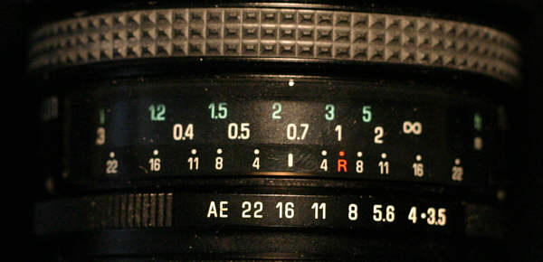
A Focus on….
City Council Goals
Recent Election Directions
    2010 Bond Election
    General Election
Ongoing Planning Efforts
Organizational Values
Strategic Opportunities
Indicators of Future Trends

Slide 4
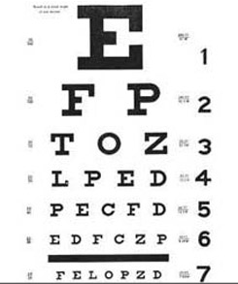
Keeping the Focus
The City of Richardson’s strong bond rating position and fiscal management success has been focused with a Goals-Driven Budget process and the continued adherence to the our financial policies.
  As examples, staffing and resource levels in Police, Fire, Code/Neighborhood Services, Parks & Recreation, Communications, Convention & Visitors Services, Information Technology Services, and Capital Engineering are directly related to recent policy direction by the City Council.

Slide 5
Keeping the Focus
The 2011 General Election and the 2010 Bond referendum are two key directives of the community that provide important policy guidance.
The recent Series 2011 rating agency results of Aaa/AAA by Moody’s and S&P reconfirm the City’s fiscal management approach and City Council policy directions.
Given the dynamic world of today, continued future adjustments are likely.
Effective local government services will continue to be vital to economic recovery and future attractiveness for growth.

Slide 6
Keeping the Focus:
A 10-year City Services Comparison
Even as this FY 2011-2012 budget holds the line on new staffing and operational cost, ongoing changes in service demands place added pressures.
Key Indicators of Workload | FY 2000-2001 | FY 2010-2011 | % Change
Ambulance Calls | 5,115 | 6,060 | 18%
Fire Alarms | 2,258 | 2,450 | 9%
Total Park Acres Maintained | 847.5 | 1,597 | 88%
Total Playgrounds Maintained | 25 | 28 | 12%
Recycled Materials (tons) | 4,500 | 5,000 | 11%
BABIC Requests | 49,567 | 71,000 | 43%
Signalized Intersections | 92 | 125 | 36%
Number of Signs | 18,500 | 19,600 | 6%
HOAs | ~30 | 56 | 87%
Court Citations Processed | 37,000 | 41,000 | 24%
Fleet Service Requests | 8,400 | 10,200 | 21%
PCs Supported | 700 | 900 | 29%
Utility Bills Processed | 310,500 | 384,000 | 11%

Slide 7
Keeping the Focus:
A 10-year City Services Comparison
Additional work load indicators comparing FY 2000-2001 to FY 2010-2011.
  70% increase in library circulation
  44% increase in irrigation zones maintained
  Over 150 matching fund beautification projects added to maintenance schedules
  55% increase in facility square footage maintenance
  14% increase in animal services calls
  22% increase in food inspections
  45% increase in environmental inspections
  Increased trail maintenance: Prairie Creek Trail, Lookout Trail, University Trail, Central Trail, and Glenville Trail
  US75 Landscaping Enhancement maintenance
  Two new Sports Complexes at Breckinridge and Huffhines

Slide 8
Keeping the Focus:
A 10-year City Services Comparison
The following are program additions or enhancements made in the last 10 years.
  Eisemann Center/Galatyn Plaza
  Transit Oriented Development
  Tax Increment Financing Districts
  Volunteers in Policing (V.I.P.S)
  Neighborhood Crime Watch Patrols
  Neighborhood Police Officer Program
  Volunteer Assistance Program
  Home Improvement Incentive Program
  Neighborhood Vitality Program
  Neighborhood Leadership/Realtors Workshop
  West Spring Valley Reinvestment Plan
  Rental Registration Program
  Public Services Response Center (SCADA/4111)
  Convention & Visitors Bureau
  Storm Water Management
  Library Programming
  Emergency Management
  In-house Recycling
  Transparency Initiatives
  Communications

Slide 9
Budget Development Objectives
The City’s budget development process conforms to a variety of guidance features:
    City Council Goals
    State & Federal Laws
    City Charter
    City Financial & Investment Policies
    Fund Accounting Standards
    Bond Rating Criteria

Slide 10
Budget Development Objectives
Continue the active implementation of the 2010 G.O. Bond Program.
Support the implementation game plan for the West Spring Valley Reinvestment Study. Evaluate the next Special Study area for review.
Support transit-oriented development initiatives around the existing and proposed DART Light Rail stations – and seek continued support of DART transit enhancements for Richardson.
Complete the activation of public safety radio and technology infrastructure enhancements.
Continue the strengthening work plan for enhanced community outreach, marketing and promotion.

Slide 11
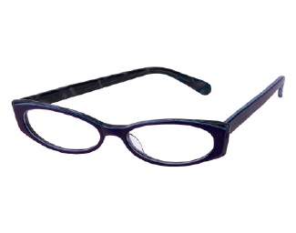
Budget Development Objectives
Continue to leverage with personal and corporate donations and volunteerism to strengthen community arts, city services, and community assets.
Maximize the economic development retention and recruitment opportunities to strengthen our tax base – including retail initiatives and international business development.
Foster the redevelopment of Richardson’s older assets through quality planning updates and financial support efforts like Tax Increment Financing (TIF) and active infrastructure upgrades.

Slide 12
Budget Development Objectives
Continue to support the strong work plan for Community Services – including the partnership with HOA’s and volunteers with the Neighborhood Services emphasis and ongoing attention to building quality and sustainable development practices.
Sustain Richardson’s leadership posture with DART, NTTA and TxDOT initiatives to sustain good transportation access and air quality efforts.
Support the planning and fiscal requirements for regional utility services for water supply, sewer treatment, and solid waste management to assure the future of these important infrastructure assets and resources.

Slide 13

Budget Development Objectives
Continue our strong alliance commitments with our community partnerships: RISD, PISD, MRMC, Richland College & UT-Dallas
Sustain our focus on the quality-of-life components of municipal services devoted to parks, recreation and open space/trail. Be attentive to refining service delivery in these areas as we design and construct the bond and grant-funded recreation assets.
Continue to support a competitive employment environment to sustain and recruit a high-quality public service work force.

Slide 14
Key Budget Elements for FY2011-2012:
Property Tax
Since our Budget Retreat on July 18, we have received the FY 2011-2012 Certified Tax Roll
We are pleased to see a 0.4% increase in the overall certified tax base (1.0% after factoring in Values in Dispute and Tax Increment Financing)
No tax rate change is proposed. The current $0.63516 rate was used in this budget development.
With no significant upward pressure in residential property values, the Senior Exemption’s current $55,000 value amount will maintain a 31% protection for FY 2011-2012, above the 30% target level.
Property taxes provide about 37% of the entire General Fund resources.

Slide 15
Key Budget Elements for FY 2011-2012:
Sales Tax
Sales tax revenue estimating continues to be a challenge to determine a true trend or pattern. Additionally, periodic audit adjustments must be factored into any forecast estimate.
This current FY 2010-2011 year has had a mixed pattern – but generally dampened.
We are estimating an -$764,000 decline (-3.2%) for next year, in an effort to stay conservative on this revenue front.
This FY 2011-2012 estimate of $23.3 million just matches the FY 2000-2001 level.
This revenue provides about 24% of the entire General Fund resources.

Slide 16
Key Budget Elements for FY 2011-2012:
Rates & Fees
No residential rate change is proposed at this time for Water/Sewer Utility and Solid Waste. Interim uses of available Rate Stabilization reserves are included to allow for a timely review during the next Fiscal Year for any required rate considerations.
  Water rates were last adjusted in FY 2007-2008.
  The last sewer rate adjustment occurred in FY 2008-2009.
  The Utility Fund has been able to postpone this rate adjustment to this next FY 2011-2012, even as the regional providers (NTMWD, DWU, Garland) have made periodic rate changes to Richardson for the wholesale price of these services.
    During the period since our last adjustment(2008-2009), NTMWD’s wholesale water rate has increased by $0.19 per thousand gallons – a 16% change to date, with an additional projected increase of $0.14 or 10.2% change planned for FY 2011-2012.

Slide 17
Key Budget Elements for FY 2011-2012:
Rates & Fees (more)
A residential solid waste rate change may be recommended during this next fiscal year. (These rates were last adjusted in FY 2008-2009.) An exact plan will be related to the results of the currently-active Solid Waste service study, with a Spring/Summer 2012 completion. Commercial rates are proposed for market-based adjustment.
A market-based commercial solid waste rate is proposed for adjustment.

Slide 18
Key Budget Elements for FY 2011-2012:
Rates & Fees (more)
We are proposing to implement the Drainage Utility Fee that was introduced for review in 2008 during this 2011-2012 fiscal year. Richardson is one of the few remaining cities in the DFW area that has not established this fee, even as our General Fund has absorbed the mandates of the State’s Stormwater Quality Management regulations.
  Formal adoption is tentatively scheduled for this Fall, with billings to begin after the new year in 2012. Key features from prior briefings would include:
  About $1.15 million of current General Fund expenses related to this drainage program (engineering, enforcement, inspection, etc.) will be redirected and assigned to a new Drainage Utility Fund. Additionally, about $1.5 million in annual stormwater/drainage capital improvements will be funded.
  An average residential rate impact is tentatively set at $3.75/month or $45/year. A commercial property equivalent rate of about $0.10/100 sf of impervious surface (roofs & parking) is under evaluation.

Slide 19
Key Budget Elements for FY 2011-2012:
Rates & Fees (more)
Selected fees and rates are proposed for adjustment:
  Several building permit, rental registration and inspection fees are proposed for adjustment.
  Ambulance fees are also proposed to be adjusted.
A rate adjustment is proposed for the Golf Course. This is the first adjustment since 2002.
  A range of $2 to $4 per round depending on time of day/day of week.

Slide 20

Key Budget Elements for FY 2011-2012:
New Neighborhood Enhancement
Responding to the City Council Goals & Near Term Action Items that focus on continued Neighborhood Enhancement, this FY 2011-2012 budget initiates a new $600,000 in funding:
  $500,000 in our annual C.O. program to provide Neighborhood Vitality projects that will augment the 2010 G.O. Bond program
  $100,000 in General Fund operations funding for new Neighborhood Enhancement strategies

Slide 21
Key Budget Elements for FY 2011-2012:
Staffing & Compensation
Personal Services comprise the largest expense category of the General Fund. Staff continues to hold vacant positions and to understaff to assist in managing these expenses. Overall staffing remains below the employment level of FY 2001-2002 by 49 positions or a 5% reduction.
Currently, 18 positions are frozen for FY 2011-2012.
  Significant revisions in the City’s retirement benefit program will result in a reduction in the annual TMRS contribution rate and the long term liability for this program. Beginning Jan. 2012, the rate will be 14.79% of payroll, a reduction from the current year’s rate of 19.31%. This change lowered the city's unfunded liability by $29.6 million from $75.7 million to $46.1 million.
Adjustments in the City’s employee health insurance funding are required. An increase in City funding for this program is proposed, reflecting a participation ratio similar to other area municipal entities.

Slide 22
Key Budget Elements for FY 2011-2012:
Staffing & Compensation
Funding is proposed for step pay plan merit increases (for about 50% currently topped out) and a 2% merit increase for those topped out more than a year.
Employees at Top of Salary Range
Selected Departments
Department | Current | Number at | Percent at
 | Employees | Top of Range | Top of Range
Police | 233 | 107 | 46%
Fire | 154 | 109 | 71%
Parks - Maintenance | 48 | 30 | 63%
Streets | 33 | 23 | 70%
Information Services | 21 | 14 | 67%
Facilities Services | 26 | 14 | 54%
Library | 30 | 16 | 53%
Traffic and Transportation | 25 | 13 | 52%
Engineering – Capital Projects | 21 | 11 | 52%
Fleet Services | 22 | 11 | 50%
Eisemann Center | 25 | 9 | 36%
Solid Waste - Residential | 28 | 8 | 29%
Water Operations | 15 | 7 | 47%
Animal Control | 10 | 3 | 30%

Slide 23
Key Budget Elements for FY 2011-2012:
Staffing & Compensation
Representative Salaries
Position | Pay Range Starting Step | Pay Range Final Step | Pay Range New Final Step | Difference
Accountant II | $43,656 | $61,440 | $62,669 | $1,229
Administrative Secretary II | $26,916 | $37,932 | $38,691 | $759
Assistant Municipal Court Clerk | $30,648 | $43,164 | $44,027 | $863
Building Inspector | $43,128 | $57,936 | $59,095 | $1,159
Code Enforcement Officer | $39,096 | $55,176 | $56,280 | $1,104
Custodian | $21,276 | $31,404 | $32,032 | $628
Driver/Loader - Solid Waste | $25,248 | $36,396 | $37,124 | $728
Environmental Health Specialist | $43,176 | $60,732 | $61,947 | $1,215
Fire Captain | $79,884 | $86,016 | $87,736 | $1,720
Firefighter/Paramedic | $45,456 | $64,032 | $65,313 | $1,281
Heavy Equipment Operator | $31,416 | $44,244 | $45,129 | $885
IT Support Specialist II | $53,448 | $71,628 | $73,061 | $1,433
Librarian | $40,968 | $57,624 | $58,776 | $1,152
Maintenance Helper I | $27,156 | $34,656 | $35,349 | $693
Police Lieutenant | $83,724 | $92,412 | $94,260 | $1,848
Police Officer | $47,724 | $67,164 | $68,507 | $1,343
Projects Engineer | $66,456 | $93,492 | $95,362 | $1,870
Public Safety Telecommunicator I | $32,880 | $46,296 | $47,222 | $926

Slide 24
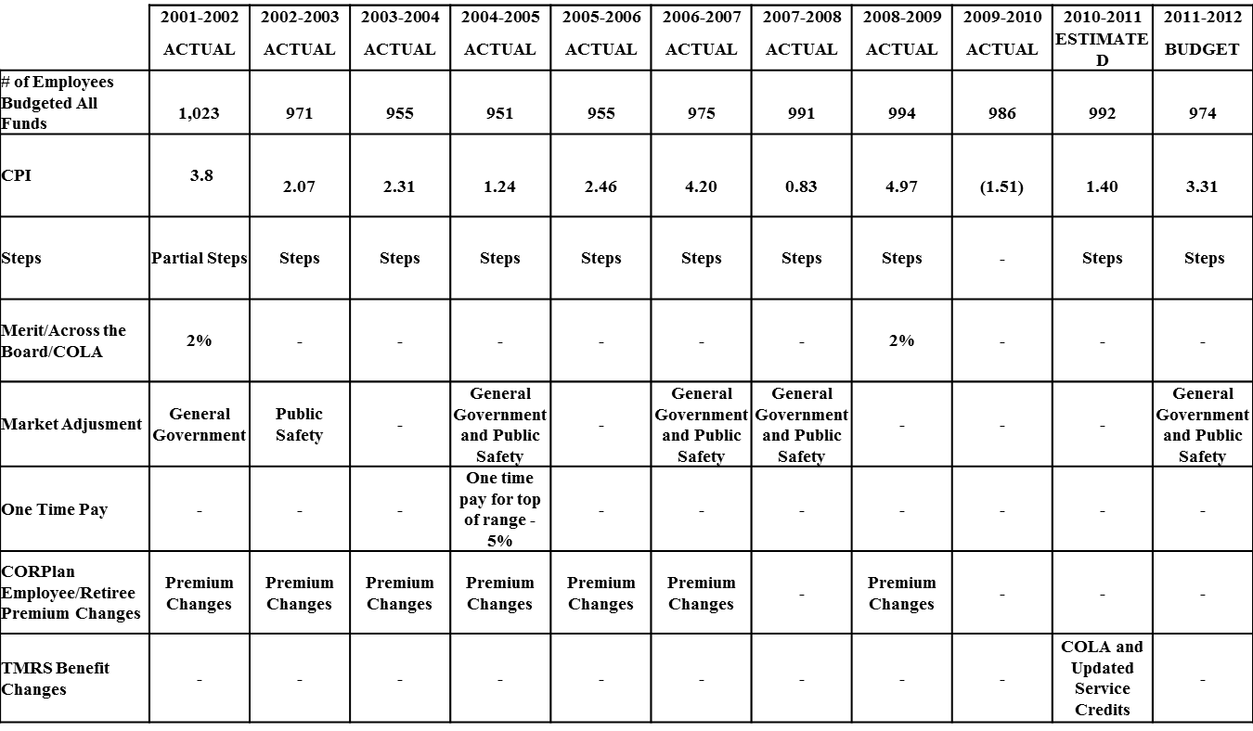
Key Budget Elements for FY 2011-2012:
Staffing & Compensation

Slide 25
Key Budget Elements for FY 2011-2012:
Staffing & Compensation
World at Work 2011-2012 Salary Budget Survey
Even with speculation of a second dip in the economy, the recovery for pay increases continues for most organizations.
Fewer companies are freezing pay
Average total salary budget increases are on the rise
More organizations are budgeting for pay increases in the 3% to 4% range — something employees had come to expect in prerecessionary years.
2,256 U.S. respondents
Mercer’s 2011/2012 US Compensation Planning Survey
97% of organizations are planning to award base pay increases in 2012.
Average increase in base pay is expected to be 3.0% in 2012, up slightly from 2.9% in 2011 and 2.7% in 2010
Half (50%) of organizations that report higher 2012 pay increases than those granted in 2011 cited greater competition for workforce and anticipated labor shortages as the main reasons.
Survey responses are from more than 1,200 mid-size and large employers across the US and reflects pay practices for more than 12 million workers.

Slide 26
Key Budget Elements for FY 2011-2012:
Staffing & Compensation
Aon Hewitt - US SIS Preliminary Results 2011-2012
Indicates 3% increases are the norm at this time
Wage Trend Indicator™ (WTI) by BNA
The overall rate of annual pay increases for wage and salary workers is expected to accelerate to around 2.0 percent

Slide 27
Key Budget Elements for FY 2011-2012:
Debt & Capital Program
Following the approval of the $66 million 2010 G.O. Bond program and related debt-assigned $0.06 tax rate change, the current focus is on active implementation of the program.
Debt service requirements now reflect these recently added obligations, and are handled in 2011-2012 through the multi-year debt plan that was developed.
For 2011-2012, $ 7.645 million across all funds is proposed for the Series 2012 C.O. debt program. This will cover the annual capital replacement requirements and the Utility Fund C.I.P. needs:
    $2.900 million for General Fund capital equipment
    $0.750 million for Fire Equipment
    $0.995 million for Solid Waste equipment
    $3.000 million for Utility Fund C.I.P.

Slide 28

Summary
As submitted, year-end and new year budgets are balanced and maintain adequate fund balances.
This budget continues to reflect the economic conditions of the area and preserves key services as we await signs of improvement.
The fiscal plan can allow continued “Focus” on the important missions that the City Council’s new Goals and Action Items identify.
Following this overview with further specifics are the narratives and key fund summary reports for:
    General Fund & Debt Service Plan
    Utility Fund
    Solid Waste Fund
    Hotel/Motel Fund
    Golf Fund

Slide 29
City of Richardson, Texas
Combined Fund Summaries

Slide 30
FY 2011-2012
Combined Budget
Combined Budget
 | 2010-2011 Estimated | 2011-2012 Budget | Est./Bud. | %
Beginning Fund Balances | $40,571,154 | $38,653,358 | ($1,917,796) | -4.7%
Revenues | $181,789,992 | $186,906,381 | $5,116,389 | 2.8%
Expenditures | $183,707,788 | $188,561,154 | $4,853,366 | 2.6%
Ending Fund Balances | $38,653,358 | $36,998,585 | ($1,654,773) | -4.3%

Slide 31
FY 2011-2012
Combined Budget
Classification of Combined Operating Fund Expenditures
 |  | Proposed |  | Percent
Operating Expenditures |  | 2011-2012 Budget |  | of Total
Personal Services |  | $88,277,002 |  | 46.82%
Professional Services |  | 8,384,975 |  | 4.45%
Maintenance |  | 34,706,126 |  | 18.41%
Contracts |  | 29,171,549 |  | 15.47%
Supplies |  | 10,867,178 |  | 5.76%
Capital |  | 718,048 |  | 0.38%
Total Operating Expenditures |  | $172,124,878 |  | 91.28%
Transfers Out |  | $8,549,705 |  | 4.53%
Total Operating Expenditures and Transfers Out |  | $180,674,583 |  | 95.82%
Debt Service Payments |  | $33,638,888 |  | 17.82%
Less Interfund Transfers |  | $(25,752,317) |  | -13.64%
Net Appropriations |  | $188,561,154 |  | 100.00%

Slide 32
FY 2011-2012
Combined Budget
2011-2012 Key Budget Elements
  Certified Tax Roll Increase of 0.4%
    Senior Exemption of $55,000/31%
    1% of Tax Roll equals $616,000 impact
    1 penny equals $976,000
    No change in tax rate

Slide 33
FY 2011-2012
Combined Budget
2011-2012 Key Budget Elements (cont.)
  No proposed adjustments in Water and Sewer or Residential Solid Waste.
  Golf Rates will increase in a range from $2 to $4 per round.
  A mid-year adoption of a drainage fee is planned.
  Sales Tax forecast flat over estimated “base to base” year-end 2010-2011 collections
  Fund Balances Maintained in all 5 major operating funds.

Slide 34
FY 2011-2012
Combined Budget
2011-2012 Key Budget Elements (cont.)
  General Fund Expenditures Increase 2.3%
    Non-Personal Services increase 2.4%
  Reinstate 5% Step Increases
    For the 50% of employees eligible and who merit the increase.
  18 Frozen Positions – 8 Understaffed
    49 positions/5.0% fewer employees than in 2001-2002

Slide 35
FY 2011-2012
Combined Budget
2011-2012 Key Budget Elements (cont.)
  Reduction in required contributions for the Employee Retirement Program – TMRS
  CORPlan – The City contribution will increase with no change in employee or retiree premium
    The General Fund increase is $1.6M
  2.0% merit based increase for those employees at the top of their pay range and have not received a pay adjustment for over one year.
  New funding for Neighborhood Vitality program and Projects.

Slide 36
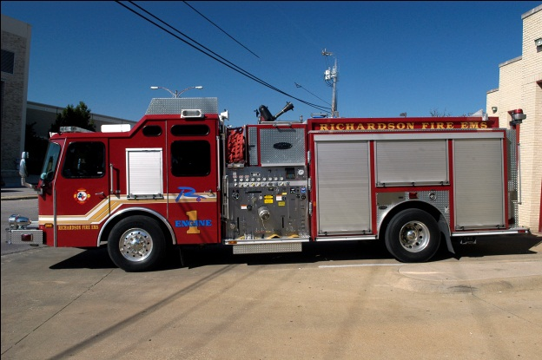
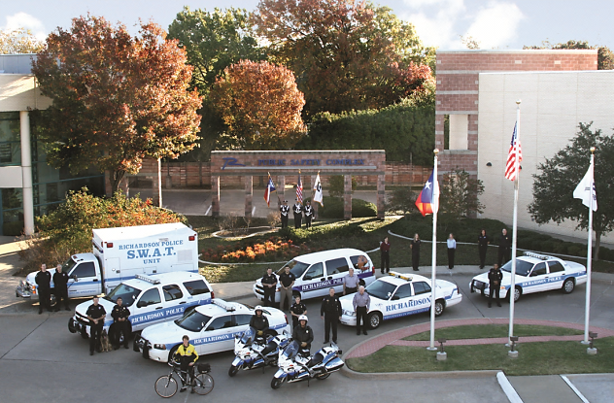
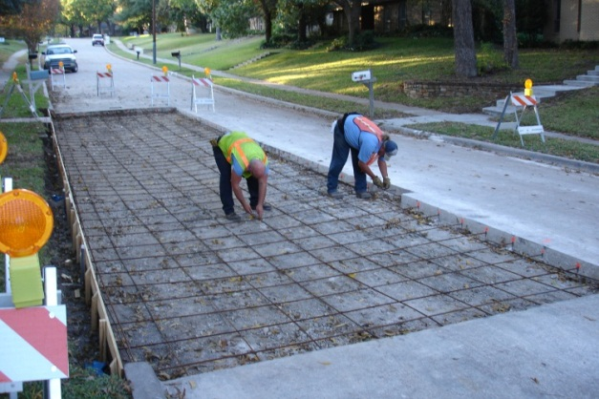
City of Richardson, Texas
General Fund

Slide 37
FY 2011-2012
General Fund
General Fund Budget
 | 2010-2011 Estimated | 2011-2012 Budget | Est./Bud. | %
Beginning Fund Balances | $15,854,175 | $15,861,235 | $7,060 | 0.0%
Revenues | $94,879,675 | $97,102,573 | $2,222,898 | 2.3%
Expenditures | $94,872,615 | $97,015,461 | $2,142,846 | 2.3%
Ending Fund Balances | $15,861,235 | $15,948,347 | $87,112 | 0.5%
FY 2007-2008 Budget $91,596,711
FY 2011-2012 Budget $97,015,461
Increase from 2007-2008 $ 5,418,750
  5.9% budget increase over 5 years
  8.3% CPI increase over 5 years

Slide 38
FY 2011-2012
General Fund Expenditures
Classification of General Fund Expenditures
 |  | Proposed |  | Percent
Operating Expenditures |  | Budget |  | of Total
Personal Services |  | $ 73,628,229 |  | 75.89%
Professional Services |  | 5,483,734 |  | 5.65%
Maintenance |  | 3,019,312 |  | 3.11%
Contracts |  | 5,631,781 |  | 5.81%
Supplies |  | 8,276,157 |  | 8.53%
Capital |  | - |  | 0.00%
Total Operating Expenditures |  | $ 96,039,213 |  | 98.99%
Transfers Out |  | $976,248 |  | 1.01%
Total Operating Expenditures and Transfers |  | $ 97,015,461 |  | 100.00%

Slide 39
FY 2011-2012
General Fund Revenue Overview
$2,223,000 or 2.3% increase
  Property Taxes increase $1,479,000
  Franchise Fees increase $240,000
  Sales Tax decrease ($801,000)
  License and Permits $119,000 – fee increase
  Recreation and Leisure $168,000
  General & Administrative (G&A) increases $835,000 – includes $1.1M in “Drainage Fee Operating Support”
  Remaining Revenues $182,000 - ambulance fee increase

Slide 40
2011 Property Tax Analysis

Slide 41
2011 Certified Tax Roll Comparison
2011 Certified Tax Roll Comparisons
August 2011
Entity | % Change
Arlington | 3.4%
Allen | 2.7%
Fort Worth | 2.6%
Frisco | 2.6%
Grand Prairie | 1.7%
Collin County | 1.4%
Plano | 1.0%
Richardson (CCAD) | 1.0%
McKinney | 0.8%
Richardson (Total) | 0.4%
Richardson (DCAD) | 0.0%
Carrollton | -0.3%
Irving | -1.5%
Dallas | -1.6%
Mesquite | -1.6%
Dallas County | -1.7%
Garland | -2.2%

Slide 42
Tax Parcel Reappraisals
DCAD 2011 Tax Roll – Percent of Parcels Reappraised
 | 2009 | 2010 | 2011
Residential | 29% | 46% | 28%
Commercial | 89% | 42% | 65%
BPP | 100% | 100% | 100%
All | 45% | 54% | 42%
CCAD reappraises 100% of all property every year

Slide 43
Property Tax Revenue
Property Tax Revenue
 | Budget | Estimated | Budget
 | 2010-2011 | 2010-2011 | 2011-2012
Certified Assessed Value | $9,711,158,368 | $9,711,158,369 | $9,746,482,430
Operations & Maintenance (GF) | $35,180,870 | $34,751,097 | $35,419,257
Debt Service (DS) | $26,409,167 | $26,071,130 | $26,588,118
Total | $61,590,037 | $60,822,227 | $62,007,375

Slide 44
Assessed Valuation
Total assessed valuation assumes a 0.4% increase in certified assessed valuation plus $81.7 Million of “Values in Dispute”, that could be added to the certified roll once the cases have been finalized and allows for deduction of the Tax Increment Finance District values of $65.7 million
 | 2010 | 2011 | % Difference
Certified | $9,711,158,368 | $9,746,482,430 | 0.4%
Values In Dispute | $20,185,613 | $81,652,836 | 305.0%
TIF | ($34,568,816) | ($65,654,139) | 90.0%
Total Taxable Value | $9,696,775,165 | $9,762,481,127 | 1.0%
Property Tax Rate
 | 2010-2011 | 2011-2012
Operations & Maintenance (O & M) | $0.36281 | $0.36281
Debt Service | $0.27235 | $0.27235
Total | $0.63516 | $0.63516

Slide 45
Tax Rate Calculations
2011-2012 Tax Rate Calculations
 | Rate | Difference | Revenue
2011-2012 Rate | $0.63516 | - | -
Rollback Rate | $0.66589 | $0.03073 | $3,000,010
Effective Rate | $0.63769 | $0.00253 | $246,991
2010-2011 Tax Rate Calculations
 | Rate | Difference | Revenue
2010-2011 Rate | $0.63516 | - | -
Rollback Rate | $0.68468 | $0.04952 | $4,801,843
Effective Rate | $0.60686 | ($0.0283) | ($2,744,187)

Slide 46
Tax Rates in Other Jurisdictions
Tax Rates in Other Jurisdictions
 | Current | Reported Rate Change
Jurisdiction | Tax Rate | (cents)
Frisco | $0.465000
Plano* | $0.48860
Allen | $0.55400
Irving* | $0.57610
McKinney | $0.58550
Carrollton* | $0.61788
RICHARDSON | $0.63516
Mesquite | $0.64000
Arlington* | $0.64800
Grand Prairie *** | $0.66999
Garland** | $0.70460
Dallas* | $0.79700
Fort Worth* | $0.85500
PISD**** | $1.35340 | $0.02 increase
RISD***** | $1.34005
Dallas Co. Equalization Fund* | $0.01000
DCCCD* | $0.099923
CCCCD | $0.08630
Dallas County* | $0.24310
Collin County | $0.24000
Dallas County Hospital District* | $0.27100

Slide 47
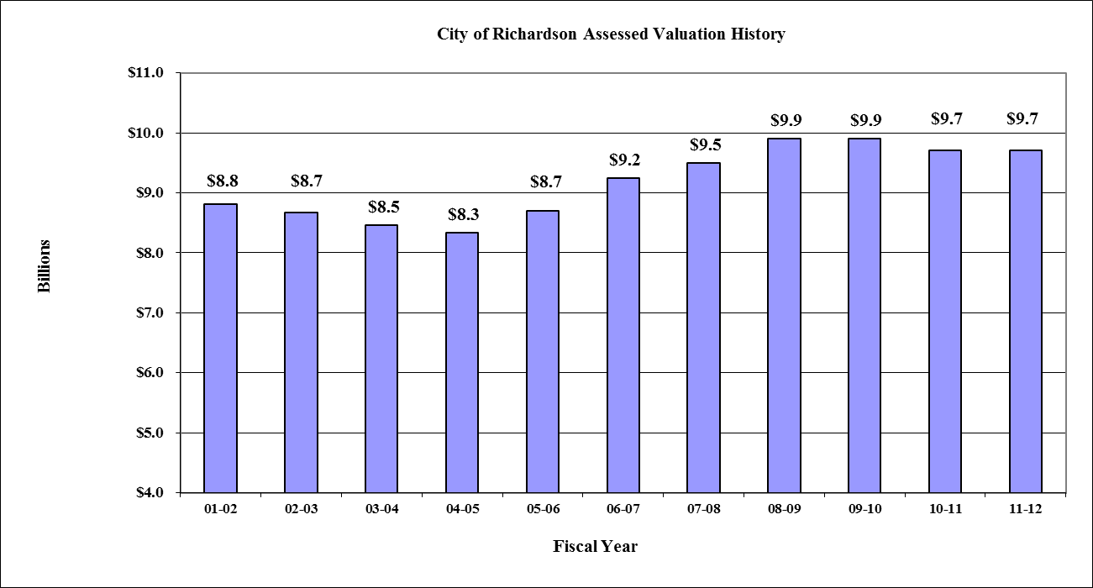
FY 2011-2012
Assessed Valuation

Slide 48
FY 2011-2012
Assessed Valuation

Slide 49
FY 2011-2012
Assessed Valuation
Valuation Including New Improvements
District | 2011 Certified Roll | 2011 New Improvements | %
CCAD | $3,419,042,246 | $19,834,836 | 0.6%
DCAD | $6,327,440,184 | $28,076,707 | 0.4%
Total | $9,746,482,430 | $47,911,543 | 0.5%
 | 2010 New Improvements | 2011 New Improvements | Difference | Percent
CCAD | $81,878,917 | $19,834,836 | ($62,044,081) | -75.8%
DCAD | $48,307,175 | $28,076,707 | ($20,230,468) | -41.9%
Total | $130,186,092 | $47,911,543 | ($82,274,549) | -63.2%

Slide 50
Market Value Increase
Roll Increase - Market Value
 | 2010 | % | 2011 | % | % Change
Improvements | $6,938,267,152 | 60.1% | $6,885,779,461 | 58.7% | -0.8%
Land | $2,788,874,453 | 24.1% | $2,736,472,951 | 23.3% | -1.9%
Business & Personal Property | $1,821,876,603 | 15.8% | $2,109,860,775 | 18.0% | 13.6%
Total | $11,549,018,208 | 100.0% | $11,732,113,187 | 100.0% | 1.6%

Slide 51
Tax Roll Increase
Roll Increase – Taxable Values
 | Residential | % Change | Commercial | % Change | BPP | % Change | Total | % Change
2001 | $3,556,206,861 | 7.9% | $3,110,180,887 | 10.2% | $2,141,535,354 | 17.9% | $8,807,923,102 | 11.0%
2002 | $3,820,030,932 | 7.4% | $3,089,714,225 | -0.7% | $1,755,517,943 | -18.0% | $8,665,263,100 | -1.6%
2003 | $4,169,788,247 | 9.2% | $2,827,745,763 | -8.5% | $1,460,920,007 | -16.8% | $8,458,454,017 | -2.4%
2004 | $4,311,934,417 | 3.4% | $2,663,396,379 | -5.8% | $1,356,666,064 | -7.1% | $8,331,996,860 | -1.5%
2005 | $4,529,783,318 | 5.1% | $2,755,659,510 | 3.5% | $1,418,623,768 | 4.6% | $8,704,066,596 | 4.5%
2006 | $4,578,470,728 | 1.1% | $3,271,227,051 | 18.7% | $1,394,937,977 | (1.7%) | $9,244,635,756 | 6.2%
2007 | $4,712,070,464 | 2.9% | $3,386,900,716 | 3.5% | $1,437,536,180 | 3.1% | $9,536,507,360 | 3.2%
2008 | $4,742,302,167 | 0.6% | $3,605,732,317 | 6.5% | $1,566,813,227 | 9.0% | $9,914,847,711 | 4.0%
2009 | $4,699,651,917 | -0.9% | $3,525,971,862 | -2.2% | $1,658,474,266 | 5.9% | $9,884,098,045 | -0.3%
2010 | $4,753,636,539 | 1.2% | $3,272,140,875 | -7.2% | $1,685,380,954 | 1.6% | $9,711,158,368 | -1.7%
2011 | $4,684,107,745 | -1.5% | $3,294,460,395 | 0.7% | $1,767,914,290 | 4.9% | $9,746,482,430 | 0.4%
Change in Values From 2001 to 2011
 | $1,127,900,884 | 31.7% | $184,279,508 | 5.9% | ($373,621,064) | (17.4%) | $938,559,328 | 10.7%

Slide 52
Tax Roll Comparison
Tax Roll Comparison
 | 2010 |  | 2011
 | $Mil | % | $Mil | % | % Change
Residential | $4,753,636,539 | 48.9% | $4,684,107,745 | 48.1% | -1.4%
Commercial | $4,330,917,824 | 44.6% | $4,449,248,128 | 45.7% | 2.7%
Industrial | $455,262,984 | 4.7% | $453,141,251 | 4.6% | -0.5%
Undeveloped | $171,341,021 | 1.8% | $159,985,306 | 1.6% | -6.6%
Total | $9,711,158,368 | 100.0% | $9,746,482,430 | 100.0% | 0.4%

Slide 53
Percent of Total Value
Percent of Total Value
Tax Year | Residential | Commercial | BPP | Total
2000 | 42% | 35% | 23% | 100%
2001 | 40% | 36% | 24% | 100%
2002 | 44% | 36% | 20% | 100%
2003 | 49% | 34% | 17% | 100%
2004 | 52% | 32% | 16% | 100%
2005 | 52% | 32% | 16% | 100%
2006 | 50% | 35% | 15% | 100%
2007 | 49% | 36% | 15% | 100%
2008 | 48% | 36% | 16% | 100%
2009 | 47% | 36% | 17% | 100%
2010 | 49% | 34% | 17% | 100%
2011 | 48% | 34% | 18% | 100%

Slide 54
Top Ten Taxpayers
Top Ten Taxpayers
 |  | % of Total
 | Taxable Value | Taxable Value
1. Cisco Systems | $196,789,462 | 2.02%
2. AT&T | $164,239,373 | 1.68%
3. Bank of America | $163,098,524 | 1.67%
4. Verizon | $132,836,500 | 1.36%
5. EMC Corporation | $104,452,637 | 1.07%
6. Texas Instruments | $100,465,287 | 1.03%
7. Fujitsu | $94,203,170 | 0.97%
8. IBM | $79,799,744 | 0.82%
9. Oncor | $53,504,285 | 0.55%
10. Equastone | $52,377,407 | 0.54%
Total | $1,141,766,389 | 11.71%
Total 2011 Taxable Value | $9,746,482,430

Slide 55
Change In Residential Valuations
Number Residential Properties Affected by Valuation
 | 2010-2011 |  | 2010-2011
Impact | # Properties | % of Total Res. Properties | # Properties | % of Total Res. Properties
No Change | 8,357 | 29.7% | 13,632 | 48.8%
Decrease | 13,215 | 47.0% | 8,813 | 31.6%
Up 1-10% | 5,583 | 19.9% | 4,692 | 16.8%
Up>10% | 960 | 3.4% | 791 | 2.8%
Total Res. Properties | 28,115 | 100.0% | 27,928 | 100.0%

Slide 56
Change In Residential Valuations

Slide 57
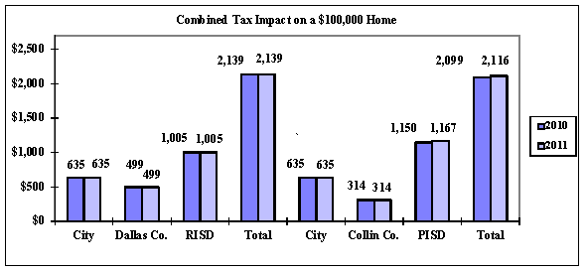
Tax Impact on a $100,000 Home

Slide 58
Average Senior Home Value
Average Senior Home Value Statistics
 |  | Avg. Sr. | % Change
Tax | Senior | Home Mkt. | From Year | % of
Year | Exempt. | Value (1) | to Year | Total Val
2002 | $30,000 | $146,315 | 9.54% | 20.50%
2003 | $30,000 | $151,997 | 3.88% | 19.74%
2004 | $30,000 | $155,650 | 2.40% | 19.27%
2005 | $30,000 | $163,726 | 5.19% | 18.32%
2006 | $50,000 | $168,609 | 2.98% | 29.65%
2007 | $50,000 | $173,581 | 2.95% | 28.80%
2008 | $55,000 | $178,094 | 2.60% | 30.88%
2009 | $55,000 | $178,961 | 0.49% | 30.73%
2010 | $55,000 | $178,079 | (0.49%) | 30.89%
2011 | $55,000 | $178,788 | 0.40% | 30.76%

Slide 59
Current Tax Rate Metroplex Comparison
Current 2010-2011 Adopted Rates
 |  | 2011 |  | 2011 |  | 2011 |  | 2011
City |  | Tax Rate |  | Homestead |  | Over 65 |  | Over 65 Freeze
Frisco |  | $0.465000 |  | N/A |  | $50,000 |  | No
Plano |  | $0.503500 |  | 20% |  | $40,000 |  | Yes
Allen |  | $0.554000 |  | N/A |  | $50,000 |  | No
Irving |  | $0.576100 |  | 20% |  | $30,000 |  | No
McKinney |  | $0.585500 |  | N/A |  | $50,000 |  | No
Carrollton |  | $0.617875 |  | 20% |  | $60,000 |  | No
Average |  | $0.633603 |  |  |  | $50,769
Richardson |  | $0.635160 |  | N/A |  | $55,000 |  | No
Mesquite |  | $0.640000 |  | N/A |  | $65,000 |  | Yes
Arlington |  | $0.648000 |  | 20% |  | $60,000 |  | Yes
Grand Prairie |  | $0.669998 |  | 1% |  | $45,000 |  | Yes
Garland |  | $0.704600 |  | 8% |  | $51,000 |  | No
Dallas |  | $0.704600 |  | 20% |  | $64,000 |  | No
Ft. Worth |  | $0.855000 |  | 20% |  | $40,000 |  | Yes

Slide 60
Senior Exemption
The number of senior property tax exemptions (for persons 65 and older, disabled persons, and surviving spouses) increases by 203 for 2011-2012. The revenue impact of the $55,000 exemption for 2010-2011 is $2.4 Million
Senior Citizen Exemptions
Year | Number | Total Residential Properties | % of Total
2002-2003 | 5,479 | 27,456 | 20.0%
2003-2004 | 5,617 | 27,458 | 20.5%
2004-2005 | 5,630 | 27,453 | 20.5%
2005-2006 | 5,737 | 27,625 | 20.8%
2006-2007 | 5,923 | 27,749 | 21.3%
2007-2008 | 6,095 | 27,947 | 21.8%
2008-2009 | 6,302 | 27,904 | 22.6%
2009-2010 | 6,563 | 27,762 | 23.6%
2010-2011 | 6,769 | 28,115 | 24.1%
2011-2012 | 6,972 | 27,928 | 25.0%

Slide 61
Remaining Revenues

Slide 62
Franchise Fees
Franchise Fees are projected at $12.9 million for 2011-2012, an increase of $240,000 or 1.9% over estimated year-end.
  All Franchise Fees reflect a re-estimate based on actuals through July.
  The Electric Franchise reflects normal growth in kw hours sold as well as the recent Rate Settlement Agreement calling for a rate increase per kw hour of 5%.
  The natural gas fee reflects an expected rise in prices as the market recovers from record low pricing during this past winter.
  The only decline in fees is expected in the water and sewer amount saw those sales return to an average sales year.

Slide 63
Sales and Other Business Taxes
Sales and Other Business Taxes are projected at $23.7 Million for next year reflecting a decrease of ($801,000) or -3.3% from estimated year-end revenues.
Our top 20 remitters account for 33.3% of total receipts this year, down from the 38.2% last year. The majority of this decline is due to large one time sales last year in the wholesale sector industry.
Mixed Beverage receipts are anticipated to drop ($40,000), or -11.0% as a result of legislative changes in Austin while the Bingo tax is proposed at a 3% growth or $1,600 over year-end. Sales Tax, the largest of the three in this category, is projected to decrease ($764,000) or -3.1% from year-end estimates based on current trends and expectations of flat “base to base” activity. Year-end 2010-2011 estimate includes $764,000 in non-recurring audit adjustments. Those adjustments are not included in the forecast for next year, only the “base” collection.

Slide 64

Sales and Other Business Taxes (cont.)

Slide 65
License and Permits
License and Permits is projected to increase $119,000 from the year-end estimate of $1.7 million and includes increases in several building inspection fees. The increases (listed in the table below) account for a $200,000 in increased revenue in three areas; building permits, rental registration and apartment inspections

Slide 66
License and Permit Fee Increases
 | COR |  | COR | COR | COR |  | Increased
Type of Permit | Current | Average | Ranking | Recommended | Ranking | Increase | 11/12 Revenue*
Rental Registration | $50 | $63.75 | 5/5 tie | $75 | 3 way tie 1/5 | $25 | $60,000
Apartment Inspection | $10 | $12.33 | 7/7 | $13 | 3/7 tie | $3 | $40,000
Miscellaneous trade work (residential) | $25 | $42 | 11 | $50 | 5 | $25 | $46,560
New single family (3,500 sf; $72.45/sf; $253,575) | $800 | $1,258 | 11 | $1,200 | 8 | $400 | $15,200
Miscellaneous trade work (commercial) | $50 | $57 | 7 | $75 | 4 | $25 | $7,450
Temporary sign | $25 | $51 | 11 | $50 | 6 | $25 | $7,325
Clean & Show | $50 | $110 | 13 | $100 | 3 | $50 | $6,200
Fence (residential - $1,500 value) | $15 | $39 | 12 | $30 | 8 | $15 | $6,075
Sign (new; reface; 50 sf) | $75 | $90 | 10 | $100 | 4 | $25 | $4,300
Minimum permit fee (commercial) | $60 | $130 | 8 | $75 | 7 | $15 | $4,050
Minimum permit fee (residential) | $25 | $56 | 10 | $50 | 7 | $25 | $3,200
Swimming pools ($35,500 value) | $100 | $244 | 11 | $200 | 7 | $100 | $2,300
New multi-family (850 sf unit;$68.25/sf; $58,013) | $400 | $513 | 9 | $500 | 7 | $100 | $1,500
Residential detached bldg <150 sf | $15 | $46 | 13 | $30 | 8 | $15 | $1,050
Demolition permit | $30 | $52 | 13 | $50 | 4 | $20 | $500
Residential detached bldg >150 sf (600 sf; $30.00/sf; $18,000) | $50 | $157 | 10 | $100 | 8 | $50 | $400
Spas,hot tubs,above ground pools ($5,000 value) | $50 | $92 | 9 | $100 | 6 | $50 | $100
Sign repair | $25 | $55 | 10 | $50 | 5 | $25 | $25
Concrete (commercial) | $30 | $49 | 9 | $50 | 4 | $20 | $20
Fence (commercial - $3,500 value) | $50 | $59 | 7 | $50 | 7 | $0 | $0

Slide 67
Fines and Forfeits
Fines and Forfeits are expected to increase $26,000 or 0.6% from the 2010-2011 estimated year-end position of $4.4 Million. The revenue in this category is received through the Municipal Court and Library with the majority of the growth expected in Court activity.

Slide 68
Revenue from Money and Property
Interest earnings are expected to show modest recoveries next year as the investment market continues to stabilize. Bookings at the Civic Center continue to reflect the communities need for affordable meeting space. Both areas combine for an additional $30,000 or a 7.9%.

Slide 69
Recreation and Leisure
Recreation and Leisure Services revenues are budgeted at $3.5 Million, an increase of $168,000 over 2010-2011 year-end estimates and includes modest growth across all categories except season swim passes and pool revenue. These two areas will be affected by the construction on the Heights Pool. Swim program shows normal growth as PARD expects that program to move to other facilities and continue as normal.

Slide 70
Other Revenue
Projected at $4.3 million or $126,000 above estimated year-end for 2010-2011. The increase is primarily due to the new contract and fee increases for ambulance service.
  Under the new contract, all collected fees come to the City. We then cut a check to the billing service. Under the old contract, the billing service fees were retained by the agency before the proceeds were sent to the City.
The Fire Department also proposes raising the transport fees from $575 for residents and $650 for non-residents to $675 and $775 respectively.
  According to survey work completed by the fire department, this proposal will place Richardson below the average and near the median for comparative cities. Along with the new billing procedures, these two changes are expected to generate $200,000 in additional fees.
  Medicare reimburses the City $342 to $588 per covered transport depending on level of care given.

Slide 71
Other Revenue (cont.)
The $160,000 annual cable access fee is eliminated this year and replaced by a new 1% franchise fee known as Public, Education and Government (PEG) Fees. These fees have to be segregated in a separate fund for use in providing facility and capital support for our C.I.T.V. department. The other revenue sources are expected to see minimal growth next year.

Slide 72
General and Administrative
Total revenue from G & A Transfers is projected at $9.4 million, an increase of $835,000 from FY 2010-2011.
In addition to a reactivation of the Child Safety Fund Transfer to offset school crossing guards, the recently completed indirect cost analysis realigned our G&A transfers to reflect the level of work the General Fund does in the administration of the other operating funds.
  While the G&A from the Golf Fund increases, the Solid Waste and Water and Sewer G&A decrease under the new study. The G&A from the capital projects fund will also decrease ($249,000).

Slide 73
General and Administrative (cont.)
The CVB transfer will offset $405,000 of that budget this year.
The Wireless Fund will continue the $450,000 transfer from the Wireless Fund. That transfer is used to help offset the cost of 911 telecommunicators in the Police Department.
The following slide discusses the new Drainage Fund Operational Support Transfer.

Slide 74
General and Administrative (cont.)
Transfer – Drainage Fee Operational Support
  With a Proposed Mid-Year implementation, approximately $1.1 million in General Fund expenses are under review for classification as Drainage Fee appropriate expenses.
  $1,150,000 will come in as a revenue transfer to offset these expenses.
    These expenses include several employees who spend a portion of their time working on drainage issues. As such, it is preferable to bring the offsetting revenue into the host fund rather than try and split their payroll expenses between funds.
    A thorough explanation of these expenses will follow later in the year as the proposal is brought forward.

Slide 75
General Fund Revenues
(Variances of $50,000 or greater – 2010-2011 Estimated to 2011-2012 Budgeted)
Property Taxes | $1,479,115
Current Taxes | $668,161
Prior Taxes | $809,563
Franchise Fees | $240,497
Telecommunications | $61,583
Gas | $136,156
Sale and Other Business Taxes | ($801,090)
Sales Tax | ($764,086)
License and Permits | $118,702
Rental Registration | $61,257
Fines & Forfeits | $26.261
Revenue From Money/Property | $29,965
Recreation and Leisure | $168,249
Older Adults | $67,528
Other Revenue | $126,017
Access Fee = Cable TV | ($220,000)
Ambulance | $242,551
Miscellaneous | $56,808
General and Administrative | $835,182
G&A Water and Sewer Fund | ($64,808)
G&A - Golf | $55,0640
G&A Solid Waste Operations | ($107,074)
Transfer – Drainage Fund Operational Support | $1,150,000
Transfer – Child Safety Fund | $50,000
G & A – Capital Projects | ($249,000)

Slide 76
FY 2011-2012
General Fund Expenditures
Classification of General Fund Expenditures
 |  | Proposed |  | Percent
Operating Expenditures |  | Budget |  | of Total
Personal Services |  | $ 73,628,229 |  | 75.89%
Professional Services |  | 5,483,734 |  | 5.65%
Maintenance |  | 3,019,312 |  | 3.11%
Contracts |  | 5,631,781 |  | 5.81%
Supplies |  | 8,276,157 |  | 8.53%
Capital |  | - |  | 0.00%
Total Operating Expenditures |  | $ 96,039,213 |  | 98.99%
Transfers Out |  | $976,248 |  | 1.01%
Total Operating Expenditures and Transfers |  | $ 97,015,461 |  | 100.00%

Slide 77
FY 2011-2012
General Fund Expenditures
$2,142,846 or 2.3% increase
  Personal Services increases $2.1 million and include,
    Step Pay Plan
      ($475,000) - Approximately 52% of all city personnel are at the top of their pay range. The remaining 48% have room to grow within their approved pay plan ranges. Historically the annual movement has been on a 5% growth step that can be earned for each year service until the top of the pay range is reached, usually within a 4-5 year period, which is a consistent pay plan program utilized in public safety across the Dallas-Fort Worth Metroplex.

Slide 78
FY 2011-2012
General Fund Expenditures
TMRS contribution reduction
  The City of Richardson experienced rapid growth and expansion during the 60’s, 70’s and 80’s. City Staff, in particular Police and Fire had to expand along with a growing population. The City is proud of, and well served by the tenure and experience our employees bring to their jobs. Of the 955 employees currently on payroll, 155 or 16% have over 20 years of service while another 146 or 15% have over 15 years’ experience with the City. Together, they account for 31% of our full time staff. We remain committed to funding our retirement system for these, and indeed all our employees.
  The state legislature approved changes to the statewide Texas Municipal Retirement System (TMRS) that restructured the internal account structure to resemble the pension system structure common to the vast majority of public retirement systems. This change lowered the city's unfunded liability by $29.6 million from $75.7 million to $46.1 million, while lowering the contribution rate to 14.79% of payroll beginning January 2012. This is a reduction from the current 19.31%, a 23.4% reduction in the City’s contribution rate while protecting the stability of the employee’s retirement.
  Additionally, the legislative change improved the city's funding ratio from 71.6% to 87.2%. The city's total actuarial accrued liability is $359,151,109. This amount consists of the actuarial value of the city's assets of $313,084,736 (87.2%) and the unfunded actuarial accrued liability of $46,066,373 (12.8%).

Slide 79
FY 2011-2012
General Fund Expenditures
2.0% for employees at top of pay range and who’ve received no pay adjustment for at least one year.
  ($516,000) A merit based pay increase for the 50% of employees at the top of their pay range prior to 09/30/2010.
    18 frozen positions and 5 understaffed positions.
  Police – 1 Detention Officer, 1 Police Specialist (frozen)
  Police – 5 Police Officers (understaffed but allowed to fill)
  Traffic and Transportation – 1 Signs and Markings Supervisor
  Facility Services – 1 Sr. Custodian, 1 Sr. Maintenance Technician.
  PARD – 1 Maintenance Helper II, 5 maintenance Helper I
  Library – 1 Librarian, 2 Library Clerks, 2 Sr. Library Clerks, 1 Administrative Secretary I
  Community Services – 1 Building Inspector

Slide 80
FY 2011-2012
General Fund Expenditures
 |  |  | General | Water and | Solid Waste | Hotel/Motel | Golf | Internal
5% Steps |  |  | Fund | Sewer Fund | Services Fund | Tax Fund | Fund | Services Fund | Total | Percentage
Police | 138.0 |  | $ 192,607 | $ - | $ - | $ - | $ - | $ - | $ 192,607 | 32%
Fire | 41.0 |  | 82,173 | - | - | - | - | - | 82,173 | 14%
General Government | 266.0 |  | 204,429 | 54,243 | 52,489 | 13,395 | 3,426 | 1,944 | 329,926 | 55%
 | 445.0 |  | $ 479,209 | $ 54,243 | $ 52,489 | $ 13,395 | $ 3,426 | $ 1,944 | $ 604,706 | 100%
 |  |  | General | Water and | Solid Waste | Hotel/Motel | Golf | Internal
2% Merit |  |  | Fund | Sewer Fund | Services Fund | Tax Fund | Fund | Services Fund | Total | Percentage
Police | 104.0 |  | $ 148,186 | $ - | $ - | $ - | $ - | $ - | $ 148,186 | 26%
Fire | 106.0 |  | 169,230 | - | - | - | - | - | 169,230 | 29%
General Government | 98.0 |  | 198,663 | 21,839 | 14,261 | 11,866 | 8,926 | 1,886 | 257,441 | 45%
 | 308.0 |  | $ 516,079 | $ 21,839 | $ 14,261 | $ 11,866 | $ 8,926 | $ 1,886 | $ 574,857 | 100%
 |  |  | General | Water and | Solid Waste | Hotel/Motel | Golf | Internal
Total |  |  | Fund | Sewer Fund | Services Fund | Tax Fund | Fund | Services Fund | Total | Percentage
Police | 242.0 |  | $ 340,793 | $ - | $ - | $ - | $ - | $ - | $ 340,793 | 29%
Fire | 147.0 |  | 251,403 | - | - | - | - | - | 251,403 | 21%
General Government | 364.0 |  | 403,092 | 76,082 | 66,750 | 25,261 | 12,352 | 3,830 | 587,367 | 50%
 | 753.0 |  | $ 995,288 | $ 76,082 | $ 66,750 | $ 25,261 | $ 12,352 | $ 3,830 | $ 1,179,563 | 100%

Slide 81
FY 2011-2012
General Fund Expenditures
Adjustment to City contribution to CORPlan.
  Sensitive to the economic environment of the last couple of years, the City has not adjusted employee contributions to the CORPlan despite rising costs for providing health care and no adjustment to employee or retiree contributions are proposed this year. Current claims patterns do require an increase in funding however. The City has not altered its contribution rate for employee and retiree premiums since 2008-2009, while also recognizing the constraints on employee salaries. For 2011-2012, the City will increase its contributions to CORPlan by $2.0 Million; thereby protecting the quality of health care we provide our employees and retirees. No increase to premiums paid by employees

Slide 82
FY 2011-2012
General Fund Expenditures
Non-Personal Services operating line items account for $22.4 million or 23.3% of the operating budget for the General Fund.

Slide 83
FY 2011-2012
General Fund Expenditures (cont.)
  Professional Services increase $420,000
    $100,000 for Planning Special Area Study
    $200,000 increase to PARD maintenance Contracts.
    $200,000 increase to Chamber Economic Development Partnership for International Business Program
  Maintenance Services increase $88,000
    $111,000 for increased computer software and hardware maintenance support
  Contracts increase $32,000
    $100,000 for “Neighborhood Reinvestment” Program
  Supplies increase $133,000
    $50,000 increase for Older Adult Trips (offset by revenue)
    $60,000 increase for PARD botanical
    $60,000 increase for Light and Power
  Transfers decrease ($488,000)

Slide 84
PARD
A total of $1.3 million of park improvements, maintenance projects and equipment/vehicle replacements are planned using $737,100 of our $2.9 million annual CO’s and $568,288 of operating funds for routine maintenance throughout the park system.

Slide 85
PARD (cont.)
 | CO's | Operating Budget
Botanical |  | $181,292
Irrigation System Maintenance |  | 136,801
Electrical System Maintenance |  | 110,000
Plumbing Systems Repair |  | 64,195
Land |  | 40,000
Building and Facility Improvements |  | 36,000
Heights Fitness Equipment | $141,750
Chipper Truck - Replacement | 72,000
Cottonwood Erosion Project | 60,000
Hydraulic Irrigation System - Heights Park | 45,000
Filter Replacement - Cottonwood | 44,750
Matching Fund Beautification | 40,000
Prairie Creek Park Erosion Project | 40,000
Crew Cab Pickup with 2 Yard Dump Body | 39,000
City Hall Fountain Copper Ring | 38,000
Water Cannon - Replacement | 38,000
Spring Creek Nature Area Trail Renovation / Drainage | 35,000
Filter Replacement – Glenville | 31,200
3/4 Ton Extended Cab Pickup – New | 29,000
Playground Safety Surface - (Custer Park and Galatyn Preserve) | 25,000
Pit Foam - Gymnastics | 20,000
Trampolines - Gymnastics (6) | 13,200
Shade Structure | 8,000
Spring Flooring - Gymnastics | 7,200
Trench Bar - Gymnastics | 5,000
Pool Furniture | 5,000
Totals | $737,100 | $568,288

Slide 86
PARD (cont.)
Over the last 16 years, much of the increase in maintenance has been handled using contract services. This has allowed the division to maintain an acceptable rotation of grounds maintenance on parks, medians, roadsides, and public properties. Privatization of the following projects/responsibilities are presently being contracted out:
Landscape Maintenance: | Others:
Median landscape maintenance | Street sweeping
US 75 landscape maintenance | Parks restroom cleaning
Pool landscape maintenance | Water management of five swimming pools
Duck Creek Park landscape maintenance | Street banner program
Memorial Park landscape maintenance | Arboricultural Services
Fire Station #5 landscape maintenance
Public Safety Complex landscape maintenance
DART right-of-way landscape maintenance
Ruth Young Park landscape maintenance
Renner Parkway landscape maintenance
Bluett Cemetery landscape maintenance

Slide 87
PARD (cont.)
Contracted Services for 2011-2012
 | Budget | Proposed
 | 2010-2011 | 2011-2012
Street Sweeping Contract | $200,000 | $240,000
Median Beautification Maintenance Contract | $379,500 | $331,169
Landscape Maintenance | $451,280 | $593,862
Arboricultural Services | $24,000 | $ 11,500
Parks Restroom Cleaning | $57,500 | $57,500
Street Banner Program | $27,720 | $25,000
Total | $1,140,000 | $1,259,031

Slide 88
PARD (cont.)
Matching Fund Beautification Projects
Homeowners Association | Amount
Canyon Creek HOA | $24,978
Richardson Women’s Club | $12,000
Yale Park HOA | $7,200
Greenwood Hills HOA | $6,225
Berkenr Park HOA | $3,000
Prairie Creek Garden Club | $1.000
Total | $54,403

Slide 89
Public Safety Enhancements
Police Department
  Vehicles – the department will replace 12 patrol units with Chevrolet Tahoes at a cost of $490,764.
  Tactical - $12,100 of body armor replacement is included in the $72,000 uniform purchase in the operations fund.

Slide 90
Public Safety Enhancements
Fire Department
  Vehicles – the department will utilize $750,000 in 8 year CO’s for the replacement purchase of Rescue/CAFS Pumper and an ambulance.
  Tactical - In addition to the standard hose and wellness equipment replacements, the department will replace 7 thermal imagers using 4 year CO’s
 | 4 Year CO’s | 8 year CO’s
Rescue/Pumper with CAFS System - Replacement (1) |  | $595,000
Ambulance - Replacement (1) |  | $155,000
Thermal Imagers (7) | $108,024
Wellness Equipment - Various Stations | 16,000
Fire Hose Replacement | 10,000
Total | $134,024 | $750,000

Slide 91
Public Safety Enhancements
FIRE (cont.)
  Physical Assessment – $94,720 will fund the annual firefighter physical exams provided by the City through Concentra Medical Centers include a urinalysis, blood work including PSA for male firefighters, EKG, audiogram, vision screening, TB test, pulmonary function test, chest X-ray (2 views), body fat composition, and physician's physical examination. Mammograms for female firefighters are done through the annual CORPlan offering. Firefighters over the age of 40 receive either an annual stress test administered by the Heartplace or a heart/lung electron beam tomography (EBT) performed by ViaScan of Las Colinas. The test selection is based on physician's recommendation along with individual needs and choice. If the EBT is performed then the chest X-rays are redundant and not recommended. The EBT is much more detailed than a standard chest X-ray and involves additional radiation exposure.
    The standard physical costs $340.00 per person
    Heart/Lung Scan EBT is offered to firefighters over 40
    A standard physical with the EBT costs $573.00 and the chest x-ray is eliminated from the standard physical.
    Standard Physical with EKG and stress test is $515.00

Slide 92
Street Repair and Rehabilitation
The Street Rehabilitation Program continues for the fifteenth year. This funding allows for the continued crack sealing, city wide concrete repair contract and “clean sweep” projects.
  Funding of $1.4 million includes,
    $976,000, or one penny of the tax rate.
    $375,000 in operations funding
 | Actual | Estimated | Proposed
 | 2009-2010 | 2009-2010 | 2010-2011
Street Rehabilitation Fund | $991,361 | $969,678 | $976,248
Operating Budget
Misc. Street & Alley Concrete Repairs | $163,893 | $230,000 | $240,000
Misc. Asphalt Overlay Projects | $94,308 | $124,950 | $125,000
Screening Fence repairs | $9,060 | $20,185 | $10,461
Subtotal Operating Budget | $267,261 | $375,135 | $375,461
Total Street Rehab and Operating | $1,258,622 | $1,344,813 | $1,351,709

Slide 93
Traffic Safety Fund
Established in March 2006 when Richardson began the operation of red light cameras.
City code and state law requires the creation of the Traffic Safety Fund and specifies revenues generated from red light cameras can only be used for the costs of operating the enforcement system, public traffic or pedestrian safety programs, traffic enforcement, and intersection improvements.
Senate Bill 1119 requires the City to return to the State 50% of revenue generated from the cameras after the cost of operating the camera system is subtracted.
For FY 2010-2011, the Traffic Safety Fund is able to absorb $545,000 of expenses from the Police and Traffic Departments that would otherwise have to be funded in the General Fund.

Slide 94
Traffic Safety Fund
These items include signs, markings, signal and video camera maintenance, as well as overtime and supplies for traffic safety emergency issues for the Police Department.
All expenditures from this fund are in compliance with allowable uses according to state law.
 | Operations | Traffic Safety Fund
Traffic Signs | $37,500 | $37,500
System Design and Traffic Counts | 5,000 | 30,000
Signal System and Lights Main. | 60,000 | 60,000
Street Light Maintenance | 10,000 | 50,000
Video Cameras/Maintenance | 10,000 | 20,000
Barricades | 10,000 | 7,500
Police Traffic Enforcement Supplies | 0 | 8,160
Police Traffic Overtime | 0 | 78,828
Markings | 25,000 | 225,000
Crash Incident Software | 0 | 19,000
Professional Training | 4,500 | 8,800
Total | $162,000 | $544,788

Slide 95
Capital Equipment Purchase
In addition to the expenditures proposed in the base operating budget for the General Fund, $2.9 Million of 4 year and $750,000 of 8 year public property Certificates of Obligation (CO's) are proposed to fund major General Fund infrastructure maintenance, technology improvement, public safety and miscellaneous equipment purchases and replacement initiatives for 2011-2012.
Proposed Short-term CO's - Series 2012
Amount | Length | Initiatives Funded
$2,900,000 | 4-year | Infrastructure maintenance, technology improvement, and miscellaneous equipment purchases and replacement
$750,000 | 8-year | Ambulance and CAFS Pumper Replacement

Slide 96
Line Items Over $25,000 Change
GENERAL FUND - Operations Line Item Expenditures Excluding Transfers (Variances in Excess of $25,000) 2010-2011 Estimated – 2011-2012 Proposed
General Fund Line Item Expenditure Increase |  |  | $2,631,276
1102-2999 | Personal Services |  | $2,096,366
 | 1101- Supervision | $300,766
 | 1102 – Clerical | $154,707
 | 1103 - Operations Hourly | $992,363
 | 1201 – Part-Time | $136,420
 | 1202 – Part-Time Seasonal | ($62,105)
 | 2101 --Insurance – Personnel | $1,506,956
 | 2103 – Insurance - Retirees | $109,312
 | 2201 – FICA | $197,583
 | 2202 - Medicare | $42,567
 | 2301 – TMRS | ($1,301,544)
 | 2401 – Tuition Reimbursement | ($75,000)
 | 2921 – Training | $98,562
3201-3499 | Professional Services |  | $419,344
 | 3312 – Legal – City Attorney | ($78,000)
 | 3399 – Contractual Services – Others | $420,902
 | 3402 - Consultant | $48,000
 | 3498 – Attorney Collection Fee | ($30,996)
 | 3499 – Other Professional Services | $45,277

Slide 97
Line Items Over $25,000 Change
4101-4599 | Maintenance |  | $87,600
 | 4303 - Radio | $91,976
 | 4323 – Computer Software | $75,750
 | 4324 – Computer Hardware | $30,802
 | 4333 – Markings | ($25,000)
 | 4426 – Computer Equipment Rental | ($148,191)
5201-5999 | Contracts |  | $31,602
 | 5211 – Equipment and Vehicle Premiums | $30,205
 | 5299 – Other Premiums | $28,774
 | 5321 – 911 Emergency Service Charge | $33,000
 | 5901 – Judgments and Damages | ($170,000)
 | 5911 – Election Expenses$ | ($42,125)
 | 5981 – Wildflower Festival | ($25,000)
 | 5987 – Eco. Devo. Agreements | $33,350
 | 5995 – Bank Charges | ($57,500)
6101-6562 | Supplies |  | $133,079
 | 6104 – Older Adult - Trips | $51,400
 | 6111 - Uniforms | $36,528
 | 6171 – Botanical | $55,000
 | 6181 - Postage | ($33,907)
 | 6197 – EMS Supplies | $37,543
 | 6198 – Other General Operating | $25,769
 | 6211 - Light and Power | $61,863
 | 6501 – Outside Repair | ($26,000)
 | 6531 – Fuel | $31,087
 | 6999 - Prior Year Encumbrances | ($213,590)
7102-7499 | Capital |  | ($136,715)
 | 7452 – Computer Software | ($109,168)

Slide 98
City Of Richardson, Texas
Capital Improvement Plan

Slide 99
FY 2010-2011
Capital Improvement Plan
Series 2012: 2011-12 Debt Issuance Program Proposed – All Funds
Amount Bond Type Purpose Debt Service
$2.900 million C.O. Capital Equipment 4 yr. General Debt Service
$0.750 million C.O. Fire Equipment 8 yr. General Debt Service
$0.995 million C.O. Capital Equipment 8 yr. Solid Waste Debt Ser.
$3.000 million C.O. Water and Sewer C.I.P. Utility Fund Debt Service
$7.645 million Total.
Year | Debt Rate | Operations Rate | TOTAL
2008-09 | $0.21235 | $0.36281 | $0.57516
2009-10 | $0.21235 | $0.36281 | $0.57516
2010-11 | $0.27235 | $0.36281 | $0.63516
2011-12 | $0.27235 | $0.36281 | $0.63516

Slide 100

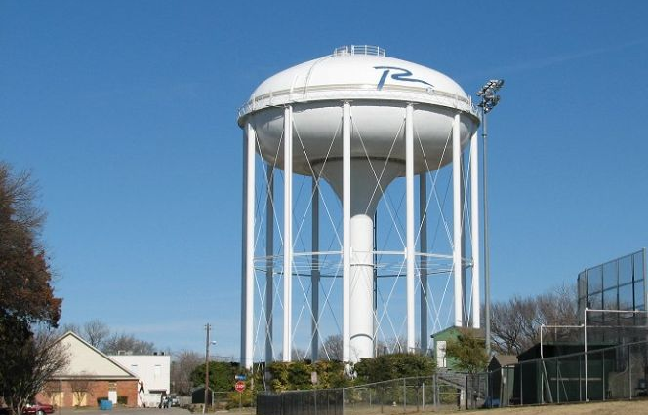

City of Richardson, Texas
Water and Sewer Fund

Slide 101
FY 2011-2012
Water and Sewer Fund
Water & Sewer Fund
 | Actual | Budget | Estimated | Proposed
 | 2009-2010 | 2010-2011 | 2010-2011 | 2011-2012
Beginning Fund Balance | $10,779,732 | $9,679,837 | $11,716,649 | $12,097,322
Total Revenues | $42,883,902 | $44,035,684 | $45,034,636 | $46,447,459
Total Funds Available | $53,663,634 | $53,715,521 | $56,751,285 | $58,544,781
Operating Expenditures | $31,208,882 | $33,642,814 | $33,287,327 | $35,274,243
Operating Transfers. | $6,307,203 | $6,362,148 | $6,446,206 | $6,361,087
Debt Service Transfer | $4,430,900 | $4,920,430 | $4,920,430 | $5,305,972
Total Expend. & Transfers | $41,946,985 | $44,925,392 | $44,653,963 | $46,941,302
Ending Fund Balance | $11,716,649 | $8,790,129 | $12,097,322 | $11,603,479
Days in Fund Balance | 99.64 | 71.42 | 98.88 | 90.22

Slide 102
FY 2011-2012
Water and Sewer Fund Expenditures
Classification of Water and Sewer Fund Expenditures
 |  | Proposed |  | Percent
Operating Expenditures |  | Budget |  | of Total
Personal Services |  | $6,097,760 |  | 12.99%
Professional Services |  | 621,646 |  | 1.32%
Maintenance |  | 26,394,475 |  | 56.23%
Contracts |  | 7,003,599 |  | 14.92%
Supplies |  | 1,174,772 |  | 2.50%
Capital |  | 343,078 |  | 0.73%
Total Operating Expenditures |  | $ 41,635,330 |  | 88.70%
Transfers Out |  | $ 5,305,972 |  | 11.30%
Total Operating Expenditures and Transfers |  | $ 46,941,302 |  | 100.00%

Slide 103
FY 2011-2012
Water and Sewer Fund Revenues
$1.4 million or 3.1% increase
  Projection based on a 5 year average of water and sewer sales.
  Water Sales projected to decrease 1.0%
  Sewer sales projected to decrease 1.0%
  Possible utilization of $1.8 million in rate stabilization
  Remaining revenues will see slight increases
  Off season multi-year financial plan and rate analysis.

Slide 104
FY 2011-2012
Water and Sewer Fund Revenues
Residential Municipal Cost Comparison
For $182,911 Homestead For Fiscal Year 2010-2011
 | Annual | Annual | Annual | Annual | Annual | Total | % of
 | Property | Water | Sewer | Solid Waste | Drainage | Annual | Richardson
CITY | Taxes | Charge | Charge | Fee | Fee | Charges | Total
Plano* | $ 715 | $ 375 | $ 505 | $ 146 | $ 40 | $ 1,781 | 83%
Carrollton* | 904 | 453 | 261 | 204 | - | 1,822 | 85%
Irving* | 843 | 474 | 264 | 237 | 48 | 1,866 | 87%
Frisco | 851 | 496 | 373 | 143 | 24 | 1,887 | 88%
Arlington* | 948 | 399 | 398 | 143 | 51 | 1,939 | 90%
Allen | 1,013 | 478 | 382 | 203 | 36 | 2,112 | 98%
Richardson | 1,162 | 492 | 282 | 216 | - | 2,152 | 100%
McKinney | 1,071 | 569 | 449 | 200 | 33 | 2,322 | 108%
Grand Prairie* | 1,192 | 522 | 388 | 180 | 45 | 2,327 | 108%
Mesquite | 1,171 | 601 | 402 | 195 | 36 | 2,405 | 112%
Dallas* | 1,166 | 473 | 476 | 244 | 93 | 2,452 | 114%
Fort Worth* | 1,251 | 508 | 400 | 237 | 86 | 2,482 | 115%
Garland* | 1,186 | 581 | 477 | 215 | 35 | 2,494 | 116%
Average | $ 1,036 | $ 494 | $ 389 | $ 197 | $ 41 | $ 2,157
Richardson %
(Below) Above Average | 12.2% | (0.4%) | (27.5%) | 9.6% | N/A | (0.2%)

Slide 105
FY 2011-2012
Water and Sewer Fund Expenditures
$2.3 million or 5.1% increase
  84% of that increase is due to increased wholesales costs from water and sewer service providers
    Wholesale water increases $0.14/1000 to $1.51/1000 gallons or $1.5 million over last year.
    Sewer Treatment costs increase $378,000 to $9.8 million
  Personal Services increases $209,317 and includes,
    Step Pay Plan
    TMRS
    Adjustment to City contribution for CORPlan
    2.0% for employees at top of pay range and who’ve received no pay adjustment for at least one year
  Professional Services increase $54,000

Slide 106
FY 2011-2012
Water and Sewer Fund Expenditures
  Maintenance increases $2.0 million due to NTMWD water contract and sewer service provider increases.
  Contracts increase $69,000
    $17k for water quality mailer as required by TCEQ
    $12k increase for equipment and general liability insurance
  Supplies decrease ($164,000)
    2010-2011 prior year encumbrances
  Debt Service increases $386,000
  Capital includes $343,000 in “pay as you go” equipment.

Slide 107
FY 2011-2012
Water and Sewer Fund

Slide 108
FY 2011-2012
Water and Sewer Fund
 | FY 2000-2001 | FY 2011-2012 | % Growth FY 2000-2001
Expenditures | Actual | Proposed | to FY 2011-2012
Operations | $11,515,439 | $16,310,047 | 41.6%
Wholesale Water | 7,588,501 | $15,139,160 | 99.5%
Sewer Treatment | 6,975,362 | $9,843,045 | 41.1%
Capital | 873,717 | $343,078 | (607%)
Debt Service | 2,447,278 | $5,305,972 | 116.8%
Total Costs | $29,400,297 | $46,941,302 | 59.7%
NTMWD Water Purchases
 | 2008-2009 | 2009-2010 | 2010-2011 | 2011-2012
Minimum Purchase | 11.0 billion | 11.0 billion | 11.0 billion | 11.0 billion
Projected Sales | 7.3 billion | 7.3 billion | 7.3 billion | 7.5 billion
Actual Purchase | 8.3 billion | 7.9 billion | 9.2 billion | N/A
Purchase as a % of Contract | 76% | 72% | 84% | N/A
Wholesale Cost | $11,538,591 | $13,774,139 | $15,096,456 | $16,639,160
Rebate per 1,000 Gals. | $0.53 | $0.44 | N/A | N/A
Total Rebate | $1,464,195 | $1,355,631 | N/A | N/A
Rebate as a % of Total Cost | 12.7% | 9.8% | N/A | N/A
NTMWD Rate per ‘000 gallons | $1.18 | $1.25 | $1.37 | $1.51
Effective Rate / ‘000 gallons | $1.40 | $1.56 | N/A | N/A

Slide 109
Water and Sewer Rates
Water and Sewer Rates
 | NTMWD Water Rate | NTMWD Sewer Rate | Cottonwood Creek Sewer Rate (Dallas) | Duck Creek Sewer Rate (Garland)
10-11 Budget | $1.37 | $1.42 | $2.00 | $2.17
10-11 Estimated | $1.37 | $1.42 | $2.00 | $2.17
11-12 Budget | $1.51 | $1.41 | $2.06 | $2.39
% Est./Prop. | 10.2% | -0.7% | 3.0% | 10.1%
% Basins Flow |  | 48% | 24% | 28%

Slide 110
Capital Equipment
 |  |  | Certificates of
Department / Item Description | Request | Operations | Obligation
Sanitary Sewer Reconstruction Material | $ 355,310 | $ - | $ 355,310
Jet Truck - Replacement (Upgrade of type) | 328,000 | - | -
Creek Annual Repair Program | 150,000 | 150,000 | -
12 Yard Dump Truck - Replacement (Current truck has low hours) | 136,500 | - | -
Water Mains Replacement Materials | 68,107 | 68,107 | -
Hybrid SUV - Replacement | 32,000 | 32,000 | -
New Meters and Settings | 26,000 | 26,000 | -
Service Connections | 16,000 | 16,000 | -
Service Connection Material | 14,781 | 14,781 | -
Service Connection Material | 14,000 | 14,000 | -
Table Top Folding Machine | 8,250 | 8,250 | -
4 Inch Water Trash Pump (2) | 5,000 | 5,000 | -
2 Inch Water Pumps (2) | 3,400 | 3,400 | -
Line Locators | 2,500 | 2,500 | -
3/4 Inch Root Saw Kit | 2,040 | 2,040 | -
Submersible Pump | 1,000 | 1,000 | -
Total Water and Sewer Fund Capital Requests | $ 1,162,888 | $ 343,078 | $ 355,310

Slide 111
Infrastructure Maintenance – CO Funded
Water, Sewer, & Erosion Maintenance Projects 2011-2012
Paving Cuts Program | $200,000
Sewer Projects
300 Centennial | $187,000
1200 W. Beltline | 108,000
100 Hyde Park | 30,000
Manhole Rehabilitation | 50,000
Total Sewer Projects | $375,000
Water Line Replacements
803-901 Willowcrest Dr. | $ 44,093
309-313 Ridgeview Dr. | 44,093
2414-2420 Fairway Dr. | 47,186
1501-1509 Willowcrest Dr. | 47,380
500-516 Cambridge Dr. | 92,300
601-641 Rorary Dr. | 71,500
1214-1228 Cypress Dr. | 71,500
401-423 Georgetown Dr. | 93,693
3001-3005 North Springs Dr. | 51,895
Total Water Lines | $563,640

Slide 112
FY 2011-2012
Water and Sewer Fund CIP
The Utility CIP program proposes a $3.0 million C.O. issue to fund Water & Sewer System improvements and replacements.
Water and Sewer Series 2012 CIP
Water Line Replacement | $1,650,000
Utility Pavement Repair | $400,000
Sewer Line Replacement (inline) | $375,000
Utility Paving Cuts | $200,000
Water Meter Replacement | $200,000
2012 G&A | $175,000
Total | $3,000,000

Slide 113
Line Items in Excess of $25,000
WATER AND SEWER - Operations Line Item Expenditures Excluding Transfers (Variances in Excess of $25,000) 2010-2011 Estimated – 2011-2012 Proposed
Overall Water & Sewer Fund Operating Expenditure Increase |  |  | $1,901,797
1102-2999 | Personal Services |  | $209,317
 | 1103 – Operations Hourly | $135,933
 | 2101 – Insurance - Personnel | $160,219
 | 2301 – TMRS | ($113,733)
 | 2921 - Training | $31,511
 | 2941 – Comp. Abs – Sick Leave | ($47,000)
3201-3499 | Professional Services |  | $53,959
 | 3499 – Other Professional Services | $52,677
4101-4599 | Maintenance |  | $2,020,506
 | 4111 - Water – NTMWD | $1,5742,704
 | 4134 – Sewer - NTMWD Reg. System | $131,049
 | 4134 - Sewer - NTMWD Upper East Fork | $57,149
 | 4141 – Sewer - Dallas | $88,651
 | 4142 – Sewer – Garland | $101,729
 | 4303 - Radio | $273,481
 | 4358 – Standpipes and Reservoirs | ($193,100)
 | 4531 – Paving Cuts | $33,000
5201-5999 | Contracts |  | ($16,502)
 | 5999 – Other Unclassified | ($85,119)
6101-6562 | Supplies |  | ($163,765)
 | 6211 – Light and Power | $37,451
 | 6999 - Prior Year Encumbrances | ($228,522)
7102-7499 | Capital |  | ($201,718)
 | 7421 - Vehicles | ($223,689)

Slide 114
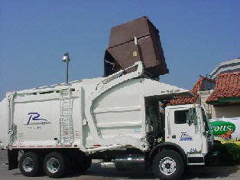
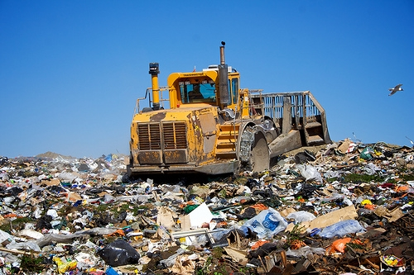
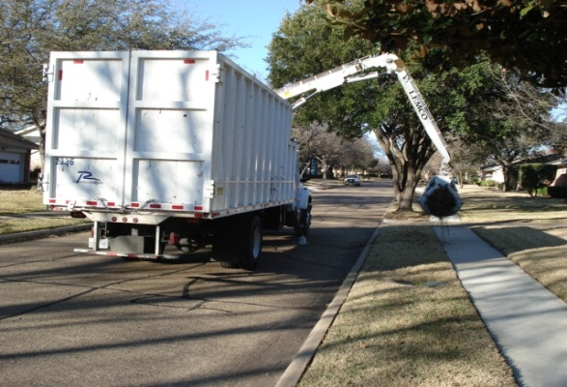
City of Richardson, Texas
Solid Waste Services Fund

Slide 115
FY 2011-2012
Solid Waste Fund
Solid Waste Services Fund
 | Actual | Budget | Estimated | Proposed
 | 2009-2010 | 2010-2011 | 2010-2011 | 2011-2012
Beginning Fund Balance | $3,007,711 | $3,318,641 | $3,582,693 | $3,391,849
Total Revenues | $12,330,589 | $12,842,285 | $12,232,098 | $12,912,633
Total Funds Available | $15,338,300 | $16,160,926 | $15,814,791 | $16,304,482
Total Expenditures | $8,444,217 | $9,134,473 | $8,703,671 | $9,266,830
Total Operating Transfers. Out | $2,677,490 | $2,704,328 | $2,691,576 | $2,597,228
Total Other Transfers | $633,900 | $1,027,695 | $1,027,695 | $1,207,985
Total Expend. & Transfers | $11,755,607 | $12,866,496 | $12,422,942 | $13,072,043
Ending Fund Balance | $3,582,693 | $3,294,430 | $3,391,849 | $3,232,439
Days in Fund Balance | 111.18 | 93.46 | 99.66 | 90.26

Slide 116
FY 2011-2012
Solid Waste Fund Expenditures
Classification of Solid Waste Services Fund Expenditures
 |  | Proposed |  | Percent
Operating Expenditures |  | Budget |  | of Total
Personal Services |  | $4,249,630 |  | 32.51%
Professional Services |  | 15,550 |  | 0.12%
Maintenance |  | 4,542,835 |  | 34.75%
Contracts |  | 2,852,583 |  | 21.82%
Supplies |  | 203,460 |  | 1.56%
Capital |  | - |  | 0.00%
Total Operating Expenditures |  | $11,864,058 |  | 90.76%
Transfers Out |  | $1,207,985 |  | 9.24%
Total Operating Expenditures and Transfers |  | $13,072,043 |  | 100.00%

Slide 117
FY 2011-2012
Solid Waste Fund Revenues
$681,000 or 5.6% increase.
  Residential Collections projected to decrease ($26,000) or -0.5%.
    Continued increases in the Sr. Discount program.
    Senior Rate of $13.30/month represents a 26% discount in monthly bill.
  Commercial collections projected at 4.5% or $280,000 increase.
    Includes a proposed 5% increase in Commercial haul fees (based on market averages and fuel increases)

Slide 118
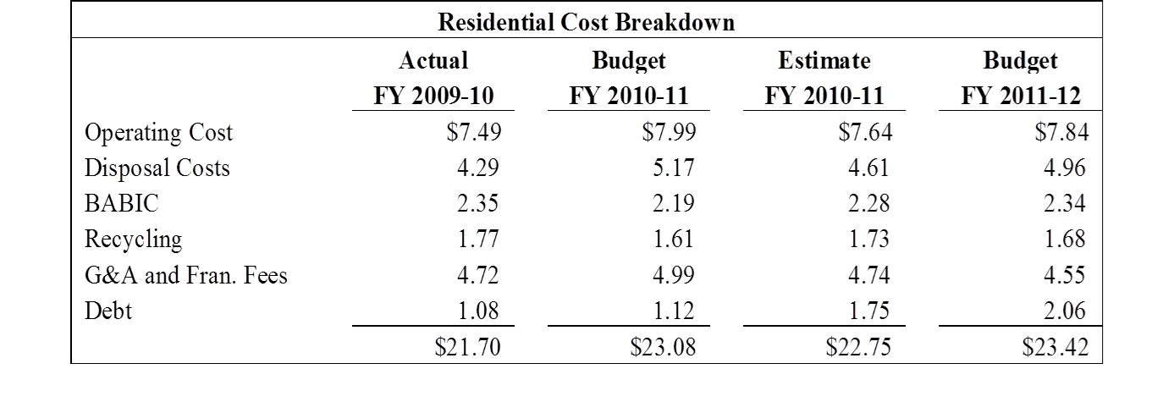
FY 2011-2012
Solid Waste Fund Revenues
  Possible utilization of $410,000 in rate stabilization.
  Last residential rate change in FY 2008-2009.
  $1.85/month increased monthly rate to $18.00 with a true cost of service provision at $23.42/month.
  Commercial subsidizes each residential account $65.00 per year.

Slide 119
FY 2011-2012
Solid Waste Fund Revenues
Off season multi-year financial plan update and rate analysis will proceed after the conclusion of the comprehensive operational analysis currently being performed by HDR.
  Expected conclusion of study by early Summer 2012.

Slide 120
FY 2011-2012
Solid Waste Fund Expenditures
$649,000 or 5.2% increase.
  Disposal Fee and projected tonnage increases account for $248,000 of the increase.
  Personal Services increase $251,000 and include the Step Pay, City share of CORPLan, TMRS and understaffing of 3 full time positions.
  Remaining operational expenditure categories combine to increase $15,000.
  Change in G&A Transfer reflects the recently revised indirect cost analysis.
  Debt Service increases $180,000.

Slide 121
FY 2011-2012
Solid Waste Fund Expenditures
BABIC - $783,000 Cost
  2007-2008 / 70,900 stops
  2008-2009 / 71,182 stops
  2009-2010 / 71,569 stops
  2010-2011 / 64,500 stops (YTD)
  7 Knuckleboom Trucks (1 truck – 1992 start)
Recycling - $558,000 Cost
  30% participation
  4,868 tons collected
  $200,000 annual savings (in house operations / March 2008)

Slide 122
FY 2011-2012
Solid Waste Fund Expenditures
Capital Equipment Replacement/Purchase
  Fleet and major equipment purchases will be handled through the issuance of $995,000 in 8 year Certificates of Obligation.
    Replace 4 Rearloader Trucks in Residential
    Standard replacement of Commercial containers and compactor power units

Slide 123
Capital Equipment
 | 8 Year Debt
Item Description | Financed
Rearloaders - Replacement (4) | $ 808,000
8 Yard Frontload Containers (60) | 57,000
Compactor Power Units (10) | 45,000
34 Yard Compactors (2) | 42,000
30 Yard Open Top Containers (5) | 30,000
4 Yard Frontload Containers (20) | 13,000
Total Solid Waste Services Fund Capital Requests | $ 995,000

Slide 124
Solid Waste Fund
Master Plan Update
Solid Waste Master Plan update – HDR Study.
  Evaluation of existing collection systems,
  Defining future solid waste management needs and identification of new programs and implementations of each,
  Program Options like yard waste, composting, recycling collection, etc.,
  Program refinements and cost impacts to implement each at right times and,
  Option implementation issues.
  Expected completion early Summer 2012

Slide 125
FY 2011-2012
Solid Waste Fund
SOLID WASTE - Operations Line Item Expenditures Excluding Transfers (Variances in Excess of $25,000) 2010-2011 Estimated – 2011-2012 Proposed
Overall Solid Waste Fund Operating Expenditure Increase |  |  | $ 468,811
1102-2999 | Personal Services |  | $250,504
 | 1103 – Operations Hourly | $111,473
 | 1301 - Overtime | $25,740
 | 2101 – Insurance - Personnel | $117,900
 | 2301 – TMRS | ($48,884)
3271-3499 | Professional Services |  | ($3,279)
4101-4599 | Maintenance |  | $297,678
 | 4201 - Disposal Costs – NTMWD | $248,111
 | 4303 - Radio | $63,567
5201-5999 | Contracts |  | ($68,311)
 | 5999 – Other Unclassified | ($92,098)
6101-6999 | Supplies |  | ($7,781)

Slide 126
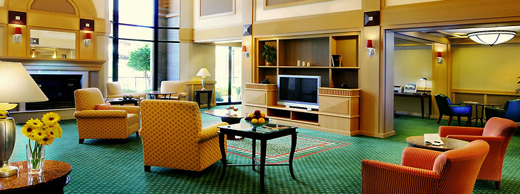
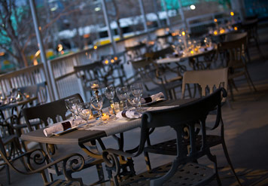
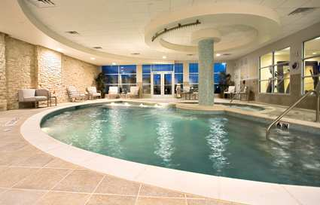
City of Richardson, Texas
Hotel/Motel Tax Fund

Slide 127
FY 2011-2012
Hotel/Motel Tax Fund
Hotel Motel Tax Fund
 | Actual | Budget | Estimated | Proposed
 | 2009-2010 | 2010-2011 | 2010-2011 | 2011-2012
Beginning Fund Balance | $382,522 | $347,494 | $662,451 | $651,471
Total Revenues | $4,863,230 | $5,325,660 | $5,515,203 | $5,679,850
Total Funds Available | $5,245,752 | $5,673,154 | $6,177,654 | $6,331,322
Total Expend. & Transfers | $4,583,301 | $5,341,692 | $5,526,183 | $5,740,289
Ending Fund Balance | $662,451 | $331,462 | $651,471 | $591,033

Slide 128
FY 2011-2012
Hotel/Motel Tax Fund Expenditures
Classification of Hotel/Motel Tax Fund Expenditures
 |  | Proposed |  | Percent
Operating Expenditures |  | Budget |  | of Total
Personal Services |  | $1,883,579 |  | 32.81%
Professional Services |  | 987,336 |  | 17.20%
Maintenance |  | 96,112 |  | 1.67%
Contracts |  | 2,039,994 |  | 35.54%
Supplies |  | 733,268 |  | 12.77%
Capital |  | - |  | 0.00%
Total Operating Expenditures |  | $5,740,289 |  | 100.00%
Transfers Out |  | $ - |  | 0.00%
Total Operating Expenditures and Transfers |  | $5,740,289 |  | 100.00%

Slide 129



FY 2011-2012
Hotel/Motel Tax Fund Revenues
Hotel Property | Actual | Budget | Estimated | Budget
 | 2009-2010 | 2010-2011 | 2010-2011 | 2011-2012
Como Motel | $18,030 | $18,808 | $20,466 | $18,505
Continental Inn | $ 20,067 | $20,824 | $20,321 | $20,524
DoubleTree Hotel | $289,201 | $290,706 | $427,653 | $440,483
Econo Lodge | $28,996 | $29,783 | $39,107 | $34,201
Hampton Inn | $126,245 | $138,853 | $170,547 | $153,358
Hawthorne Suites | $88,623 | $42,291 | $39,011 | $33,952
Hilton Garden Inn | $220,085 | $200,662 | $242,958 | $247,817
Holiday Inn | $189,170 | $188,590 | $192,823 | $196,679
Homestead Suites | $60,700 | $62,511 | $79,521 | $70,051
Hyatt Regency | $429,388 | $450,479 | $512,712 | $522,966
Hyatt Summerfield | $130,927 | $134,899 | $203,727 | $185,806
Mariott Courtyard - Galatyn | $163,959 | $172,732 | $182,945 | $188,433
Marriott Courtyard - Spring Valley | $138,094 | $141,673 | $160,435 | $166,852
Marriott Renaissance | $597,841 | $611,995 | $555,615 | $572,284
Residence Inn | $142,756 | $158,476 | $158,973 | $162,152
Super 8 | $38,255 | $40,344 | $42,930 | $38,304
TOTAL | $2,682,337 | $2,703,626 | $3,049,744 | $3,052,367

Slide 130
Hotel Occupancy
 | 2010 | Through June 2011
Average Daily Rate | $79.84 | $84.32
Occupancy | 58% | 63%
Rev/PAR | $46.28 | $53.97

Slide 131
FY 2011-2012
Hotel/Motel Fund Revenues
$165,000 or 3.0% increase
  Hotel occupancy tax receipts projected flat from year-end estimate.
    Beginning in January of 2011, all hotel properties were required to begin remitting hotel tax receipts every month as opposed to quarterly as allowed by the previous ordinance. This change only affected 7 of our 16 properties, as the others had been remitting monthly already. When a change like this occurs, it’s not unusual to get a “bump” in revenue the first year the change occurs since the early quarterly payments may have included one or two months receipts from the prior City of Richardson fiscal year. Such was the case in 2010-2011. When projections are made for the proposed year, these anomalies have to be taken into account and nullified prior to any forecast. It’s this reason that hotel receipts are only expected to increase $2,600 in 2011-2012.

Slide 132
FY 2011-2012
Hotel/Motel Fund Revenues
  Eisemann Center revenues are projected at $2.4 Million reflecting a $150,000 or 6.6% increase from estimated year-end.
    Operations revenue is estimated based on performance levels similar to FY 2010-2011 levels with some recovery in rental fees. The majority of the revenue increase is due to the Eisemann Center Presents Series for FY 2011-2012 reflecting a normal ticket revenue model after the three shows last year fell below expectations
  Parking Garage fees increase $10,000 based on minor volume growth.
  Interest improves slightly based on cash flow.

Slide 133




FY 2011-2012
Hotel/Motel Fund Expenditures
Eisemann Center Operations
Eisemann Center Presents
Convention & Visitors Bureau
Parking Garage
Local Arts Grants
Richardson
Arts Grants

Slide 134
FY 2011-2012
Hotel/Motel Fund Expenditures
$214,000 or 3.9% increase.
  Eisemann Center expenditures increase $170,000.
    Operations increase $29,000
    Eisemann Center Presents Series increase $140,000 and is offset by matching revenue.
  Parking Garage Expenditures increase 6.9% or $34,000 based on the parking garage services agreement. The City budgets the maximum allowable by contract.

Slide 135
FY 2011-2012
Hotel/Motel Fund Expenditures
  The Transfer to General Fund – CVB of $405,000 supports that department’s hotel/motel marketing initiatives.
  Arts grant funding continues at $300,000
  The recently completed indirect cost analysis supports a General and Administrative Transfer to the General Fund of almost $1.0 million.
    As with year-ending 2010-2011, the fund will send a G&A Transfer of $250,000 to the General Fund to help offset the indirect costs associated with the Hotel/Motel fund which are currently hosted in the General Fund.

Slide 136
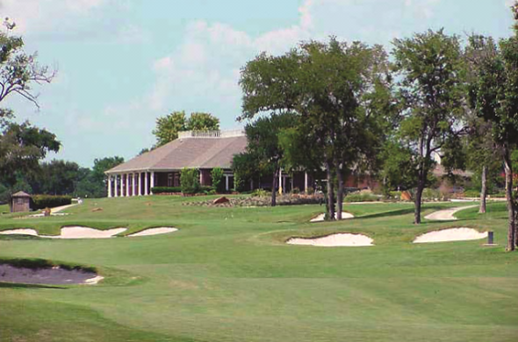
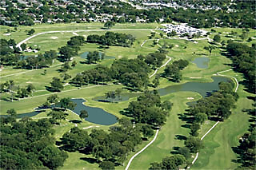
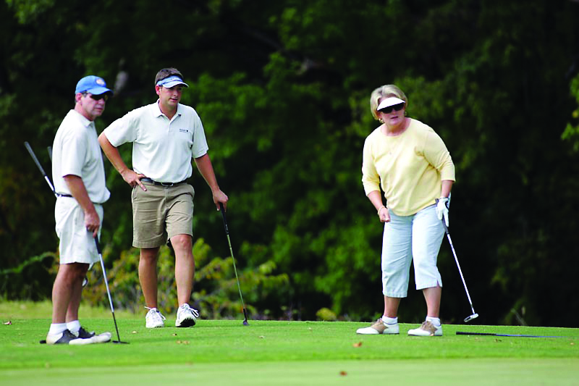

City of Richardson, Texas
Golf Fund

Slide 137
FY 2011-2012
Golf Fund
Golf Fund
 | Actual | Budget | Estimated | Proposed
 | 2009-2010 | 2010-2011 | 2010-2011 | 2011-2012
Beginning Fund Balance | $268,382 | $184,061 | $192,719 | $176,689
Total Revenues | $2,232,120 | $2,140,555 | $2,095,301 | $2,182,447
Total Funds Available | $2,500,502 | $2,324,616 | $2,288,020 | $2,359,136
Total Expenditures | $1,607,599 | $1,514,761 | $1,481,504 | $1,550,419
Total Transfers Out | $700,184 | $629,827 | $629,827 | $626,981
Total Expend. & Transfers | $2,307,783 | $2,144,588 | $2,111,331 | $2,177,400
Ending Fund Balance | $192,719 | $180,028 | $176,689 | $181,736
Days in Fund Balance | 30.27 | 30.64 | 30.55 | 30.46

Slide 138
FY 2011-2012
Golf Fund
Classification of Golf Fund Expenditures
 |  | Proposed |  | Percent
Operating Expenditures |  | Budget |  | of Total
Personal Services |  | $993,626 |  | 45.63%
Professional Services |  | 30,183 |  | 1.39%
Maintenance |  | 94,008 |  | 4.32%
Contracts |  | 158,833 |  | 7.29%
Supplies |  | 358,750 |  | 16.48%
Capital |  | - |  | 0.00%
Total Operating Expenditures |  | $1,635,400 |  | 75.11%
Transfers Out |  | $542,000 |  | 24.89%
Total Operating Expenditures and Transfers |  | $2,177,400 |  | 100.00%

Slide 139
FY 2011-2012
Golf Fund Revenue
Revenues are projected at $2.2 Million for FY 2011-2012 representing a 4.2% growth in anticipated revenues over year-end estimates.
  Based on rounds at 100,000
  The budget includes a proposed green fee increase of $4 for the weekend and weekday rack rate and a $2 increase for all other green fee rates.

Slide 140
FY 2011-2012
Golf Fund Revenue
 |  | Current | Proposed | Proposed w/ Cart
#1 Weekend | Regular Rate | $34 | $38 | $47
 | 1st Twilight | $24 | $26 | $35
 | 2nd Twilight | $18 | $20 | $29
 | Super Twilight | $14 | $16 | $25
#1 Weekday | Regular Rate | $24 | $26 | $35
 | 1st Twilight | $18 | $20 | $29
 | 2nd Twilight | $16 | $18 | $27
 | Super Twilight | $12 | $14 | $23
 | Sr./Jr. | $16 | $18 | $27
#2 Weekend | Regular Rate | $28 | $32 | $41
 | 1st Twilight | $18 | $20 | $29
 | 2nd Twilight | $14 | $16 | $25
 | Super Twilight | $10 | $12 | $21
#2 Weekday | Regular Rate | $20 | $22 | $31
 | 1st Twilight | $14 | $16 | $25
 | 2nd Twilight | $12 | $14 | $23
 | Super Twilight | $8 | $10 | $19
 | Sr./Jr. | $14 | $16 | $25
Sherrill Park established current green fees in 2001 following the Course #2 renovation and have not increased rates in the last 10 years.
The resident punch card pricing is proposed to remain the same.
  Senior Punch Card $100 (10 to 15 rounds)
  Resident Punch Card $200 (10 to 15 rounds)

Slide 141
FY 2011-2012
Golf Fund Revenue
The green fee survey of area comparable courses shows there is room to increase rates and still remain a good value for golfers.
Weekday Weekend
 | Rack | 1st | 2nd | Super | Sr. | Jr. |  | Rack | 1st | 2nd | Super
SP Course 1 (Proposed) | $35 | $29 | $27 | $23 | $27 | $18 |  | $47 | $35 | $29 | $25
SP Course 2 (Proposed) | $31 | $25 | $23 | $19 | $26 | $16 |  | $41 | $29 | $25 | $21
Firewheel (Old& Lakes) | $39 | $33 | $28 | $26 | $26 | $13 |  | $47 | $40 | $30 | $28
Firewheel (Bridges) | $51 | $45 | $35 | $23.5 | $31 |  |  | $57 | $47 | $41 | $23.5
Chase Oaks | $39 | $29 |  | $19 | $25 |  |  | $49 | $32 |  | $22
Indian Creek (Creeks) | $53 | $43 | $33 |  | $37 | $18 |  | $63 | $53 | $33
Indian Creek (Lakes) | $43 | $33 | $28 |  | $31 | $18 |  | $52 | $42 | $31
Grapevine | $45 | $34 |  |  | $31 | $16 |  | $50 | $36
Iron Horse | $44 | $34 | $24 |  | $34 | $16 |  | $54 | $44 | $29
Tenison Highlands | $48 | $37 |  | $30 | $33 | $20 |  | $56 | $42 |  | $35
Average | $43 | $34 | $28 | $23 | $30 | $17 |  | $52 | $40 | $31 | $26

Slide 142
FY 2011-2012
Golf Fund Revenue
Estimating rounds at 100,000 anticipates a solid year of play. The six year history of rounds, excluding 2009-10, shows an average of 98,000 rounds. Of the six years, three of them were over 100,000.

Slide 143
FY 2011-2012
Golf Fund Revenue
Weather conditions are a key factor to the volume of play at Sherrill Park. Below is historical weather information.
2007-2008 – Total Rounds: 102,584
  Total Bad Weather Days – 56 days
  Total Weekend Bad Weather Days – 11
  Comments: Great weather around Christmas break.
2008-2009 – Total Rounds: 100,266
  Total Bad Weather Days – 54
  Total Weekend Bad Weather Days – 14
  Comments: Great weather around Christmas break and Memorial Day weekend.
2010-2011 – Total Rounds: 94,000 (estimated)
  Total Bad Weather Days – 59
  Total Weekend Bad Weather Days -17
  Comments: 40 Days of consecutive 100 degree plus weather.

Slide 144
FY 2011-2012
Golf Fund Expenditures
Expenditures Increase - $66,069
  Personal Services will increase $70,093 and includes:
    Step Pay Plan
    Merit based 2.0% increase for employees who’ve been at the top of their range and have received no adjustment in at least one year.
    City contribution to CORPlan
    Increase in part-time workers for continued course maintenance.
  Professional Services increases $1,533
  Maintenance increases $1,508
  Contracts increases $10,595
  Supplies increase $4,645
  Capital decreases ($19,459)

Slide 145
Sherrill Park Rankings
2011 Dallas Morning News Ranking:
  Course #1 - #1 in the state in the economy-priced course category
  Course #2 - #8 in the state in the economy-priced course category
In 1999 Course #1 received a Golf Digest “4 Star Rating”
Notable Tournaments and Golf Qualifiers:
  13th Anniversary of the Eastern Championship of the Northern Texas PGA will be held in August. Sherrill Park has hosted the tournament 12 years.
  Course #1 hosted the U.S. Open Local Qualifier
  Course #1 hosted the U.S. Amateur Local Qualifier
  Course #1 hosted the Byron Nelson Tournament Qualifier
  Course #1 hosted the USGA Woman’s Public Links Qualifier
  Course #2 hosted the Mark Brooks Shootout sponsored by the Texas Legend Junior Tour

Slide 146
History of DMN Rankings
2010 | Course #1 | #10 in the state in the mid-priced course category
 | Course #2 | #10 in the state in the economy-priced course category
2009 | Course #1 | #6 in the state in mid-priced course category Ranked in the top 100 golf course in the state (public and private) Ranked #38 in top 50 public courses in the state
 | Course #2 | #7 in the state in economy-priced course category
2008 | Course #1 | #89 in the top 100 golf courses in the state (public and private) #32 in the state for non-private golf courses #4 in the state in the Mid-Priced Course Category
 | Course #2 | #4 in the state in the Economy-Priced Course Category
2007 | Course #1 | #8 in the state in the Mid-Priced Course Category
 | Course #2 | #12 in the state in the Economy-Priced Course Category
2006 | Course #1 | #7 in the state in the Economy-Priced Course Category 5th best “bang for your buck” in the DFW area 13th best daily fee course in DFW
 | Course #2 | #22 in the state in the Economy-Priced Course Category 4th best “bang for your buck” in the DFW area
2005 | Course #1 | #9 in the state in the Economy-Priced Course Category
 | Course #2 | #22 in the state in the Economy-Priced Course Category
2004 | Course #2 | #9 in the state in the Economy-Priced Course Category
2003 | Course #1 | #4 in the state in the Municipal Category
2002 | Course #1 | #5 in the state in the Municipal Category

Slide 147
2011-2012 Budget
Closing Comments and Next Steps

Slide 148
Closing Comments
The pace of economic change continues to be forecasted as a gradual, multi-year effort.
  Our local pace and expectations will need to be throttled accordingly.
  Budgetary adjustment are prudent and strategic – not every year
As economic renewal occurs, it will be selective and seek assurances of a support environment.
We continue to use this economic climate to reinforce our Richardson advantages:
  Articulate community goals, plans and mission focus
  Stable local government with credible, financial soundness
  Quality & reliable public services and committed public workforce
  Progressive municipal goals supporting renewal and enhanced neighborhood and commercial investment
  Supportive and attentive economic development efforts

Slide 149
Next Steps
Further opportunities to provide access and to gain public input are scheduled before final adoption.
    Council Budget Work Session – Web/Cable Access
    Web, City Secretary & Library copies of the filed budget provided
    Budget Public Hearing-August 29, 2011
    Adoption on September 12, 2011
Stay Focused

