Slide 1
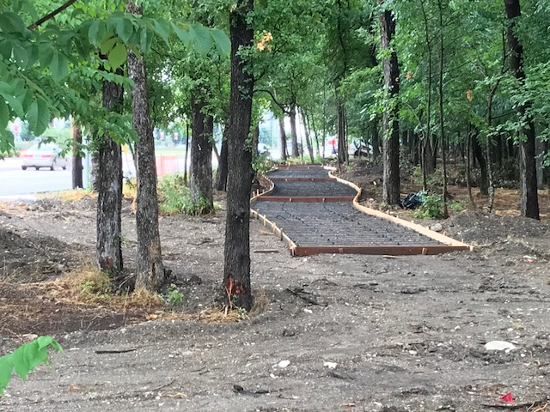
Path Taking & Path Making 2018-19:
Strengthening the Municipal Services Value Proposition
2018-2019 Fiscal Year
City of Richardson, Texas
Municipal Budget Presentation
City Council Presentation
August 13, 2018

Slide 2
“Path Taking & Path Making”
Our Richardson municipal leadership responsibilities have us constantly assessing our “path” forward – into the next fiscal year, the next municipal service era, and the evolving economic, commercial, residential and political mandates.
As we “navigate” with policies and decisions, we often utilize the previously established routes and gameplans of prior assessments and commitments, knowing there is wisdom in sustained attention and commitment….we are path taking.
We also know that evolving settings and opportunities present the need to set a “new route” – the adds and deletes that will be responsive to these new factors…we are path making.

Slide 3
“The Municipal Services
Value Proposition”
The “quest” (or value proposition) of this journey is the delivery and enjoyment of quality municipal services – worthy of its “pricing” and validated by personal experience and measured assessments.
Rankings, surveys, advisory boards, community comments and voter approvals are just some of the ways that we gain feedback to confirm that we continue to deliver value.
This 2018-19 Budget will again offer a mixture of routes … path taking in some cases… path making in others… as we seek to strengthen our Richardson municipal service proposition.

Slide 4
“Path Taking”
Continue to work towards 2017-2019 City Council Goals and Strategies
Continued attention to our financial and budgetary policies
  Continue to incrementally build days of Fund Balance in the General Fund
  Continuation of construction of the Public Safety Campus
  Implementation of our numerous street, alley and traffic improvement projects and their funding commitments
  Design of Fire Station #3 and other 2015 Bond elements

Slide 5
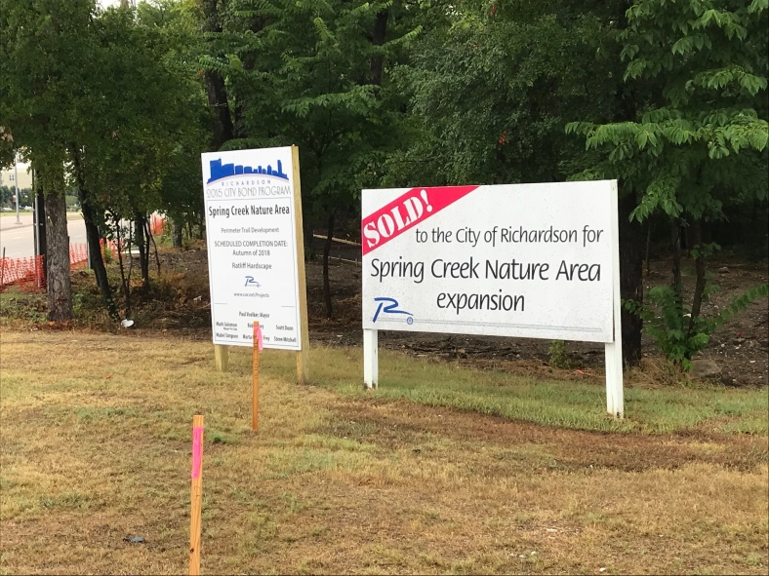
“Path Making”
  Development of the Collins/Arapaho TOD and Innovation District Study
  Continued planning with DART regarding the Cottonbelt Rail Line
  Planning and design for the Main Street infrastructure strategies
  Preparing for the 2019 Texas Legislative Session
  Working to phase-out short-term debt for equipment and small capital purchases
  Strengthen neighborhood park maintenance funding and strategies
  Strengthen prior year’s commitment to targeted alley maintenance funding
  Construction of the Spring Creek Nature Area perimeter trail & inner loop

Slide 6
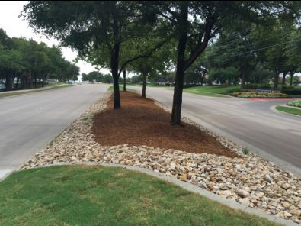
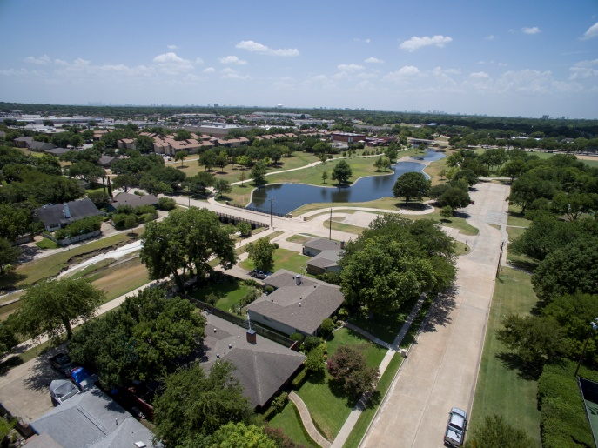
Budget Preparation Guidance
The City’s budget development process conforms to a variety of guidance features:
    State & Federal Laws
    City Charter
    City Council Direction
    City Financial & Investment Policies
    Fund Accounting Standards
    Bond Rating Criteria

Slide 7
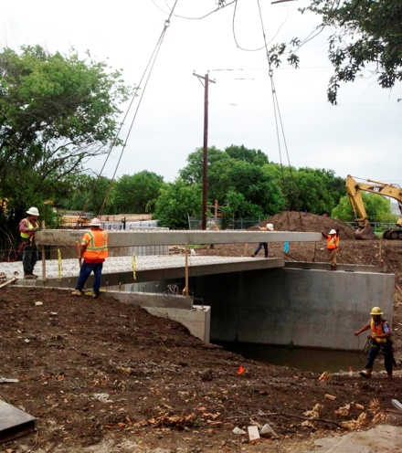
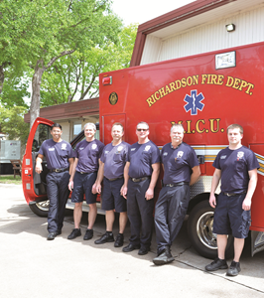
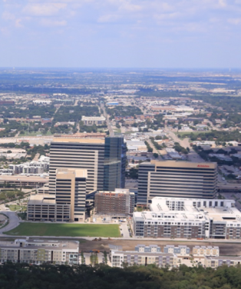
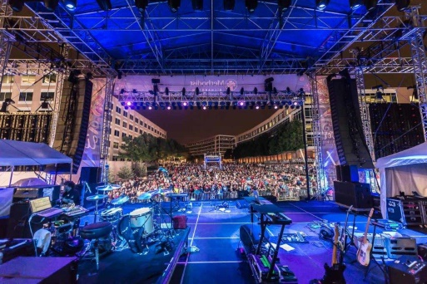
Our Sustainable Budget Attentions
Enhanced Infrastructure Maintenance
Enhanced Customer & City Experience
Public Safety Resources
Economic Development and Renewal

Slide 8
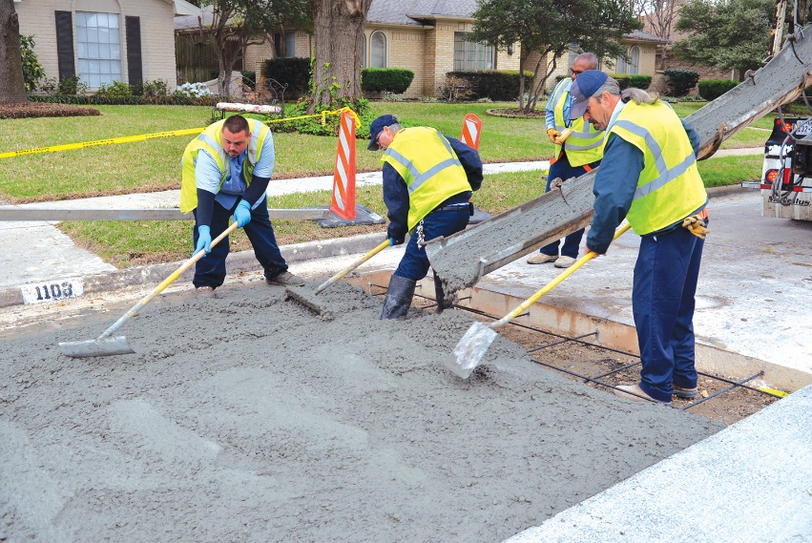
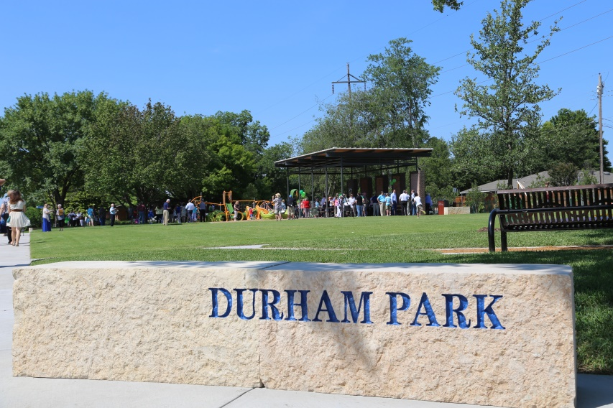
Pursuits for the FY 2018-2019 Budget
Develop a 2018-2019 Budget and Work Plan that requires no new property tax rate increase.
Continue the strong alignment of municipal resources around the key themes of the Council’s goals & key missions.
Continue the implementation of the 2015 Bond Program.

Slide 9
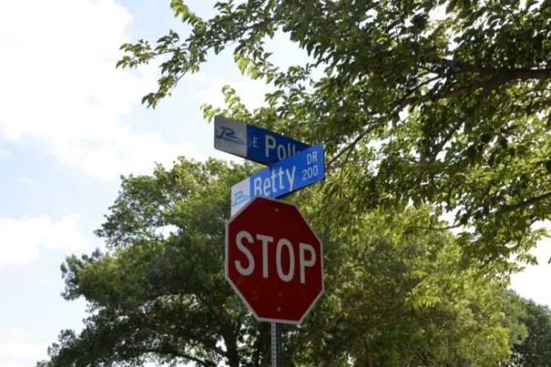
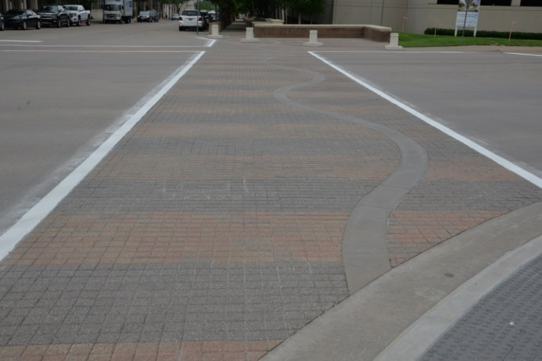
Pursuits for the FY 2018-2019 Budget
Sustain the significant maintenance initiatives begun in recent budget efforts:
  Continue to have 2.5 pennies dedicated to street maintenance.
  Increase the alley rehabilitation dedication to 1.0 penny of the tax rate.
  Establish a ½ cent dedication for parks maintenance to implement multi-year maintenance strategies.
  Sustain Year 6 Strategies for key maintenance activities: bridges, walls, traffic signs, traffic markings, etc.
  Continue efforts to enhance infrastructure maintenance for the water distribution system and sewer collection systems.
  Enhance maintenance strategies for aquatic facilities and city facilities.

Slide 10
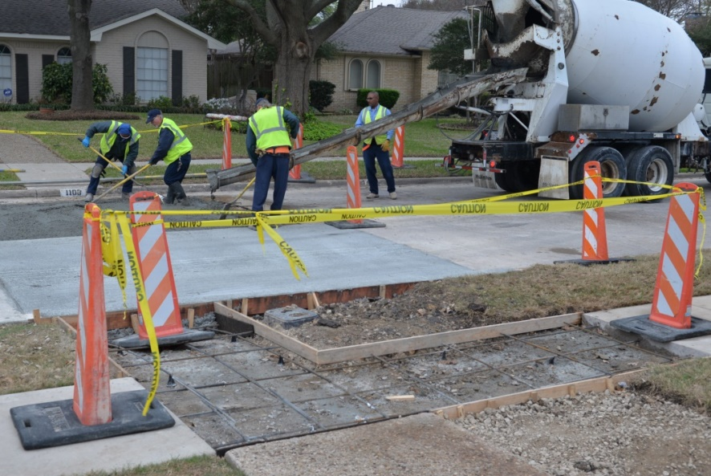
Key Budget Elements for 2018-2019:
Property Tax
Maintaining the current $0.62516 tax rate was used in budget development.
  Operations: $0.37413
  Debt: $0.25103
  Total: $0.62516
The tax rate was lowered by one cent in
the development of the FY 2016-2017
Budget.
The Senior Exemption has increased from $80,000 to $85,000 for 2018-2019. The estimated cost of this increase in the exemption is $352,000.
Property taxes provide about 42.1% of the entire General Fund resources.

Slide 11
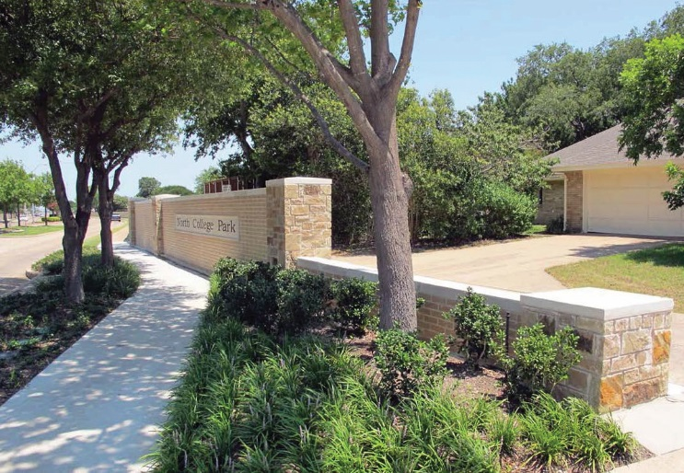
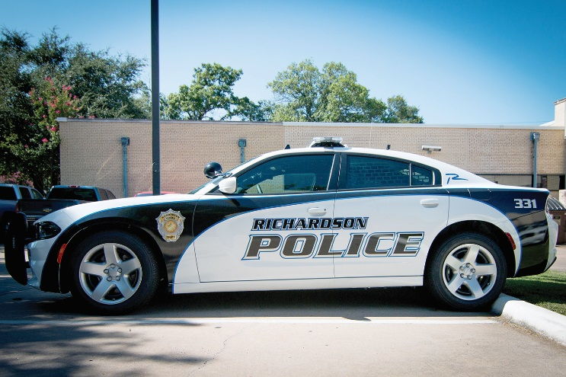
Key Budget Elements for 2018-2019:
Revenue Overview
Sales tax revenue estimates continue to be on a modest upward trend.
This current 2017-2018 year has seen a mostly positive trend for sales tax.
This preliminary 2018-2019 estimate for sales tax of $37.3 million uses a 2.75% growth factor for base collections.
Sales tax revenue provides about 27.5% of the entire General Fund resources.

Slide 12
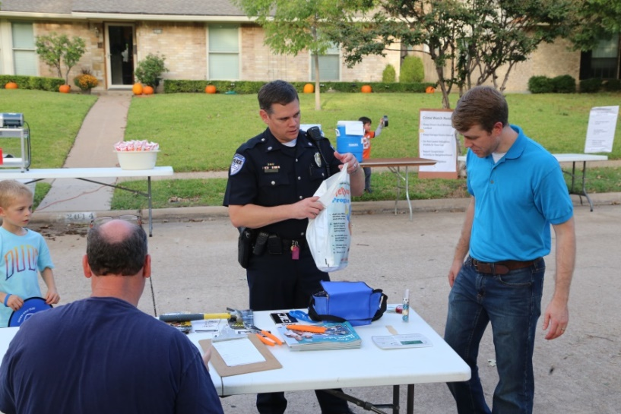
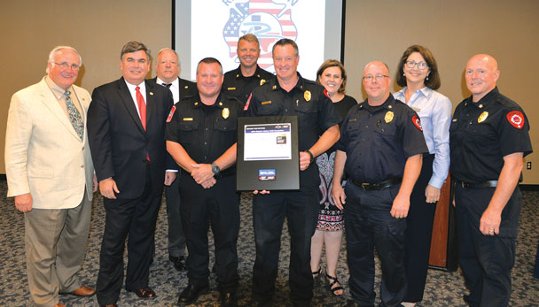
Key Budget Elements for 2018-2019:
Public Safety Initiatives
The FY 2018-2019 Budget includes several efforts to enhance public safety resources including:
  Capital funding for Public Safety Campus and Fire Station #3 projects that was approved in the 2015 Bond Program.
  Full year funding of additional Public Safety positions initially funded in the FY2017-2018 Budget.
  Replacement of vehicles for the Police Department, replacement of a Quint fire apparatus and an ambulance.
  Funding for replacement of the Fire Department’s SCBA* equipment.
  Funding for department issued firearms and rifles for sworn Police Department personnel.
* SCBA (Self-Contained Breathing Apparatus)

Slide 13
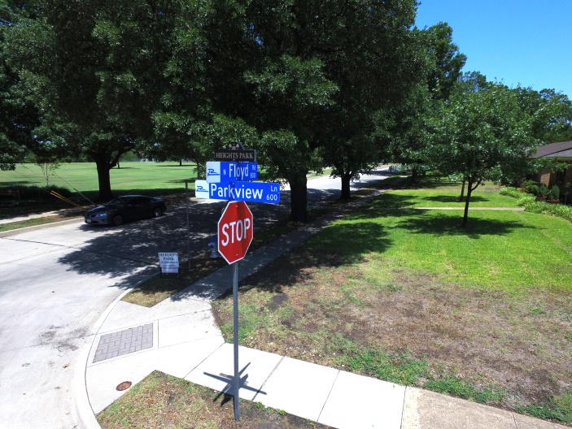
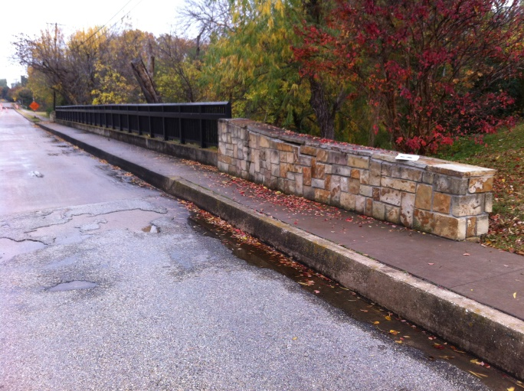
Key Budget Elements for 2018-2019:
Maintenance Activities - General Fund
Streets & Alleys
Proposed budget includes 3.5 cents of property tax for arterial streets, collector streets and neighborhoods zones, an alley repair program and a preventive maintenance program.
Bridge Railings
In 2018-2019, 9 bridges will be repaired and enhanced.
Traffic Signs & Pavement Markings
Proposed budget includes funding for:
Replacing small street name signs in 2 zones plus replacing 1,000+ traffic control and guide signs and overhead street name signs as needed.
Refreshing markings around school zones.
Replacing markings on streets repaired via pavement rehab program.
Updating 2 existing bike lanes and adding 1 mile of bike lane.

Slide 14
Key Budget Elements for 2018-2019:
Maintenance Activities – General Fund
 | FY 14-15 Actual | FY15-FY16 Actual | FY16-FY17 Actual | FY 17-18 Projected | FY 18-19 Proposed
Street/Alley Maintenance Strategy | $2,570,000 | $2,889,000 | $4,327,000 | $4,593,000 | $5,377,000
Bridge Railings | $320,000 | $300,000 | $300,000 | $0 | $100,000
Pavement Markings | $300,000* | $350,000* | $400,000 | $400,000 | $400,000
Street Name Sign Replacement | $100,000* | $100,000* | $100,000 | $100,000 | $100,000
TOTAL | $3,290,000 | $3,639,000 | $5,127,000 | $5,093,000 | $5,977,000
* Included funding from the Traffic Safety Fund

Slide 15
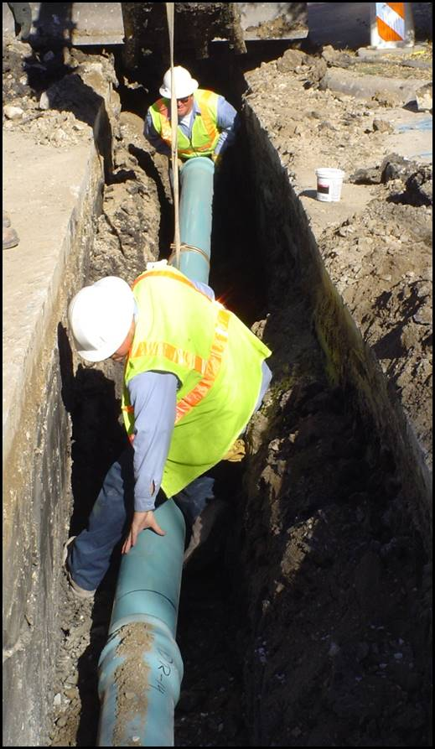
Key Budget Elements for 2018-2019:
Maintenance Activities - Water/Sewer Fund
Water Distribution System Strategy:
Proposed budget includes funding for:
Water storage and pumping facilities
Water mains repair and replacement
Fire hydrant maintenance
Valve replacement program
Water meter replacement program
Work management system
Sewer Collection System Strategy:
Proposed budget includes funding for CMOM:
Capacity: flow monitoring, capital improvements
Management: minimization of Inflow & Infiltration
Operations & Maintenance: condition assessment, sewer line televising, planned and unplanned rehabilitation

Slide 16
Key Budget Elements for 2018-2019:
Maintenance Activities - Water/Sewer Fund
 | FY15-FY16 Actual | FY16-17 Actual | FY 17-18 Projected | FY 18-19 Proposed
Water Distribution – Operations | $1,057,000 | $1,078,000 | $1,292,000 | $1,474,000
Water Distribution – Debt | $1,900,000 | $3,075,000 | $3,500,000 | $7,055,000
Sewer Collections – Operations | $1,325,000 | $3,900,000 | $3,900,000 | $3,900,000
Sewer Collections – Debt | $200,000 | $750,000 | $1,760,000 | $1,600,000
TOTAL | $4,482,000 | $8,803,000 | $10,452,000 | $14,029,000

Slide 17
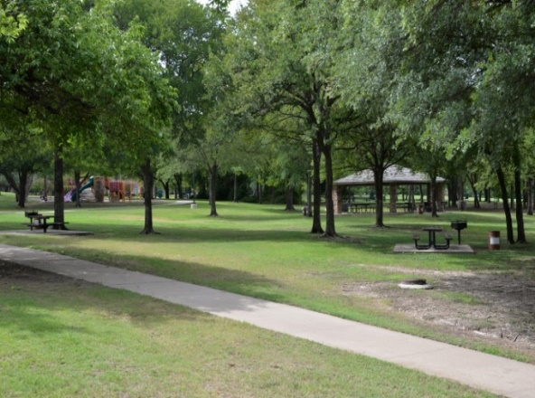
Key Budget Elements for 2018-2019:
Maintenance Activities – Neighborhood Parks
Neighborhood Parks Multi-Year Strategy:
An enhanced FY18-19 maintenance strategy is proposed following an assessment of parks capital assets.
The FY 2018-2019 Proposed Budget includes proposed sustained funding for parks capital asset management, maintenance and repair. For this 2018-2019, 10 neighborhood parks would be impacted:
Park restroom renovation and replacement at several parks including Breckinridge, Terrace, Cottonwood, Huffhines, Foxboro and Lookout parks.
Replacement of tennis court fencing and resurfacing Mimosa, Richland Park and Heights Park.
Replace backstop at Crowley Park.
Replace irrigation system in Huffhines Woods

Slide 18
Key Budget Elements for 2018-2019:
Maintenance Activities - Neighborhood Parks
 | FY17-18 Budget | FY 18-19 Proposed | FY 19-20 Outlook
General Fund Operating | $302,000 | $410,000 | $416,000
Annual C.O. Funding | $132,000 | $0 | $0
½ Cent Dedication of the Tax Rate for Parks Maintenance | $0 | $768,000 | $783,000
G.O. Bonds | $163,000 | $202,000 | $270,000
TOTAL | $597,000 | $1,380,000 | $1,469,000

Slide 19
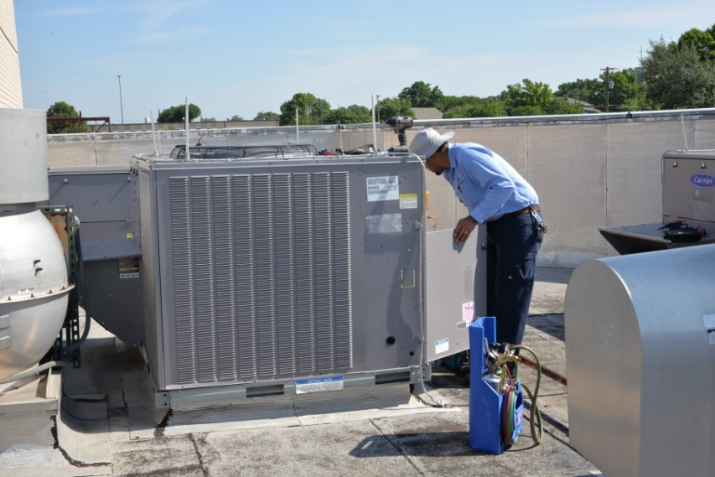
Key Budget Elements for 2018-2019:
Maintenance Activities - Facilities
Facilities Services Renewal/Replacement Strategy:
The FY 2018-2019 Proposed Budget includes funding for:
Preventative maintenance
Annual service contracts
Corrective maintenance
Regulatory certifications
System renewal which includes HVAC system unit replacements, HVAC controls, roofs and lighting upgrades
Additional funding for system renewal is being considered as a component of the 2019 Supplemental C.O. issuance.

Slide 20
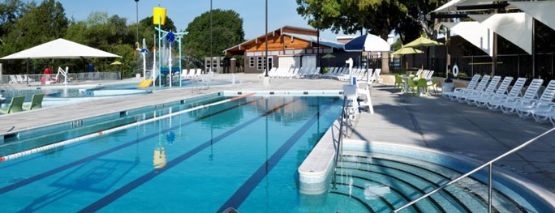
Key Budget Elements for 2018-2019:
Maintenance Activities - Aquatics
Aquatics Maintenance Strategy:
The FY 2018-2019 Proposed Budget includes funding for:
  Terrace Pool – re-plastering
  Terrace Pool – slide replacement
  Pool cover replacement
  Operational items including site and building improvements, refinishing of slide at Height Family Aquatic Center and autofill repairs at Canyon Creek, Cottonwood and Glenville pools

Slide 21
Key Budget Elements for 2018-2019:
Maintenance Activities - Facilities & Aquatics
 | FY15-FY16 Actual | FY16-17 Actual | FY 17-18 Projected | FY 18-19 Proposed
Facilities – General Fund* | $519,000 | $745,000 | $724,000 | $1,168,180
Facilities – C.O. Debt | $234,000 | $0 | $285,000 | $1,000,000
Facilities – Hotel Fund | $376,000 | $343,000 | $238,000 | $75,000
Aquatics – Operations | $0 | $551,000 | $49,000 | $415,000
Aquatics – Short-Term Debt | $46,000 | $440,000 | $216,000 | $192,000
Aquatics – GO Bond | $0 | $322,000 | $0 | $0
TOTAL | $1,175,000 | $2,401,000 | $1,512,000 | $2,850,180
* Includes funding from the General Fund and Special Maintenance Initiatives

Slide 22
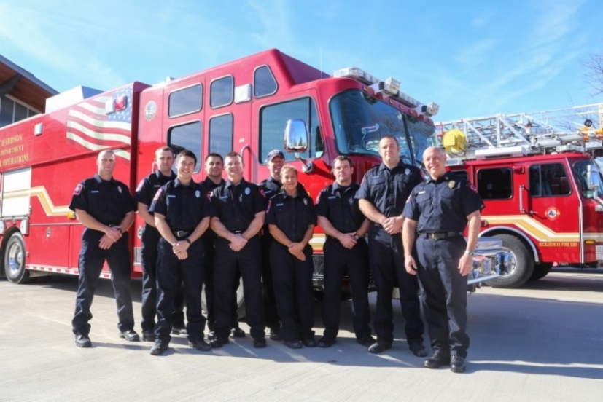
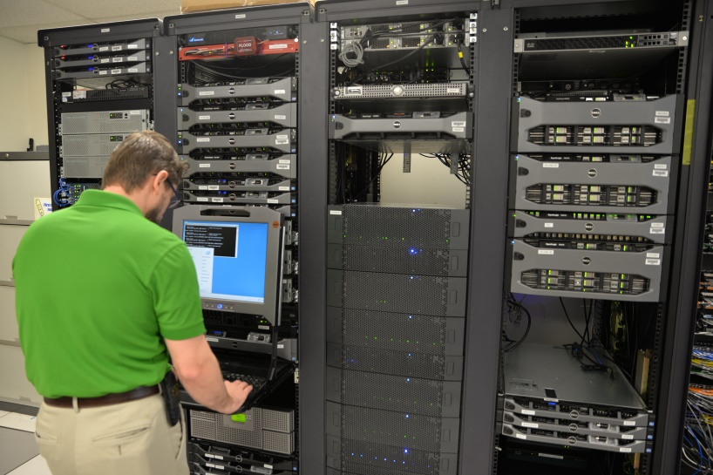
Key Budget Elements for 2018-2019:
Staffing & Compensation
Personal Services comprise the largest expense category of the General Fund. Staff continues to hold open some vacant positions and understaff to assist in managing these expenses.
The City compares salary and benefits information with twelve benchmark cities and uses private sector data (World at Work) to help develop compensation and benefit recommendations.
A 3%, merit based, compensation adjustment is proposed to remain regionally competitive with other communities.

Slide 23
Key Budget Elements for 2018-2019:
Staffing & Compensation
Police and Fire employees are on a step plan. All benchmark cities are on a step plan for sworn Police and Fire employees.
Non-Public Safety employees are in an open range. Progression through the range will be based on performance and annual funding.
Police and Fire salaries are compared both at minimum and maximum pay levels when most plans top out for each position.

Slide 24
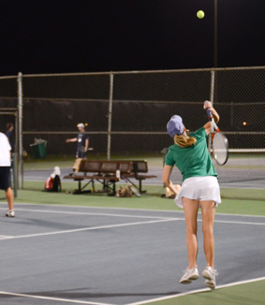
Key Budget Elements for 2018-2019:
Health Benefits
The City’s philosophy for the past four years regarding health insurance is to:
  Ensure the medical plan is financially sustainable
  Remain compliant with the Affordable Care Act
  Offer a medical plan that remains competitive in attracting and retaining employees
This approach has proven to be effective by establishing a stable multi-year health care insurance financial strategy and allowing the City to provide a competitive benefits package
In 2019, the City is continuing its efforts to achieve these goals by:
  Eliminating a PPO medical plan and encouraging employees to migrate to a high deductible medical plan
  Incorporating pharmacy plan design changes that are consistent with consumer driven health care plans
  Increasing premiums for pre-65 retiree plans

Slide 25
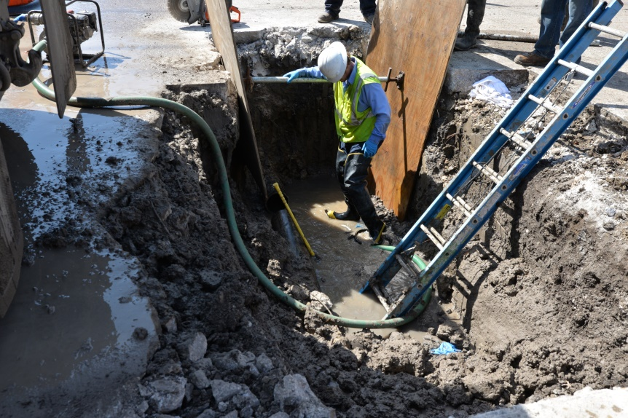
Key Budget Elements for 2018-2019:
Water/Sewer Utility Fund
The North Texas Municipal Water District (NTMWD) wholesale water rate is projected to increase 28 cents/1,000 gallons or $3.08 million for the next fiscal year. In addition, the NTMWD wholesale water rates continue to increase annually through the near future.
The NTMWD and other providers have also increased their wastewater rates to reflect new capacity developments and/or their maintenance initiatives.
Presentations regarding utility fund dynamics were made at the June 4th City Council meeting.
For 2018-2019, a rate adjustment for water and sewer of 9.5% is included in the proposed budget.

Slide 26
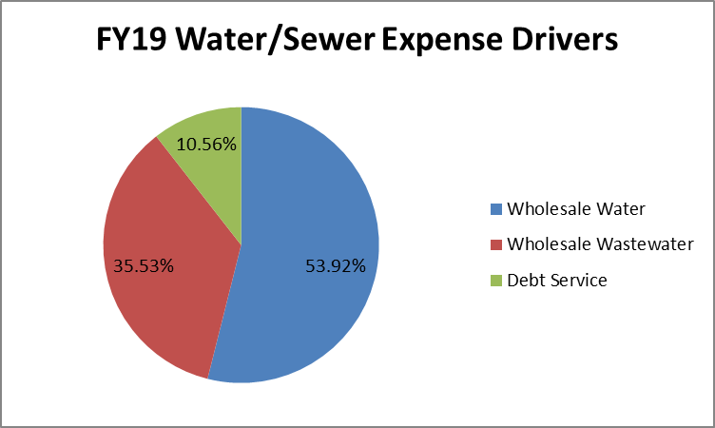
Key Budget Elements for 2018-2019:
Water/Sewer Utility Fund
  Water and Sewer services from our third party providers are both experiencing increased needs and additional mandates and requirements that necessitate additional capital projects. In addition, the City has additional debt service requirements for Water/Sewer Utility Fund capital projects. The chart below demonstrates the impact of these expense drivers that comprise the majority of the increase in Water/Sewer Utility Fund.

Slide 27
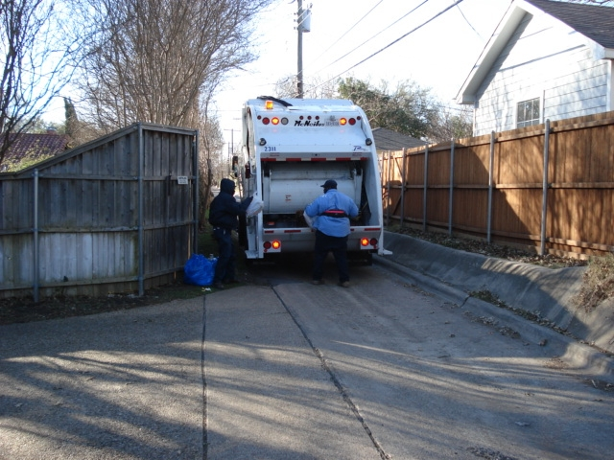
Key Budget Elements for 2018-2019:
Solid Waste Fund
  Expenditures (including transfers) are proposed at $15.0 million, an increase of 1.3% from the prior year.
  The Solid Waste Fund is projected to meet its 90 day fund balance goal in FY 2018-2019.
  Enhanced efforts related to a targeted education campaign for BABIC services and focus on efficiencies related to tracking and responding to these requests will be made.

Slide 28
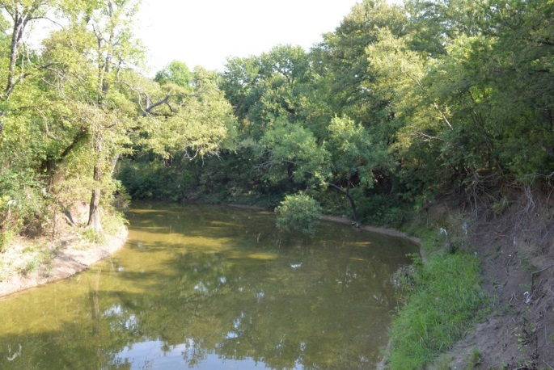
Key Budget Elements for 2018-2019:
Drainage Fund
A presentation of the proposed Drainage Fund was provided at the June 18th City Council meeting. $829,000 of current General Fund expenses related to this program will be supported by the Drainage Utility Fund.
Additionally, about $2.4 million in annual stormwater/drainage capital improvements and contract services will be funded.
The use of these funds is reflected in the Drainage Utility Fund as well as a transferred portion to the General Fund for specific cost-allocated support.
There’s been no rate adjustment since the 2012 implementation of the fee despite cost pressures and peer cities adjustment. Staff recommends deferring any adjustment for FY 2018-2019 as we await anticipated changes from both State and Federal authorities outlining the next era of storm water regulations scheduled for release during FY2018-2019.

Slide 29
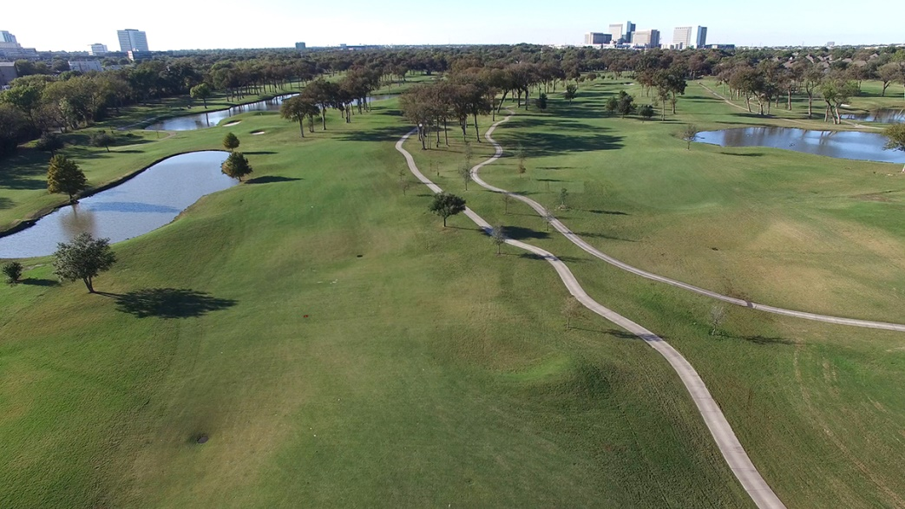
Key Budget Elements for 2018-2019:
Golf Fund
  Expenditures are proposed at $2.32 million.
  Revenues are expected to be $2.36 million.
  It is anticipated that revenues will match expenses and that no transfer will be needed in 2018-2019.
  Capital projects planned for Sherrill Park Golf Course include the replacement of specialized golf maintenance equipment.

Slide 30
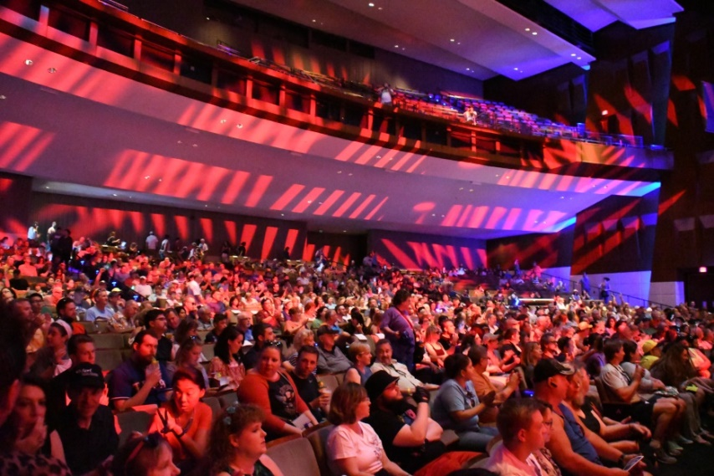
Key Budget Elements for 2018-2019:
Hotel/Motel Fund
  Hotel Occupancy Taxes are similar to prior years. In 2018-2019, these taxes are budgeted at $4.3 million, similar to the prior year.
  Eisemann Center revenues are projected at $2.47 million and parking garage fees are projected at $230,000.
  The need to renew and maintain key equipment and infrastructure at the Eisemann Center and the Galatyn Campus has led to the continuation of a multi-year investment strategy for these assets.
  The proposed budget includes the following key expenditures:
    $160,000 for Galatyn Campus maintenance projects
    $275,000 reserved for future replacement of the Eisemann Center roof
    $75,000 in Eisemann Center facility projects
    $70,000 for replacement of Eisemann Center sound equipment

Slide 31
Key Budget Elements for 2018-2019:
Debt & Capital Program
For 2018-2019, $49.35 million across all funds is under review for the Series 2019 C.O. and G.O. debt program.
    $18.405 million for Year 4 of the 2015 G.O. voter approved projects
    $2.9 million for General Fund capital equipment
    $1.2 million for Information Technology equipment
    $1.975 million for Fire Equipment
    $1.455 million for Solid Waste equipment
    $8.655 million for Utility capital equipment and projects
    $9.710 million for Public Safety, Streets, Parks and Facilities supplement
    $5.05 million for Equipment Replacement Funding Transition Strategy

Slide 32
City of Richardson, Texas
Combined Fund Summaries

Slide 33
FY 2018-2019
Combined Budget
Combined Budget
 | 2017-2018 Estimate | 2018-2019 Budget | Est./Bud. | %
Beginning Fund Balances | $64,951,765 | $68,729,351 | $3,777,586 | 5.8%
Revenues | $275,469,460 | $290,372,025 | $14,902,565 | 5.4%
Expenditures | $271,691,874 | $283,464,544 | $11,772,670 | 4.3%
Ending Fund Balances | $68,729,351 | $75,636,832 | $6,907,481 | 10.1%

Slide 34
FY 2018-2019
Combined Budget
Classification of Combined Operating Fund Expenditures
 |  | Proposed |  | Percent
Operating Expenditures |  | Budget |  | of Total
Personal Services |  | $ 112,650,460 |  | 39.74%
Professional Services |  | 27,727,385 |  | 9.78%
Maintenance |  | 63,164,498 |  | 22.28%
Contracts |  | 25,539,561 |  | 9.01%
Supplies |  | 11,549,554 |  | 4.07%
Capital |  | 1,926,424 |  | 0.68%
Total Operating Expenditures |  | $ 242,557,882 |  | 85.57%
Transfers Out |  | $ 29,615,125 |  | 10.45%
Total Operating Expenditures and Transfers Out |  | $ 272,173,007 |  | 96.02%
Debt Service Payments |  | $ 46,150,333 |  | 16.28%
Less Interfund Transfers |  | $ (34,858,796) |  | -12.30%
Net Appropriations |  | $ 283,464,544 |  | 100.00%

Slide 35
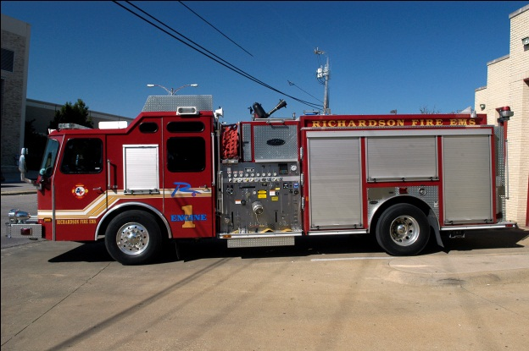
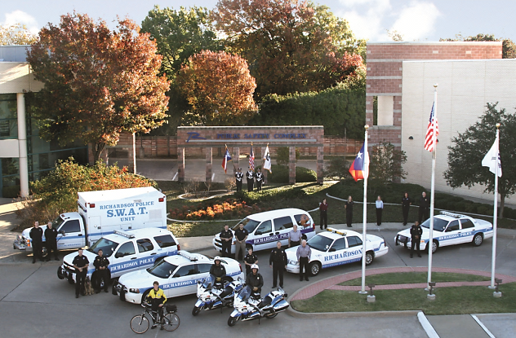
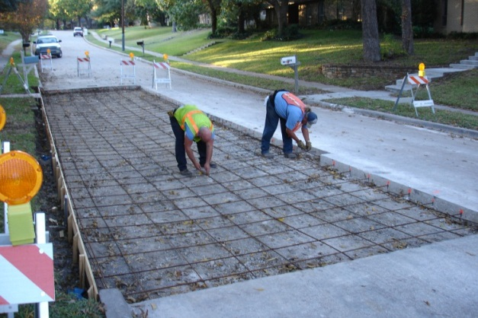
General Fund

Slide 36
FY 2018-2019 General Fund
General Fund Budget
 | 2017-2018 Estimated | 2018-2019 Budget | Est./Bud. | %
Beginning Fund Balances | $22,461,755 | $22,894,708 | $432,953 | 1.9%
Revenues | $130,691,866 | $137,886,387 | $7,194,521 | 5.5%
Expenditures | $130,258,913 | $136,159,899 | $5,900,986 | 4.5%
Ending Fund Balances | $22,894,708 | $24,621,196 | $1,726,488 | 7.5%

Slide 37
2018 Property Tax Analysis
37

Slide 38
Assessed Valuation
Tax Rate Management Considerations:
  Appraisal Increase Components
  General Tax Payer Impact
  Senior Citizen Impact
  Trends and Averages
  Maintenance Realities
  Guidance of Current Law
  Expected Future Legislative Revisions

Slide 39
Required Budget Narrative:
(Front Cover Page )
“This budget will raise more total property taxes than last year’s budget by $8,970,578 (9.20%) and of that amount $1,310,946 is tax raised from new property added to the tax roll this year.”
This specific language is required by the Local Government Code, section 102.005(b). This calculation represents a comparison of certified tax rolls and includes TIF values. In practice and by obligations, a portion of appraised value in the TIF areas are segregated into separate funds and not included in the General Fund O&M and Debt portions of property tax revenue.
This revenue is generated through growth in new value and the reappraisal of existing properties.

Slide 40
Property Tax Increase Explained: $9.0 million

Slide 41
2018 Certified Tax Roll Comparison

Slide 42
2017 Property Tax Rates

Slide 43
Tax Parcel Reappraisals
DCAD 2018 Tax Roll – Percent of Parcels Reappraised
 | 2016 | 2017 | 2018
Residential | 91% | 83% | 90%
Commercial | 22% | 67% | 48%
BPP | 100% | 100% | 100%
All | 88% | 85% | 89%
CCAD reappraises 100% of all parcels each year

Slide 44
Assessed Valuation
Total assessed valuation assumes a $1.3 billion increase in certified assessed valuation plus $187.8 million of “Values in Dispute”, that could be added to the certified roll once the cases have been finalized and allows for deduction of the Tax Increment Financing Districts values of ($1.7 billion).
 | 2017 | 2018 | % Difference
Certified | $15,509,840,625 | $16,850,380,841 | 8.64%
Values In Dispute | $93,387,516 | $187,772,485 | 101.1%
Tax Increment Financing District 1 | ($662,293,996) | ($779,563,666) | 17.7%
Tax Increment Financing District 2 | ($700,186,342) | ($787,119,523) | 12.4%
Tax Increment Financing District 3 | ($62,730,629) | ($109,937,793) | 75.3%
Taxable Value for General Fund Debt and O/M | $14,178,017,174 | $15,361,532,344 | 8.35%
Property Tax Rate
 | 2017-2018 | 2018-2019
Operations & Maintenance (O & M) | $0.37031 | $0.37413
Debt Service | $0.25485 | $0.25103
Total | $0.62516 | $0.62516

Slide 45
Tax Rate Calculations
2018-2019 Tax Rate Calculations
 | Rate | Difference | Revenue
2018-2019 Rate | $0.62516 | - | -
Rollback Rate | $0.62517 | $0.00001 | $1,536
Effective Rate | $0.58485 | ($0.04031) | ($6,192,234)
The tax rate adoption ordinance will refer to what is “effectively an 6.89 percent increase in the tax rate”. This is the percent change of the proposed tax rate $0.62516 above the effective rate $0.58485.
2017-2018 Tax Rate Calculations
 | Rate | Difference | Revenue
2017-2018 Rate | $0.62516 | - | -
Rollback Rate | $0.63316 | $0.008 | $1,134,241
Effective Rate | $0.59135 | ($0.03381) | ($4,793,588)

Slide 46
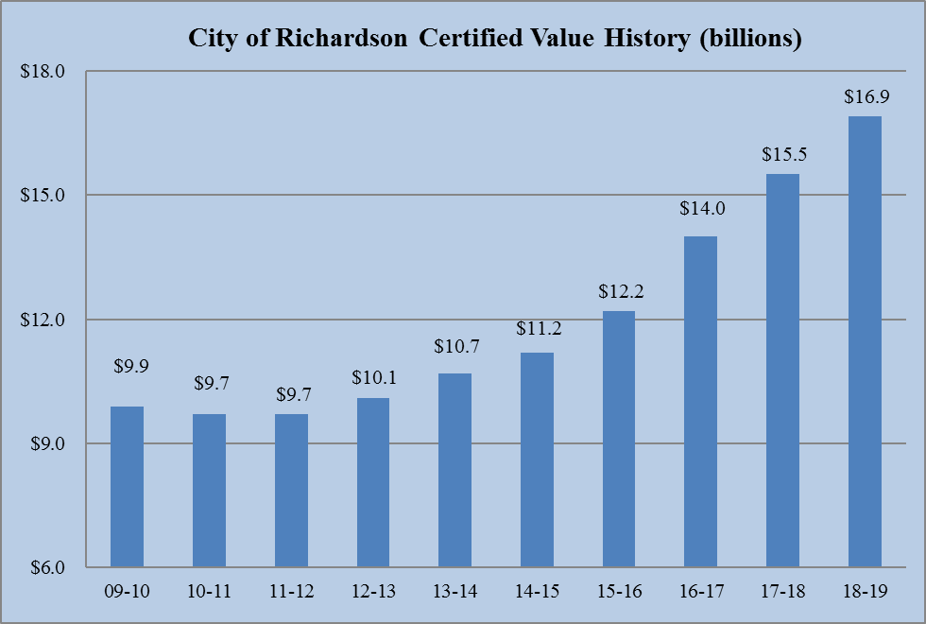
FY 2018-2019
Assessed Valuation

Slide 47
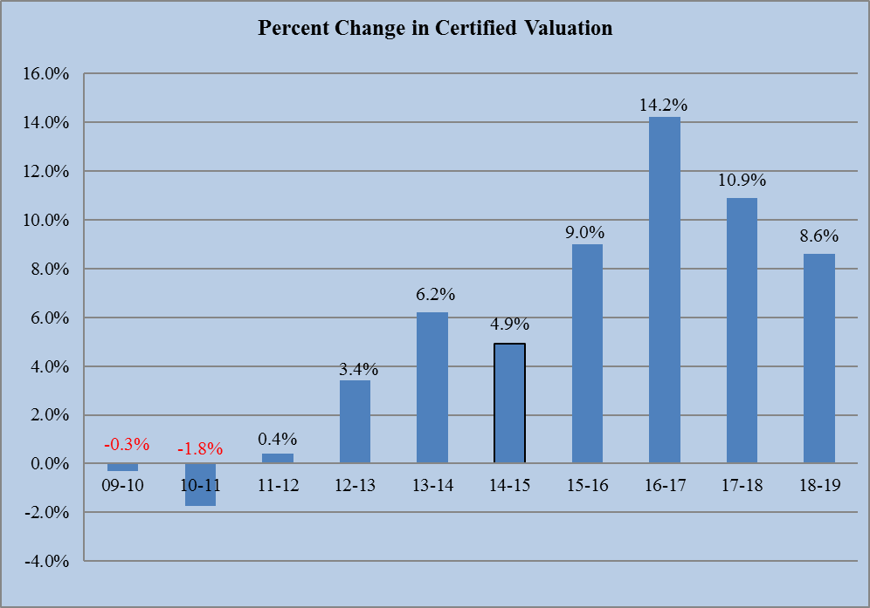
FY 2018-2019
Assessed Valuation

Slide 48
FY 2018-2019
Assessed Valuation
Valuation Including New Improvements
District | 2018 Certified Roll | 2018 New Improvements | %
CCAD | $7,014,752,668 | $286,849,040 | 4.09%
DCAD | $9,835,628,173 | $133,941,250 | 1.36%
Total | $16,850,380,841 | $420,790,290 | 2.50%
Valuation Including New Improvements
District | 2017 Certified Roll | 2017 New Improvements | %
CCAD | $6,434,094,065 | $249,042,857 | 3.87%
DCAD | $9,075,746,560 | $225,039,564 | 2.48%
Total | $15,509,840,625 | $474,082,421 | 3.06%

Slide 49
Tax Roll Increase

Slide 50
Tax Roll Comparison
Tax Roll Comparison
 | 2017 |  | 2018
 | Value | % | Value | % | % Change
Residential | $6,208,971,875 | 40.0% | $6,878,420,600 | 40.8% | 10.8%
Commercial | $8,343,018,022 | 53.8% | $8,891,903,891 | 52.8% | 6.6%
Industrial | $790,355,033 | 5.1% | $906,204,351 | 5.4% | 14.7%
Undeveloped | $167,495,695 | 1.1% | $173,851,999 | 1.0% | 5.0%
Total | $15,509,840,625 | 100.0% | $16,850,380,841 | 100.0% | 8.6%

Slide 51
Percent of Total Value
Percent of Total Value
Tax Year | Residential | Commercial | BPP | Total
2018 | 41% | 42% | 17% | 100%
2017 | 40% | 42% | 18% | 100%
2016 | 41% | 39% | 20% | 100%
2015 | 42% | 40% | 18% | 100%
2014 | 43% | 39% | 18% | 100%
2013 | 44% | 37% | 19% | 100%
2012 | 46% | 36% | 18% | 100%
2011 | 48% | 34% | 18% | 100%
2010 | 49% | 34% | 17% | 100%
2009 | 47% | 36% | 17% | 100%

Slide 52
Top Ten Taxpayers

Slide 53
Change In Residential Market Valuations
Number of Residential Properties Affected by Market Valuation
 | 2017-2018 |  | 2018-2019
Impact | # Properties | % of Total Res. Properties | # Properties | % of Total Res. Properties
No Change | 4,545 | 16.19% | 2,459 | 8.70%
Decrease | 1,056 | 3.76% | 524 | 1.85%
Increase 0% - 5% | 3,999 | 14.24% | 4,369 | 15.46%
Increase 6% - 10% | 4,406 | 15.69% | 6,413 | 22.70%
Increase >10% | 14,071 | 50.12% | 14,488 | 51.28%
Total Res. Properties | 28,077 | 100.00% | 28,253 | 100.00%

Slide 54
Senior Exemption
The City Council took action on February 26th to increase the Over 65 and Disabled Persons tax exemption from $80,000 to $85,000 a year, an increase of $5,000 or 6.3%.
For FY 2018-2019, those receiving the exemption will save an average of $531 in City Property taxes.
At $85,000, the exempted taxes total $4,311,135 with an incremental cost to the General Fund of $352,342 over last year.
    Operations = $210,861 and Debt Service = $141,481

Slide 55
Average Senior Home Value
Average Senior Home Value Statistics
 |  | % Change |  | Average Senior | % Change
Tax | Qualifying | From Year | Senior | Home Market | From Year | % of Total
Year | Parcels | to Year | Exempt. | Value | to Year | Value
2018 | 8,227 | 2.67% | $85,000 | $285,693 | 12.43% | 29.75%
2017 | 8,013 | 1.65% | $80,000 | $254,115 | 10.71% | 31.48%
2016 | 7,883 | 2.38% | $70,000 | $229,526 | 13.52% | 30.50%
2015 | 7,700 | 1.36% | $60,000 | $202,187 | 7.98% | 29.68%
2014 | 7,597 | 2.23% | $60,000 | $187,251 | 3.88% | 32.04%
2013 | 7,431 | 2.17% | $55,000 | $180,265 | 0.93% | 30.51%
2012 | 7,273 | 4.32% | $55,000 | $178,609 | -0.10% | 30.79%
2011 | 6,972 | 3.00% | $55,000 | $178,788 | 0.40% | 30.76%
2010 | 6,769 | 3.14% | $55,000 | $178,079 | -0.49% | 30.89%
2009 | 6,563 | 4.14% | $55,000 | $178,961 | 0.49% | 30.73%

Slide 56
Remaining Revenues

Slide 57
Franchise Fees
Franchise Fees are projected at $17.4 million for FY 2018-2019, an increase of $300,000 or 1.8% over estimated year-end.
  The largest increase this year, $191,000, is projected in the Water and Sewer Franchise Fee based on a rate change proposal to be discussed in more detail when we talk about that fund.
  The Electric Franchise Fee is the next largest increase projected at $74,000 over year-end and is reflective of the standard growth in consumption as well as price fluctuations.
  The remaining fees, budgeted at $5.9 million, increase $35,000 from year end.

Slide 58
Sales and Other Business Taxes
Sales and Other Business Taxes are projected at $37.9 million for next year reflecting an increase of $640,000 or 1.7% from estimated year-end revenues.
  Mixed Beverage and Bingo receipts are anticipated to increase modestly by $3,000 over year-end.
  Sales Tax, the largest of the three in this category, is projected to increase $1.0 million or 2.75% from year-end estimates for “base to base” collections.

Slide 59
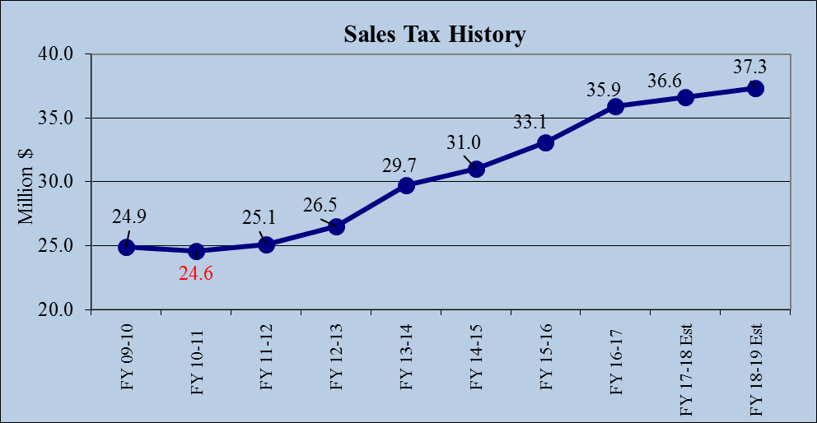
Sales and Other Business Taxes
FY 17-18 | Projected | FY 18-19
Base Actual | Growth Rate | Projected
$ 36,253,534 | 2.75% | $ 37,250,506

Slide 60
Remaining Revenues
License and Permits are projected to increase $44,000 from the year-end estimate of $2.6 million with Building Permits accounting for $25,000 of this growth.
Fines and Forfeits are expected to increase $63,000 to $3.1 million. This projection is based on current citation volume. Revenue in this category is received through the Municipal Court and Library.
Both Interest Earnings and Civic Center revenue are expecting minimal increases totaling $89,000 in FY 2018-2019.

Slide 61
Remaining Revenues
Recreation and Leisure Services revenues are budgeted at $4.2 million, an increase of $44,000 over FY 2017-2018 year-end estimates. The majority of the increase, or $36,000, is expected in Gymnastics Fees.
Other Revenue, Projected at $5.0 million or $122,000 over estimated year-end for FY 2017-2018 with modest increases across most categories
General and Administrative Transfers are projected at $8.9 million, an increase of $318,000 from FY 2017-2018. This increase is tied to inflation as outlined in the indirect cost study by MGT America as well as an $82,000 in the Convention and Visitors Bureau as they return to full staffing.

Slide 62
FY 2018-2019
General Fund Expenditures
Classification of General Fund Expenditures
 |  | Proposed |  | Percent
Operating Expenditures |  | Budget |  | of Total
Personal Services |  | $ 95,615,469 |  | 70.22%
Professional Services |  | 10,190,708 |  | 7.48%
Maintenance |  | 4,919,770 |  | 3.61%
Contracts |  | 8,293,405 |  | 6.09%
Supplies |  | 9,167,011 |  | 6.73%
Capital |  | - |  | 0.00%
Total Operating Expenditures |  | $ 128,186,363 |  | 94.14%
Transfers Out |  | $ 7,973,536 |  | 5.86%
Total Operating Expenditures and Transfers |  | $ 136,159,899 |  | 100.00%

Slide 63
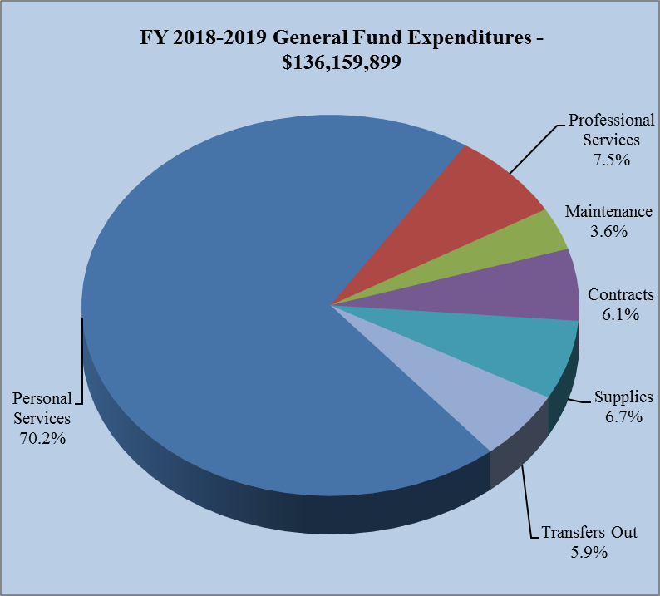
FY 2018-2019
General Fund Expenditures

Slide 64
FY 2018-2019
General Fund Expenditures
Total Expenditures and Transfers for the General Fund are projected at $136.2 million, an increase of $5.9 million from the FY 2017-2018 year-end estimates.
Personal Services – Personnel is always the largest expense and most valuable resource for an organization whose primary purpose is the provision of services to the public. Personal Services are presented at $95.6 million, an increase of 4.1% from the year-end estimate of $91.8 million and account for 74.1% of the total General Fund operating budget. The key personnel issues addressed in this proposal include;

Slide 65
FY 2018-2019
General Fund Expenditures
Public Safety movement within approved pay plan ranges of $1.6 million – In keeping with current market demands, public safety compensation continues to be the primary driver in personnel expense. Effective October 1, 2018, pay ranges for public safety will increase 3% while those employees will continue to progress through their approved pay ranges. This movement is typically on a yearly merit based 5% step plan.
$124,000 for full year funding of the 2 new police officers authorized for partial year last year.

Slide 66
FY 2018-2019
General Fund Expenditures
Understaffing of 10 positions for a total savings of ($629,000) - Understaffing is a way of recognizing savings that occur during the year through normal vacancy rates and is a particularly useful tool in larger, personnel intensive departments like public safety and public services. The City has always understaffed a certain number of sworn and non-sworn personnel in recognition that over the course of 12 months, a certain amount of salary savings is always achieved as employees come and go. The departments do not slow down or otherwise change hiring and staffing objectives, but we recognize the salary savings up front, rather than at the end of the year.

Slide 67
FY 2018-2019
General Fund Expenditures
Non-public safety Open Range adjustment totals $692,000 – Effective last year, non-public safety employees were no longer on the traditional step plan but instead in open range plans. Progression through these ranges depends on performance and available funding. For FY 2018-2019, these employees will be eligible for a 3% merit based increase.
Market Adjustment for $120,000 - Since 1995-1996, the City has proactively reviewed approved pay ranges to insure market compatibility once these ranges have been coordinated with the merit package in an effort to recruit and retain high quality employees.

Slide 68
FY 2018-2019
General Fund Expenditures
Non-Personnel Operations – For FY 2018-2019, Non-Personal Services operating line items are currently proposed at $32.6 million, an increase of $810,000 or 2.6% from year end estimates, maintaining all activities at the same high level of service currently provided.
Professional Services – Increase $400,000 or 4.1% while maintaining, among other things:
  $2.0 million for Parks and Recreation maintenance contracts, an increase of $119,000 from year end and maintains all programs.
  $672,000 for Information Technology Cloud Computing including the move to Office 365, which among other functions, accommodates off-site data storage and disaster recovery functionality, an increase of $116,000
  $118,000 increase in Custodial Services due in part to the new contract provider
  $100,000 to continue the bridge rail maintenance program

Slide 69
FY 2018-2019
General Fund Expenditures
Maintenance – This category will increase $725,000 or 17.3% for FY 2018-2019.
  Facility Maintenance receives additional maintenance funds totaling $680,000 and includes general building maintenance, elevator and heating and cooling system repairs and maintenance. Items of note include;
    $100,000 to upgrade and rehab the Fire Training Tower
    $95,000 for Fire Station 6 HVAC upgrades
    $259,000 for City Hall HVAC ($127,000) and control systems upgrades ($132,000)
    $226,000 for general facility systems maintenance
    In addition to these operating funds, the department will also have $1.0 million of C.O. funded HVAC projects throughout the City as well as $75,000 of Hotel/Motel operating funds for repairs to the Eisemann Center.

Slide 70
FY 2018-2019
General Fund Expenditures
Contracts – Increase $344,000 or 4.3% from year end while maintaining all current service and program levels including;
  The Home Improvement Incentive Program budget will decrease ($35,000) to $1.15 million based on the participation of 176 residents and the preliminary values from the appraisal district. This amount may change once the true value impacts of the properties are assessed. Established by the City Council in February of 2007, the purpose of the Home Improvement Incentive Program is to positively affect the value of the City's housing stock by encouraging reinvestment in residential neighborhoods. Since the program’s inception, over 1,146 projects have applied to take part in the program. Because of these projects, over $74 million dollars has been added to the tax roll. Of that total, just over 300 projects have invested over $100,000 each back into residential housing stock.

Slide 71
FY 2018-2019
General Fund Expenditures
Contracts (continues)
  Funding for special events including the Wildflower Festival, Santa’s Village, Christmas Parade, Family 4th, Huffhines and Cottonwood Arts Festivals continues in this category.
  General liability and vehicle insurance increases $101,000
  $80,000 is provided for the upcoming City election expense

Slide 72
FY 2018-2019
General Fund Expenditures
Supplies Categories – Decrease ($522,000) from year end due to the exclusion of $392,000 of the prior year encumbrances from year end 2017-2018.
Street Rehabilitation – For the last 21 years, the City dedicated a portion of the total tax rate to street rehabilitation. Over the last few years we have been incrementally increasing from the original one cent of the tax rate, to a total last year of two and a half cents. This year that dedication will provide $3.8 million in funding that will allow for ongoing repair, street leveling and crack sealing projects.
  An increase over 2017-2018 of $296,000

Slide 73
FY 2018-2019
General Fund Expenditures
Alley Rehabilitation – The half cent dedication, begun two years ago increases this year to a full penny of the tax rate and will provide $1,536,000 to the rehabilitation program for alleys in similar fashion to the Street Rehabilitation program.
  An increase over 2017-2018 of $827,000
Economic Development – Increased two years ago to 8/10 of a cent, this tax rate dedication will provide $1.2 million for economic development work in FY 2018-2019.
  An increase over 2017-2018 of $95,000

Slide 74
FY 2018-2019
General Fund Expenditures
Parks Maintenance – New for this year, the half cent dedication will provide $768,000 for a multiyear strategy aimed at enhancing parks maintenance items. This first year dedication will include;
    Replace restroom facilities at Huffhines
    Renovate restrooms at Breckinridge, Cottonwood, Lookout, Foxboro and Terrace Parks
    Pavilion B renovation at Breckinridge Park
    Replace/Rehab the Tennis Court chain-link fencing at Richland, Cottonwood, Mimosa and Heights Park
    Backstop replacement at Crowley Park
    Huffhines Woods Irrigation System Replacement

Slide 75
FY 2018-2019
General Fund Expenditures
Equipment Fund – Beginning in FY 2018-19, the City will begin a four year transition from the use of short term Certificates of Obligation for the purchase and replacement of General Fund related machinery, equipment and other capital supplies to a cash financed program. The proposed budget includes the initial General Fund transfer of $600,000 to the Equipment Replacement Fund.

Slide 76
Equipment Replacement Fund
(Millions) | FY 2019 | FY 2020 | FY 2021 | FY 2022
Beginning Balance | $0.00 | $5.05 | $1.68 | $0.00
Short-term Equipment CO | $5.05 | $0.00 | $0.00 | $0.00
Transitional Equipment CO | $5.05 | $0.00 | $0.00 | $0.00
Cash Transfer | *$0.00 | $1.68 | $3.37 | $5.05
Expenses | ($5.05) | ($5.05) | ($5.05) | ($5.05)
Ending Balance | $5.05 | $1.68 | $0.00 | $0.00
* FY 2019 “Early Start” opportunity of $600,000 towards goal

Slide 77
FY 2018-2019
General Fund Expenditures
Fund Balance – The proposed budget ends the year 66.0 days, or 6.0 days over the Council prescribed 60.0 days of fund balance and builds an additional 1.8 days of fund balance above the 64.2 days at year end.
  Each day of fund balance this year equals $373,000
Capital Requests – For FY 2018-2019, funding of capital equipment will be handled through the use of short-term C.O.’s.

Slide 78
Fire Department Enhancements
Vehicles - The department will utilize $1.2 million in 8 year CO’s for a Fire Suppression Apparatus with 78’ Aerial, as well as the purchase of the replacement Ambulance. A replacement chassis for Med-1 will be purchased with $95,000 on a 4-year CO
All Self Contained Breathing Apparatus (SCBA’s) will be replaced with $732,000 of 8-year CO’s
Tactical - In addition to the standard uniform, hose and equipment replacements, the department will also purchase 2 AED replacements.
 | 4 Year CO’s | 8 Year CO’s
Quint - Replacement |  | $ 970,000
SCBA Replacement |  | 732,000
Ambulance - Replacement |  | 270,000
F550 - 4 Wheel Drive Chassis for Med1 - Replacement | 95,000
Fire Hose Replacement | 15,000
Total | $110,000 | $1,972,000

Slide 79
Police Department Enhancements
A replacement for the current 9-1-1 System will be purchased with $720K in special projects funding.
The Department will receive $743K in funding from short term CO’s for vehicle replacement as well as Department issued firearms.
 | 4 Year CO’s | Special Projects Funds
911 System Replacement |  | $720,000
Tahoes - Marked (6) - Replacement | $ 316,000
Interceptor SUV- Marked (3) - Replacement | 141,000
Department issued Rifles | 112,000
Department issued Sidearms | 91,000
Charger - Marked (1) - New | 42,000
Charger - Unmarked (1) – New | 41,000
Total | $743,000 | $720,000

Slide 80
Parks and Recreation Department
In addition to the ½ cent dedication of property tax discussed on slide 73, a total of $1.9 million of park improvements, maintenance projects and equipment/vehicle replacements are planned using $843,000 of our $2.9 million annual CO’s and $1.1 million of operating funds for routine maintenance throughout the park system including irrigation, electrical and plumbing systems.

Slide 81
Parks and Recreation Department

Slide 82
Street Repair and Rehabilitation
This funding allows for the active street maintenance work proposed for FY 2018 2019.
  Funding of $5.3 million includes,
    $5,376,536 from the tax rate dedication.
    $375,500 in operations funding
 | Actual | Estimated | Proposed
 | 2016-2017 | 2017-2018 | 2018-2019
Tax Rate Dedication
Street Rehabilitation Fund | $3,262,709 | $3,544,504 | $3,840,383
Street Rehabilitation Supplement | - | $650,000 | -
Alley Rehabilitation | $652,542 | $708,901 | $1,536,153
Subtotal Tax Rate Dedication | $3,915,251 | $4,903,405 | $5,376,536
Operating Budget
Misc. Street & Alley Concrete Repairs | $220,917 | $199,000 | $200,000
Misc. Asphalt Overlay Projects | $78,437 | $123,000 | $140,000
Screening Fence repairs | $26,065 | $125,000 | $35,000
Subtotal Operating Budget | $325,419 | $447,000 | $375,000
Total Street Rehabilitation and Operating | $4,240,670 | $5,350,405 | $5,751,536

Slide 83
Capital Improvement Plan

Slide 84
FY 2018-2019
Capital Improvement Plan
Amount | Type | Purpose
$2.9 million | CO | General Fund Equipment 4-Yr
$1.2 million | CO | Information Technology Equipment 4-Yr
$1.975 million | CO | Fire Equipment 8-Yr
$14.76 million | CO | General Government Supplement 4/15/20-Yr
$18.405 million | GO | 2015 GO Bond Program 20-Yr
$8.655 million | CO | Water & Sewer CIP 15/20-Yr
$1.455 million | CO | Solid Waste Equipment 8-Yr
$49.35 million | Total

Slide 85
Budget Approach Discussion
Budget Element | Proposed Budget/Same Rate | Alternate/$0.01 Reduction
Base Budget Elements | Per Retreat* | Per Retreat*
Fund Balance Level | 66 days | 66 days
Alley Maintenance *Base at $0.005 $768,077 | +$768,077 Set at $0.01 $1,536,153 | No add Maintain $0.005 $768,077
Parks Maintenance *Base at $400,000 | +$368,077 (add $368,077 to base $400,000) Set at $0.005 $768,077 | +$50,000 (Add only a Balancing $50,000) Set at $0.00293 $450,000
Equipment Fund “Early Start” (Balance net available under Rollback) | $600,000 | $910,000
Reference: Tax Rate | O&M $0.37413 Debt $0.25103 Total $0.62516 | O&M $0.36816 Debt $0.24700 Total $0.61516

Slide 86
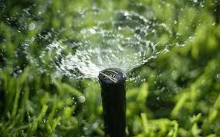
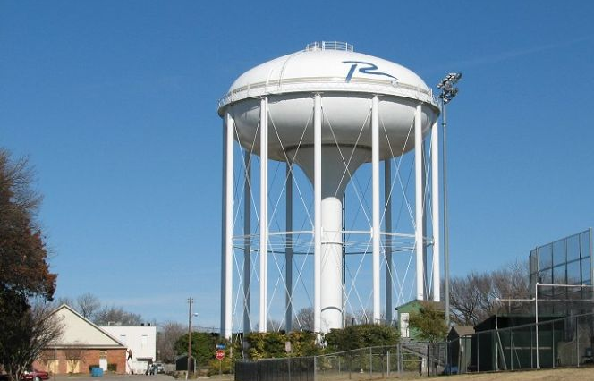

Water and Sewer Fund

Slide 87
FY 2018-2019
Water and Sewer Fund
Water and Sewer Fund Budget
 | 2017-2018 Estimated | 2018-2019 Budget | Est./Bud. | %
Beginning Fund Balances | $16,817,669 | $17,736,813 | $919,144 | 5.5%
Revenues | $78,486,618 | $82,384,222 | $3,897,604 | 5.0%
Expenditures | $77,567,474 | $81,973,145 | $4,405,671 | 5.7%
Ending Fund Balances | $17,736,813 | $18,147,890 | $411,077 | 2.3%

Slide 88
FY 2018-2019
Water and Sewer Fund
Classification of Water and Sewer Fund Expenditures
 |  | Proposed |  | Percent
Operating Expenditures |  | Budget |  | of Total
Personal Services |  | $ 7,100,870 |  | 8.66%
Professional Services |  | 4,197,115 |  | 5.12%
Maintenance |  | 53,371,984 |  | 65.11%
Contracts |  | 1,009,534 |  | 1.23%
Supplies |  | 1,089,117 |  | 1.33%
Capital |  | 313,000 |  | 0.38%
Total Operating Expenditures |  | $ 67,081,620 |  | 81.83%
Transfers Out |  | $ 14,891,525 |  | 18.17%
Total Operating Expenditures and Transfers |  | $ 81,973,145 |  | 100.00%

Slide 89
FY 2018-2019
Water and Sewer Fund Revenues
On June 4, 2018, the North Texas Municipal Water District staff gave City Council an update on the Districts Water Supply Plan and other initiatives. A copy of that presentation and video of the remarks are available on-line at www.cor.net. The presentation called for a 10.0% increase in the cost of wholesale water
Since that presentation, the City received notice of the final 2018-2019 wastewater rates. The letter calls for rate increases, from year end estimates, to both the Regional System and the Upper East Fork System of 12.8% and 18.4% respectively. The total wastewater services costs owed the district increase $1.6 million for 2018-2019. Combined with the $428,000 in increases from Garland and Dallas combined, the total wastewater service costs increase $2.0 million this fiscal year.

Slide 90
FY 2018-2019
North Texas Municipal Water District Supply – Member City Rates

Slide 91
FY 2018-2019
Water and Sewer Fund Revenues
This budget is based on these factors as well as a continued emphasis on the City’s CMOM (Capacity, Management, Operations and Maintenance) program aimed at addressing aging infrastructure through enhanced inflow and infiltration (I&I) abatement efforts and general system maintenance including, but not limited to line and valve repair/replacement.
Projected revenues for FY 2018-2019 are based on a 9.5% rate increase for both the water and sewer retail rates. The increase would go into effect with the first billing in November of 2018.

Slide 92
FY 2018-2019
Water and Sewer Fund Revenues
Revenue from Water Sales and Charges is programmed at $50.6 million representing a 5.5% increase from year-end and is based on a 9.5% increase across all five tiers as well as maintaining twice a week watering for the full year.
Sewer Sales are budgeted at $30.0 million or 4.1% above year-end and includes the 9.5% rate increase. Sewer charges do not apply to irrigation.
Remaining revenues combined increase $88,000 based on a budget of $1.7 million.

Slide 93
Proposed Rate Tiers

Slide 94
Residential Impact
  Sample residential bill increases $9.19/month
  (Based on 8,000 gallons a month from Oct. through May & 18,000 gallons a month for June through Sept.)
  Average residential water bill increases $6.21/month
  Average residential sewer bill increases $2.98/month

Slide 95
FY 2018-2019
Water and Sewer Fund Expenditures
Expenditures and Transfers are proposed at $82.0 million representing an increase of $4.4 million or 5.7% over year-end estimates.
The Maintenance category is the largest operational expenditure in this fund and includes the costs of water and sewer services. The City is not expecting to set a new “minimum purchase,” however we will be charged an additional $0.28/1,000 gallons in the price of wholesale water from the NTMWD. This represents an increase of $3.1 million over last year. For FY 2018-2019, the total cost of wholesale water increases to $33.7 million.
We continue to believe the water rebate program will continue for the foreseeable future. For this reason, we are budgeting the assumption of a NTMWD rebate of $1,000,000 for a total “budgeted” charge for water of $32.7 million.

Slide 96
FY 2018-2019
Water and Sewer Fund Expenditures
Sewer treatment services are expected to increase $2.0 million over the year end estimates of $16.8 million. These increases are due to the combination of the NTMWD rate increases mentioned earlier and increased projected flows in the sewer basins.
Together, the wholesale cost of water and sewer treatment services account for $51.5 million or 62.9% of the total expenses.
Personal Services is proposed at $7.1 million, an increase or 10.6% over year-end estimates and includes full staffing and the merit pay package.

Slide 97
FY 2018-2019
Water and Sewer Fund Expenditures
Professional Services of $4.2 million decrease ($77,000).
  As discussed at the June 4th work session, this proposal includes $3.9 million for the 4th year of the CMOM (Capacity, Management, Operations, and Maintenance) program and includes in this category:
    $2.1 million for condition assessment in the Cottonwood Basin, including video inspection/cleaning and begin video inspection/cleaning in Spring Creek Basin.
    $1.1 million manhole and pipeline rehabilitation in the Floyd and Duck creek basins.
Contracts increase $43,000 or 4.4% from the year end estimate of $967,000.

Slide 98
FY 2018-2019
Water and Sewer Fund Expenditures
Supplies of $1.1 million will decrease ($1.9 million) due to the inclusion last year of $1.9 million in prior year encumbrances. The two largest expenses in this category are electricity at $718,000 and postage for water bills at $142,000.
Continuing the “pay-as-you-go” initiative, $313,000 of capital equipment/vehicle replacements.
Operating Transfer Out sees an increase of $353,000 based on $191,000 in additional Franchise Fee while the BABIC Transfer remains unchanged at $467,000.
The debt service transfer increases $604,000 to $6.1 million to cover debt obligations for this fund.
Fund Balance is projected at 80.8 days, 9.2 days below the City Council approved policy of 90 days.

Slide 99
FY 2018-2019
Water and Sewer Fund Expenditures

Slide 100
Capital Equipment
Item Description |  | Operations
1 Ton Truck w/Service Body (4) Replacement |  | $ 202,000
Creek Annual Repair Program |  | 50,000
Compact Pickup Truck (1) - Replacement |  | 25,000
Compact SUV (1) - Replacement |  | 24,000
Two-Way Clean Out Material |  | 12,000
 |  | $313,000

Slide 101
Infrastructure Maintenance

Slide 102
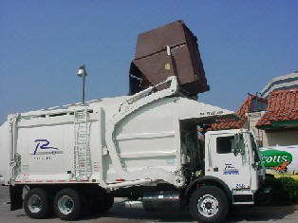
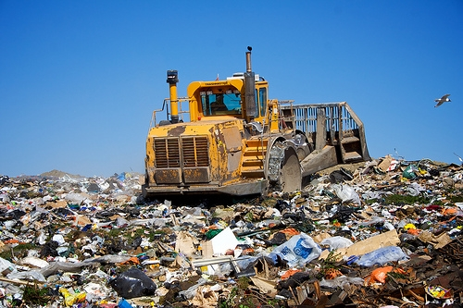
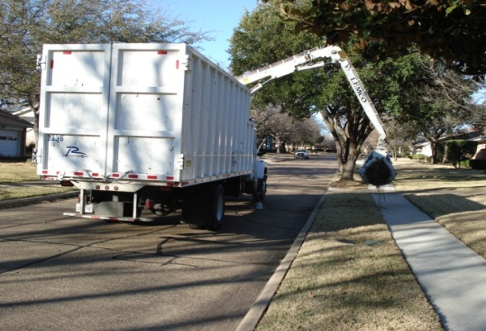
Solid Waste Services Fund

Slide 103
FY 2018-2019 Solid Waste Fund
Solid Waste Services Fund Budget
 | 2017-2018 Estimated | 2018-2019 Budget | Est./Bud. | %
Beginning Fund Balances | $4,046,054 | $4,133,607 | $87,553 | 2.2%
Revenues | $14,925,246 | $14,933,660 | $8,414 | 0.1%
Expenditures | $14,837,693 | $15,026,707 | $189,014 | 1.3%
Ending Fund Balances | $4,133,607 | $4,040,560 | ($93,047) | -2.3%

Slide 104
FY 2018-2019 Solid Waste Fund
Classification of Solid Waste Services Fund Expenditures
 |  | Proposed |  | Percent
Operating Expenditures |  | Budget |  | of Total
Personal Services |  | $ 5,161,682 |  | 34.35%
Professional Services |  | 323,939 |  | 2.16%
Maintenance |  | 4,329,500 |  | 28.81%
Contracts |  | 465,438 |  | 3.10%
Supplies |  | 332,836 |  | 2.21%
Capital |  | - |  | -
Total Operating Expenditures |  | $ 10,613,395 |  | 70.63%
Transfers Out |  | $ 4,413,312 |  | 29.37%
Total Operating Expenditures and Transfers |  | $ 15,026,707 |  | 100.00%

Slide 105
FY 2018-2019
Solid Waste Fund Revenues
Total revenues are projected to be $8,000 over year-end estimates.
Residential Collection Fees are projected to increase $31,000 or 0.5% from their estimated year-end position of $6.1 million with no increase to Residential Collections fees proposed at this time.
The City raised the monthly residential collection fee by $3.00 per month for the FY 2016-2017 budget due to rising costs for service. The current monthly residential fee is $21.00 including tax and $15.56 including tax for seniors. The City receives the pre-tax amounts of $19.40 and $14.37 per month respectively.

Slide 106
FY 2018-2019
Solid Waste Fund Revenues
As seen in the graphic below, the “true cost” of residential service is expected to be $26.91 per month. This means commercial fees continue to subsidize residential collection by $7.51 per month (excluding sales tax), or $90.12 a year for each resident in the City.

Slide 107
FY 2018-2019
Solid Waste Fund Revenues
Commercial Collections Fees are expected to increase 1.0% or $80,000 from year end estimates with no increase to commercial fees proposed at this time. This maintains the City’s goal to be at or just slightly above the market average for the Metroplex.
The BABIC transfer from the Water and Sewer fund will remain at $467,000. This allocation acknowledges the water supply protection provided by the BABIC program.
Other Revenue is projected to decrease -29.7% or ($104,000) after the strong auction revenue received last year.
Interest Earnings are expected to increase 6.0% or $2,000 based on anticipated earnings.

Slide 108
FY 2018-2019
Solid Waste Fund Expenditures
Total expenditures and transfers are proposed at $15.0 million, an increase of $189,000 or 1.3% over the year-end estimate of $14.8 million.
Personal Services increase $115,000 or 2.3% over year-end estimate and includes full staffing and the full year impacts of the merit based pay program.
Professional Services decreases ($119,000) from the year-end estimate as a result of the new recycling contract taking effect in January 2019.
The Maintenance category is projected to increase $70,000 or 1.6% over the year-end estimate and includes nominal increases in tonnage

Slide 109
FY 2018-2019
Solid Waste Fund Expenditures
Contracts and Supplies, with a combined budget of $798,000, increase $49,000 from year end.
The General and Administrative transfer increases $50,000 as a result of the indirect cost allocation study performed by MGT of America.
The Franchise Fee increases $6,000.
The Debt Service Transfer of $1.4 million is $18,000 higher than year-end estimate and represents the current payment due on equipment debt issuance.
FY 2018-2019 fund balance is proposed at 98.2 days. This achieves the goal established in the adopted financial policy of “60 days building towards 90”.

Slide 110

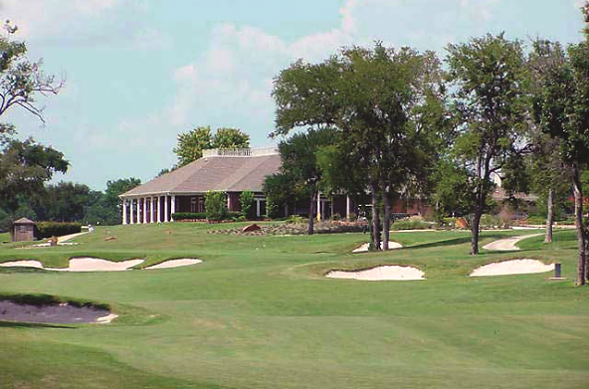
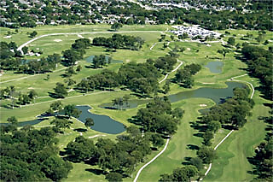
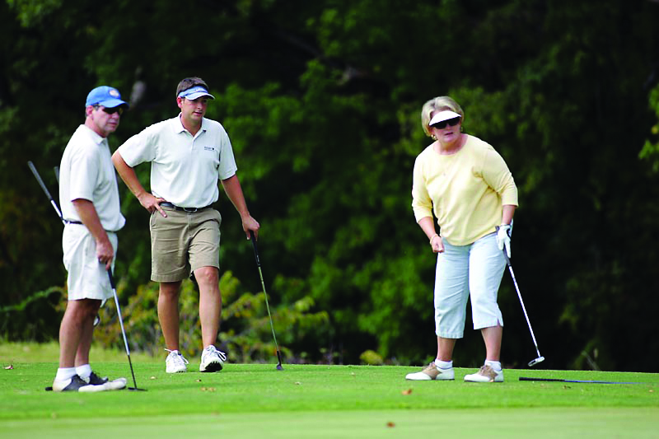
Golf Fund

Slide 111
FY 2018-2019 Golf Fund
Golf Fund Budget
 | 2017-2018 Estimated | 2018-2019 Budget | Est./Bud. | %
Beginning Fund Balances | $196,309 | $144,116 | ($52,193) | -26.6%
Revenues | $2,191,543 | $2,361,577 | $170,034 | 7.8%
Expenditures | $2,243,736 | $2,315,098 | $71,362 | 3.2%
Ending Fund Balances | $144,116 | $190,595 | $46,479 | 32.3%

Slide 112
FY 2018-2019 Golf Fund
Classification of Golf Fund Expenditures
 |  | Proposed |  | Percent
Operating Expenditures |  | Budget |  | of Total
Personal Services |  | $ 1,196,713 |  | 51.69%
Professional Services |  | 236,545 |  | 10.22%
Maintenance |  | 239,688 |  | 10.35%
Contracts |  | 148,191 |  | 6.40%
Supplies |  | 392,275 |  | 16.94%
Capital |  | - |  | -
Total Operating Expenditures |  | $ 2,213,412 |  | 95.61%
Transfers Out |  | $ 101,686 |  | 4.39%
Total Operating Expenditures and Transfers |  | $ 2,315,098 |  | 100.00%

Slide 113
FY 2018-2019 Golf Fund - Revenues
Revenues for the Golf Fund are projected at $2.4 million for FY 2018-2019 representing an increase of $170,000 or 7.8% over year-end.
  Green fees of $1.6 million represents a $162,000 from year-end and includes no change to the current fee structure.
  Cart Fees are projected to increase $19,000.
  The remaining revenues of $115,000 decrease ($11,000) from the year end position due to the insurance reimbursement included last year.

Slide 114
FY 2018-2019 Golf Fund -Expenditures
Total Expenditures and Transfers for the Golf Fund are proposed at $2.3 million, an increase of $71,000 from year-end.
Personal Services increase $74,000 and represents full staffing and pay plan adjustments.
The remaining operational expenditures decrease ($5,000) from year-end estimates of $1.0 M.
The General and Administrative transfer increases $2,000 as a result of the indirect cost allocation study performed by MGT of America,
Given the projected revenue and expenditure performance, the fund balance should end the year with 30.1 days, in compliance with the Council approved financial policy of “30 building to 60 days”.

Slide 115
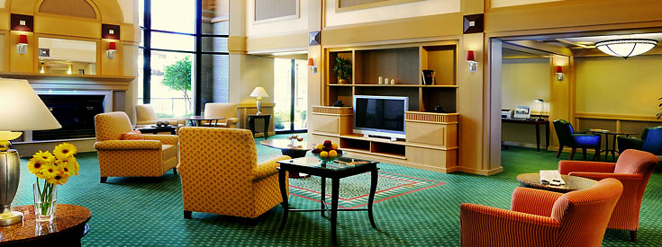
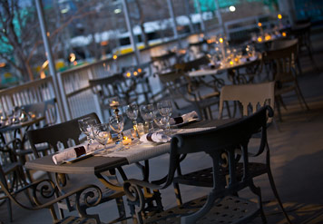
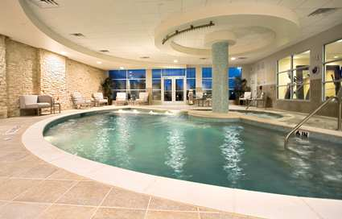
Hotel/Motel Tax Fund

Slide 116
FY 2018-2019
Hotel/Motel Tax Fund
Hotel/Motel Tax Fund Budget
 | 2017-2018 Estimated | 2018-2019 Budget | Est./Bud. | %
Beginning Fund Balances | $2,829,453 | $2,762,449 | ($67,004) | -2.4%
Revenues | $6,525,595 | $7,054,752 | $529,157 | 8.1%
Expenditures | $6,592,599 | $6,652,804 | $60,205 | 0.9%
Ending Fund Balances | $2,762,449 | $3,164,397 | $401,948 | 14.6%

Slide 117
FY 2018-2019
Hotel/Motel Tax Fund
Classification of Hotel/Motel Tax Fund Expenditures
 |  | Proposed |  | Percent
Operating Expenditures |  | Budget |  | of Total
Personal Services |  | $ 2,425,645 |  | 36.46%
Professional Services |  | 1,328,215 |  | 19.96%
Maintenance |  | 179,460 |  | 2.70%
Contracts |  | 1,244,704 |  | 18.71%
Supplies |  | 523,575 |  | 7.87%
Capital |  | 220,000 |  | 3.31%
Total Operating Expenditures |  | $ 5,921,599 |  | 89.01%
Transfers Out |  | $ 731,205 |  | 10.99%
Total Operating Expenditures and Transfers |  | $ 6,652,804 |  | 100.00%

Slide 118
Hotel Occupancy
Year | Occupancy Rate | Average Daily Rate | RevPAR
Oct-May FY17 | 69.82% | $94.04 | $65.94
Oct-May FY18 | 66.52% | $99.11 | $65.93

Slide 119
FY 2018-2019
Hotel/Motel Tax Fund Revenues
Hotel Property | Actual | Budget | Estimated | Budget
 | 2016-2017 | 2017-2018 | 2017-2018 | 2018-2019
Aloft CityLine | $ 15,070 | $ - | $ 288,484 | $ 294,254
Como Motel | 19,667 | 18,325 | 19,039 | 18,658
DoubleTree Hotel | 622,671 | 616,194 | 544,985 | 536,810
Econo Lodge | 68,349 | 69,851 | 73,744 | 76,694
Extended Stay of America | 102,115 | 106,747 | 78,080 | 81,984
Hampton Inn | 132,026 | 186,300 | 183,065 | 192,218
Hawthorne Suites | 69,456 | 68,735 | 62,541 | 61,290
Hilton Garden Inn | 301,963 | 309,265 | 281,197 | 275,573
Holiday Inn | 228,249 | 230,460 | 216,874 | 214,705
Hyatt Regency | 619,518 | 624,934 | 526,923 | 524,288
Hyatt House | 212,863 | 211,417 | 227,098 | 229,369
Marriott Courtyard - Galatyn | 252,736 | 247,243 | 234,765 | 227,722
Marriott Courtyard - Spring Valley | 241,664 | 234,475 | 244,836 | 237,491
Marriott Renaissance | 730,938 | 746,068 | 727,137 | 719,866
Marriott Residence Inn | 222,409 | 220,555 | 214,521 | 210,231
Marriott Springhill Suites | 189,133 | 210,041 | 173,191 | 169,727
Super 8 | 75,226 | 79,552 | 68,992 | 69,682
Wingate by Wyndham | 171,249 | 169,198 | 173,963 | 172,223
National Corporate Housing | 3 | - | 152 | 151
Estates of Richardson | 742 | 705 | 1,227 | 1,215
TOTAL | $ 4,276,047 | $ 4,350,066 | $ 4,340,814 | $ 4,314,151

Slide 120
FY 2018-2019
Hotel/Motel Tax Fund Revenues
Total Revenues for the Hotel/Motel Tax Fund are projected at $7.1 million for next year, reflecting an 8.1% increase in overall revenues.
For 2018-2019, Hotel/Motel Tax Receipts are budgeted at $4.3 million.
New hotel facilities are in various stages of development and may initiate service during this upcoming fiscal year. We will monitor these, but believe that prudent budget efforts should let them initiate service and establish a pattern of collection before we make budget assumptions. These facilities include;
  Drury Inn
  Cambria Inn
  Waterwalk (hybrid hotel/extended stay complex)
Parking Garage fees are projected at $231,000, an increase of $7,000 over year-end.

Slide 121
FY 2018-2019
Hotel/Motel Tax Fund Revenues
Eisemann Center revenues are projected at $2.5 million reflecting a $540,000 increase from estimated year-end reflecting minimal increases in operations and a full program for Eisemann Center Presents revenue for the 2018-2019 Season as briefed to the City Council on May 7.
FY 2018-2019 marks the fifth full year for the Facility/Maintenance Fee. As a reminder this fee is set aside in a separate fund to be used only for maintenance and capital improvements to the facility. This fee is expected to generate $250,000 over the course of the fiscal year.

Slide 122




FY 2018-2019
Hotel/Motel Tax Fund Expenditures
Eisemann Center Operations
Eisemann Center Presents
Convention & Visitors Bureau
Parking Garage
Local Arts Grants

Slide 123
FY 2018-2019
Hotel/Motel Tax Fund Expenditures
Total Expenditures and Transfers for FY 2018-2019 are proposed at $6.7 million reflecting a $60,000 increase from current year-end expenditures.
The Eisemann Center expenditures increase $259,000 from year-end.
  The Eisemann Center’s daily operations increase $40,000.
  Eisemann Center Presents Series expenditures increase $218,000 reflecting a full season as referenced above.
Parking Garage Expenditures are expected to increase slightly by $19,000 next year at $542,000.

Slide 124
FY 2018-2019
Hotel/Motel Tax Fund Expenditures
Eisemann Center Capital/Renewal Expenditures of $145,000 includes;
  $75,000 is planned for joint/crack sealing and general painting
  $70,000 for replacement of sound processors throughout the facility
Galatyn Campus Renewal of $160,000 includes;
  $10,000 for wayfinding signs
  $150,000 is budgeted for plaza improvements/repairs including tree grates and retaining walls repair, bollards, tree replacement/ relocation, irrigation improvements, pavement delineation, and site furnishings
Arts Grants funding are programmed at $375,000 for the 2018-2019 budget, reflecting no change from FY 2017-2018.

Slide 125
FY 2018-2019
Hotel/Motel Tax Fund Expenditures
Miscellaneous expense of $71,000 includes event advertising, the Hotel/Motel Fund share of the citywide audit expense, arts website maintenance and smaller miscellaneous expenses.
The Transfer to General Fund – CVB matches the department budget at $381,000.
The Hotel/Motel G&A remains static at $350,000 and reflects the services provided by the General Fund for these activities.
The Fund Balance is projected to end the year at $2.0 million net of $725,000 set aside for future roof replacement and $450,000 for entrance portals to the Spring Creek Nature area

Slide 126
Other Fund Highlights
Pages 24 through 53 of the filed budget represent all remaining funds for the City of Richardson including the Special Revenue, Internal Service and Capital Funds.
  Tax Increment Financing Districts (pages 38-40) experienced AV growth of 17.6% over the prior year to $1.7 billion generating $10.5 million in property tax revenue which is tied to reimbursement obligations inside the respective zones.
  The Economic Development Fund (page 48) was established in FY 14-15 to receive the tax rate allocation for economic development programs.

Slide 127
Other Fund Highlights
Drainage Fund (page 28) is programmed at $3.2 Million.
  $1.1 Million in contract services will provide:
    Storm Drain Pipe Inspection, Cleaning and Repair
    Inlet Inspection and Cleaning
    Street Sweeping
    Open Channel Maintenance
      Semi-annual rotation (one site)
      Bi-annual rotation (two sites)
      Addition sites as needed
  $1.25 Million is programmed for flood prevention and storm drain improvements at the following locations:
          Dorothy Drive Drainage Improvements
  No Fee Adjustment Proposed

Slide 128
Summary
The 2018-19 budget will be the sixth year of an intensive focus on enhanced infrastructure maintenance.
Prior budgets initiated articulate plans and dedicated funding strategies to foster enhanced street, traffic, and roadside amenity maintenance.
  This 2018-19 budget adds the next year of enhanced infrastructure maintenance initiatives and increases resources for neighborhood parks while maintaining the current tax rate.
We appreciate the budget dialogue with the City Council over the last several months.

Slide 129
Next Steps
Further opportunities to provide access and to gain public input are scheduled before final adoption.
  Web, City Secretary & Library copies of the filed budget provided
  Public Hearing on the Property Tax Rate on August 20, 2018
  Public Hearing on the Budget and Tax Rate on August 27, 2018
  Budget Adoption on September 10, 2018
Video replay of the Council Budget Workshop held July 16 – 17 is available on-line through web/cable access

