Slide 1


FY 2020-2021
First Quarter Budget Report
February 8, 2021

Slide 2


Presentation Overview
Review of the first quarter performance of the City’s five main operating funds
  General Fund
  Water and Sewer Fund
  Solid Waste Services Fund
  Golf Fund
  Hotel/Motel Tax Fund
The focus is on the first quarter performance of revenues and expenditures against the same period last fiscal year

Slide 3
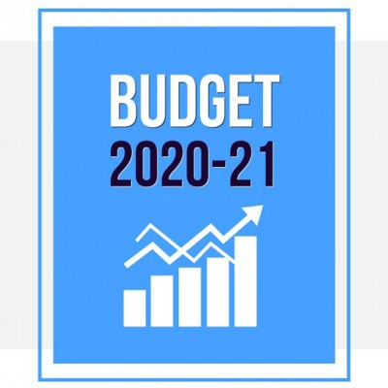
General Fund
The largest of the City’s five operating funds
Provides for basic services like public safety, parks, health and community services and administration
Revenue from property taxes, sales taxes and franchise fees typically make up 80-85% of the fund’s total revenues

Slide 4
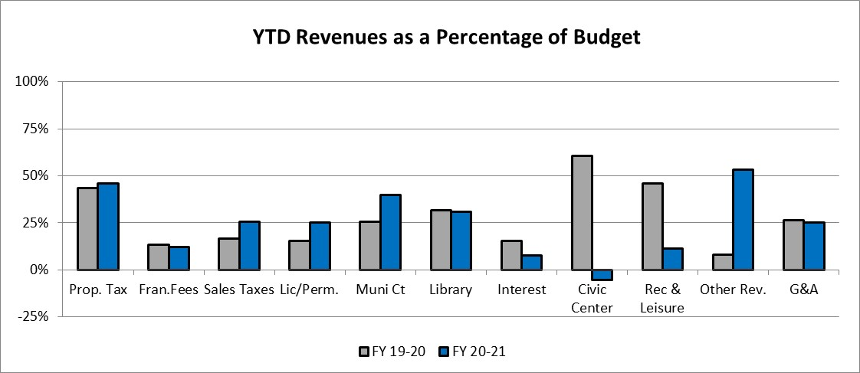
General Fund Revenues
In response to the COVID-19 pandemic, the City took a conservative approach to all revenues as part of the budget development process for FY 2020-2021
Total revenues of $44.7M, or 34.24% of the original budget compared to $42.4M, or 27.69% of FY2019-2020 YTD actual collections

Slide 5
Property Taxes
Property Tax collections of $28.5M through the first quarter are 45.91% of the budget compared to $27.4M or 43.64% of last year’s total collections
  The increase is reflective of not only the growth in the tax base, but also the timing of receipt of the large tax remittances from the mortgage companies
  Property Taxes are not delinquent until February 1
  Reminder that the adopted budget was based on a Certified Tax Estimate, with the final Certified Tax Roll being received after budget adoption
    Certified Estimate: -1.81% decrease
    Certified Tax Roll: 4.81% increase

Slide 6
Sales Taxes
Sales and Other Business Tax collections of $7.8M represent 25.37% of the budget, or $516K over last year
  The First Quarter ends with Sales Tax $629K over last years actual, $2.6M over the budget target, and $489K over last years “base-to-base” collections

Slide 7
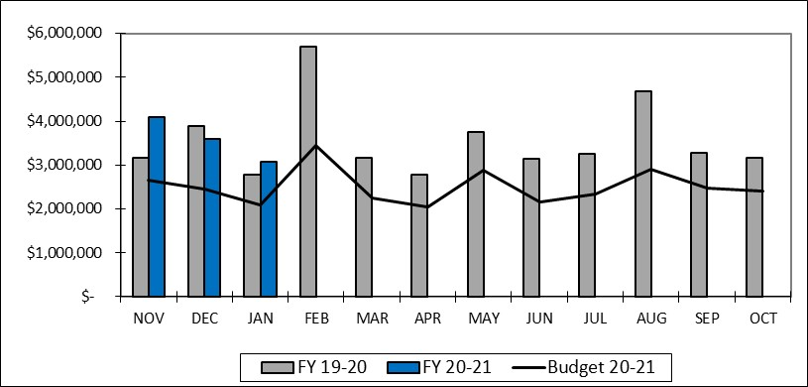
Sales Taxes
Not part of this report, the January 2021 remittance has been received
  After 3 months of collections, Fiscal Year 2020-2021 is $926K over last year’s actual, $3.6M above the original budget, and $304K above “base-to-base”

Slide 8
Franchise Fees
YTD Franchise Fees of $2.1M represent 12.17% of the original budget, down slightly from last year’s collections of $2.3M or 13.44% last year
  The 1st quarter payment of the electric franchise fee is not due for receipt until mid-February
  Telecommunications franchise fees continue to decline as residential accounts eliminate their landline. Down below last year but in line with what was anticipated this year
  Cable Franchise Fees continue to decline as we begin to see the impact of HB 1152. This subcategory has declined from $274K last year to $144K this year

Slide 9
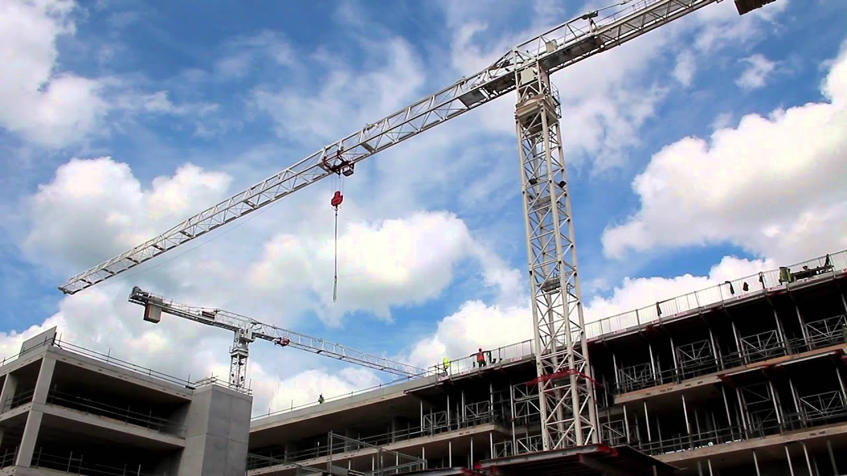

License and Permits
License and Permits of $514K represent 25.02% of the budgeted $2.1M compared to the $421K or 15.40% of last years actual of $2.7M
  Includes permits for Texas Instruments, Richardson Industrial Park and West Coast University

Slide 10
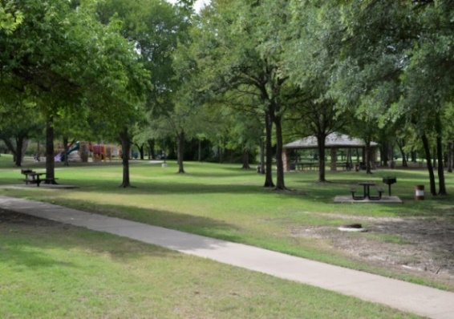
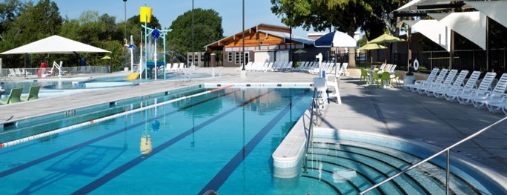
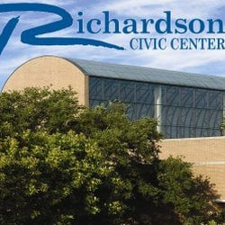
Parks and Leisure and Civic Center Revenues
Parks and Leisure revenues of $268K represent 11.26% of the original budget of $2.4M, which is down from $664K through the first quarter last year
  The budget for parks revenues is based on limited facility and program offerings through the first half of the year with a modest recovery beginning in the second half of the fiscal year
Civic Center revenues reflect a hold on facilities bookings as a result of the current pandemic

Slide 11
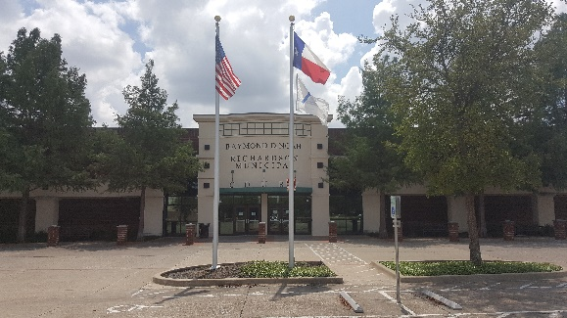

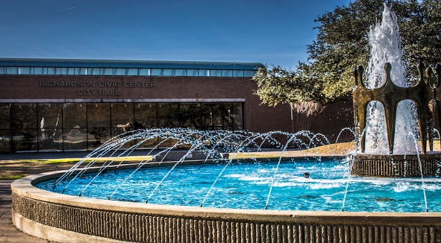
Remaining General Fund Revenues
Municipal Court revenue of $717K represent 39.76% of the budgeted $1.8M compared to the $739K or 25.74% of last years actual of $2.8M. Budget based on conservative ticket activity
Library fines are even with last year and with budgeted expectations
The Other Revenue category revenue of $2.5M represents 53.35% of the budgeted $4.7M. Included in the $2.5M is $1.4M of additional CARES funding that was not factored into this year’s budget
General and Administrative Charges are even with budget expectations

Slide 12
General Fund Expenditures
YTD Expenditures for Fiscal Year 2020-2021 of $44.5M represent 33.21% of the budgeted expenditures, compared to $43.0M or 30.55% of the year-end actual last year
  The Contracts category expenses of $2.2M includes $394K for COVID-19 related expenses that are covered through a reserve of fund balance
    Reserve for COVID-19 related expenses totals $3.8M
  Expenses in the Supplies category increase $1.6M over this time last year as the result of recording $1.8M in expenses related to prior year encumbrances that are also covered by a reserve of fund balance
    Reserve for Prior Year Encumbrances related expenses totals $4.2M
  The entire transfers out that support Street and Alley Rehabilitation, the Equipment Replacement Fund, as well as the Parks Maintenance and Economic Development Fund allocations are now made at the beginning of the year as opposed to monthly in previous years

Slide 13
Water and Sewer Fund
An enterprise fund and the second largest of the City’s five operating funds.
Provides for administration, operation and maintenance of the City’s water and wastewater system.
Revenue from water and sewer sales make up 98% of the fund’s total revenues.
Expenses for wholesale water and sewer treatment services make up about 65% of the fund’s total expenses.

Slide 14
Water and Sewer Fund Revenues
Total Water and Sewer Fund Revenues through the first quarter of FY 2020-2021 are $21.7M, or 24.93% of the budget compared to $23.3M or 26.72% of the year-end actual last year

Slide 15
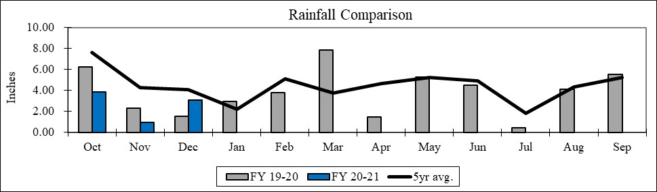
Rainfall
The following graph compares rainfall YTD of 7.90” compared to last years 10.11” and the 5-year average 15.97”

Slide 16
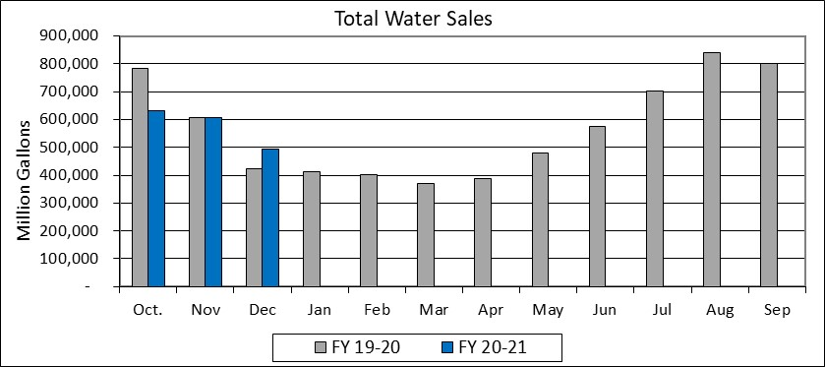
Water Sales
The following graph compares total water sales, in 1,000 gallon increments, by month for both this year and last year

Slide 17
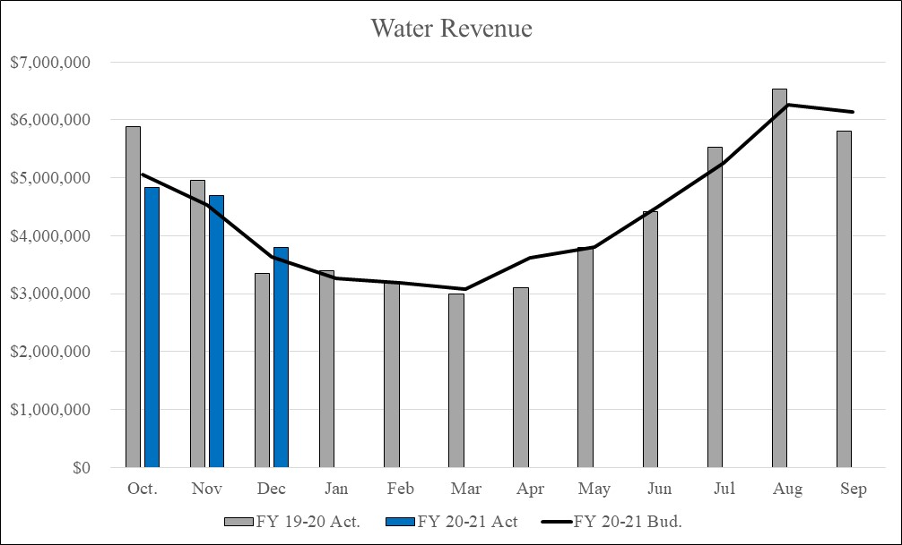
Water Revenue
Water Revenues $13.3M represent 25.43% of the budget compared to $14.2M or 26.8% last year

Slide 18
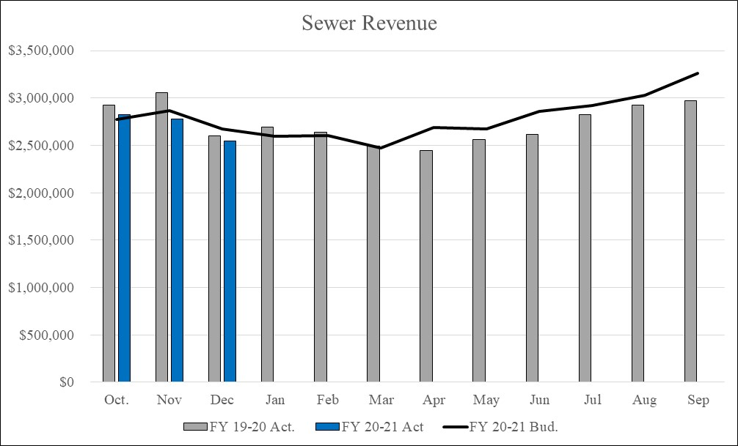
Sewer Revenue
Sewer Revenues $8.1M represent 24.38% of the budget compared to $8.6M or 26.2% last year

Slide 19

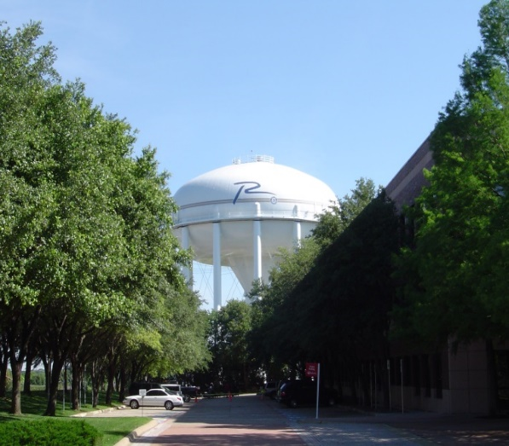
Remaining Water and Sewer Fund Revenues
The remaining revenues in the Water and Sewer fund of $200K through the first quarter are $312K below this time last year
  Late Fees are currently being waived
  Interest Earnings through the first quarter total $28K compared to $94K at this point last year due to lower interest rates
  Installation Charges of $11K are even with last year
  Other miscellaneous charges are $63K above last year

Slide 20
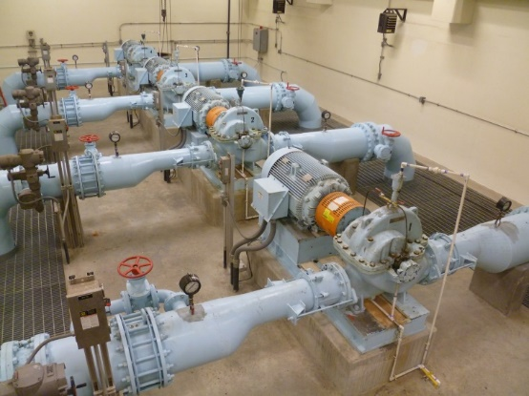
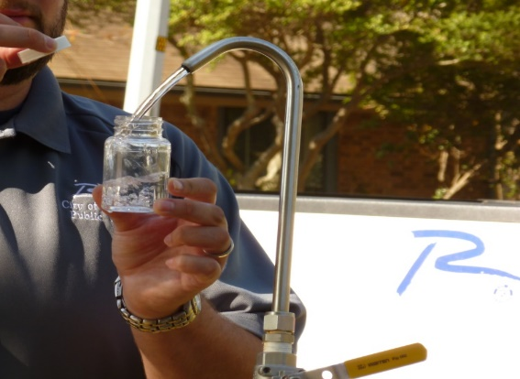
Water and Sewer Fund Expenditures
Total Expenditures and Transfers for the Water and Sewer Fund of $20.3M represent 23.62% of the budgeted $86.1M compared to last years $17.6M or 20.64% of last years actuals
  Year-to-date Maintenance expenditures are $2.2M above last year due to the timing of recording the payment to the NTMWD last year. The category is even with last year when accounting for the timing issue
  All other expenditure categories are within established parameters for their category

Slide 21

Solid Waste Services Fund
An enterprise fund and the third largest of the City’s five operating funds.
Provides for residential and commercial solid waste collection services, including recycling and bulky item collection.
Revenue from solid waste collections make up 95% of the fund’s total revenues.
Disposal fees make up 25% of the fund’s total expenses.

Slide 22
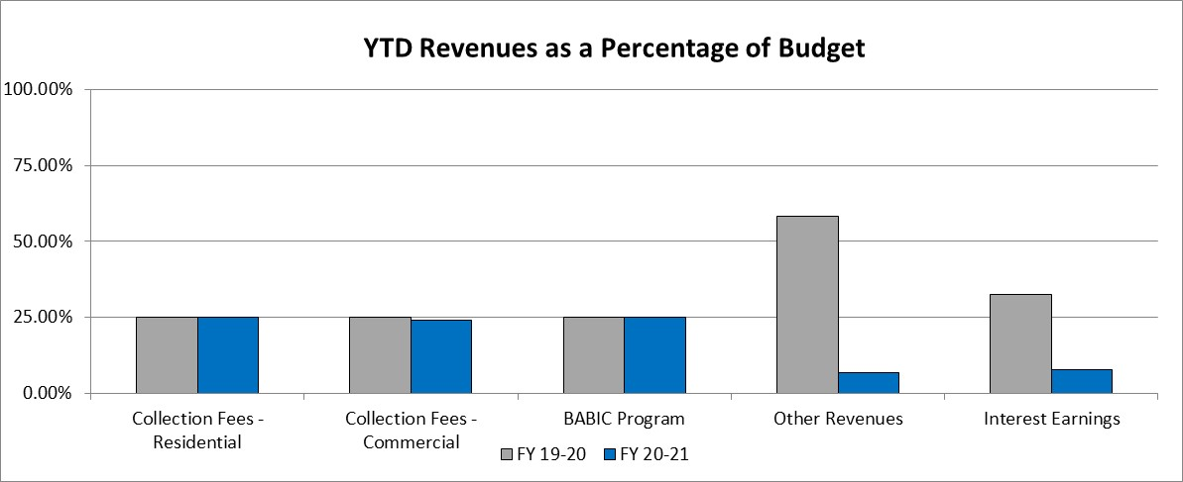
Solid Waste Services Fund Revenues
Total Solid Waste Services Fund Revenues through the first quarter of FY 2020-2021 are $3.7M, or 23.95% of the budgeted $15.5M compared to $3.9M or 25.68% of the year-end actual last year

Slide 23
Solid Waste Services Fund Revenues
Residential collections of $1.5M are even with last year
Commercial collection fees of $2.1M are ($23K) below last year
Other Revenue category is ($166K) below last year. The majority of this decrease, or $141K, is due to auction revenue received in the first quarter of last year
Interest Earnings through the first quarter total $4K compared to $13K at this point last year due to lower interest rates
The BABIC program support from the Water and Sewer Fund of $167K is even with last year

Slide 24
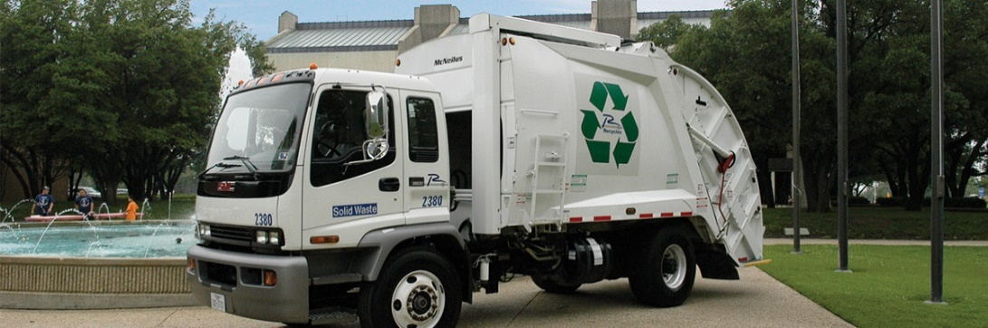
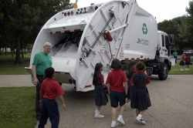
Solid Waste Services Fund Expenditures
YTD expenditures of $4.3M are 27.98% of the budget compared with 27.53% or $4.2M of the year-end actual at this time last year
All expenditure categories are performing within established parameters

Slide 25
Golf Fund
A special revenue fund.
Provides for the administration, operations and maintenance of Sherrill Park Golf Course.
Revenue from green fees make up roughly 65% of the fund’s total revenues.
Personal services expenses make up roughly 50% of the fund’s total expenses.

Slide 26
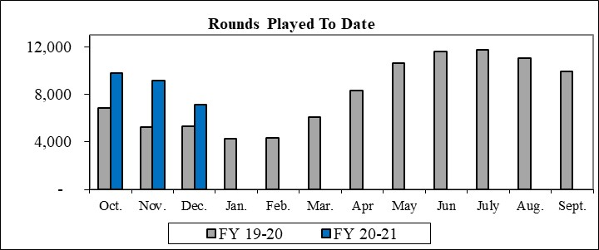
Golf Fund Revenues
Total Golf Fund Revenues through the first quarter of FY 2020-2021 are $808K, or 34.59% of the budgeted $2.3M compared to $531K or 18.02% of the year-end actual last year

Slide 27

Golf Fund Revenues
Green Fees of $553K are $195K over last year actuals and $251K over the budgeted target for the year
Cart Fees of $216K are $71K over last year and $78K over expected FY21 target
Remaining revenues of $39K are $10K over last year

Slide 28
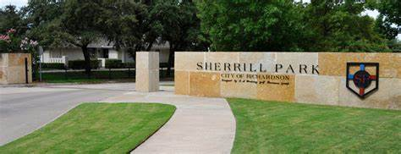
Golf Fund Expenditures
Total Expenditures and Transfers of $598K represent 25.88% of the budgeted $2.3M
All expenditure categories are within established first quarter parameters

Slide 29
Hotel/Motel Tax Fund
Provides for the administration, operations and maintenance of the Charles W. Eisemann Center, parking garage, Convention and Visitors Bureau and annual grants to local arts organizations.
Revenue from hotel/motel occupancy taxes and revenue from the operation of the Charles W. Eisemann Center and Parking garage are the main sources of the fund’s total revenues.
Eisemann Center operations historically make up roughly 75% of the fund’s total expenses.

Slide 30
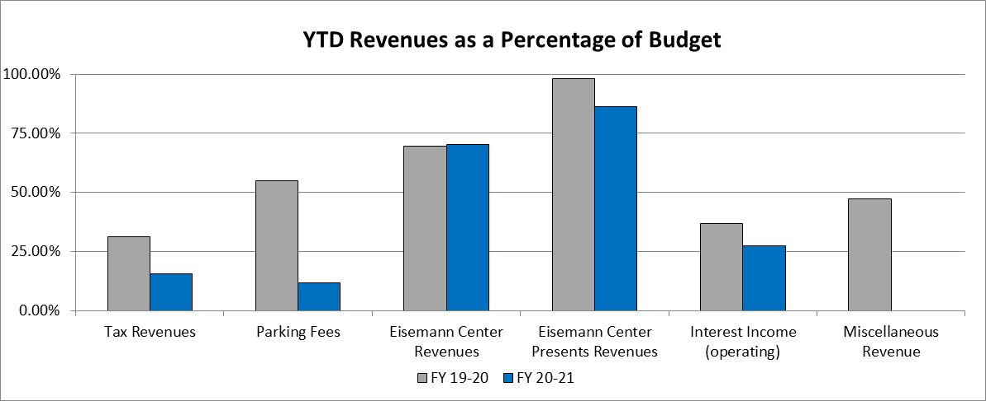
Hotel/Motel Tax Fund Revenues
Total revenues of $358K, or 21.44% of the original budget compared to $1.6M, or 35.10% of FY2019-20 YTD actuals

Slide 31
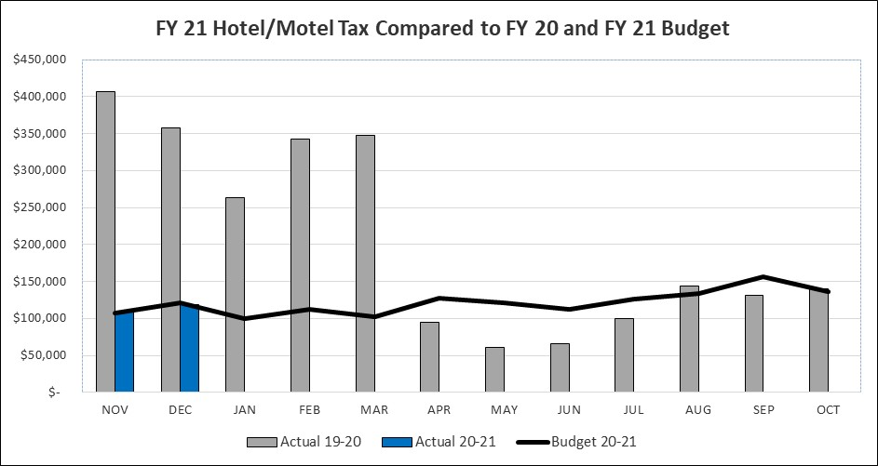
Hotel/Motel Tax Revenues
Hotel occupancy taxes of $228K are ($536K) below last year but even with the budgeted target through the end of the first quarter

Slide 32
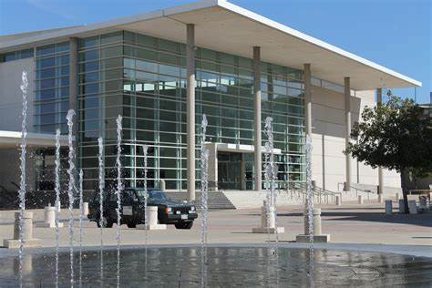
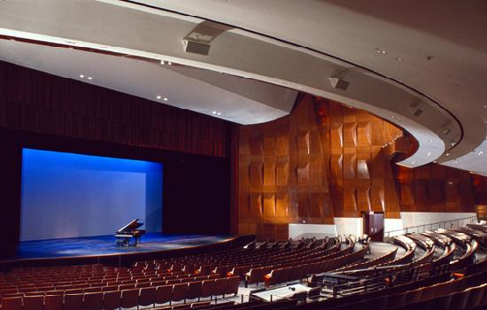
Eisemann Center Revenues
  Eisemann Center and Eisemann Center Presents Revenues of $117K represent 75.91% of the original budget
    The budget is based on conservative booking assumptions
    Eisemann Center revenues of $70K includes bookings for both the Richardson and Plano Symphony Orchestras, various dance recitals and from the Eisemann Center’s streaming offerings
    Eisemann Center Presents revenue of $46K is mainly related to the recently cancelled Keyboard Conversations. The majority of this revenue will likely be refunded in the coming months
  Remaining revenues are performing as expected

Slide 33

Hotel/Motel Tax Expenditures
Total expenditures of $867K, or 29.85% of the original budget compared to $1.8M, or 38.77% of FY2019-2020 YTD actuals
  Eisemann Center is working with arts organizations on options for hosting performing arts offerings in a “modified environment”
  All expenditures are performing as expected

Slide 34


