Slide 1


FY 2020-2021
Second Quarter Budget Report
May 17, 2021

Slide 2


Presentation Overview
Review of the second quarter performance of the City’s five main operating funds
  General Fund
  Water and Sewer Fund
  Solid Waste Services Fund
  Golf Fund
  Hotel/Motel Tax Fund
The focus is on the second quarter performance of revenues and expenditures against the same period last fiscal year
This presentation also includes additional insight on the Hotel/Motel Tax Fund in preparation for the FY21-22 budget discussions this summer

Slide 3
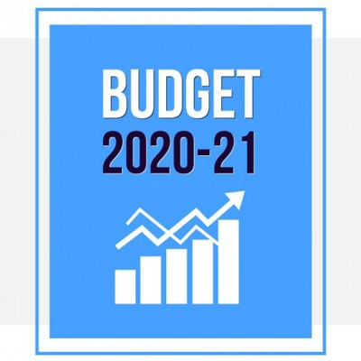
General Fund
The largest of the City’s five operating funds
Provides for basic services like public safety, parks, health and community services and administration
Revenue from property taxes, sales taxes and franchise fees typically make up 80-85% of the fund’s total revenues

Slide 4
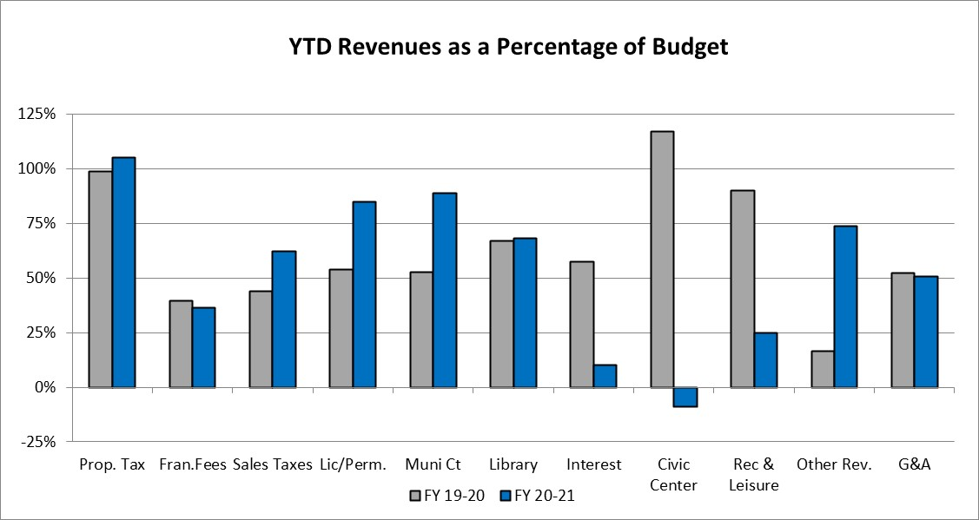
General Fund Revenues
In response to the COVID-19 pandemic, the City took a conservative approach to all revenues as part of the budget development process for FY 2020-2021
Total revenues of $102.6M, or 78.6% of the original budget compared to $99.4M, or 64.99% of FY2019-2020 YTD actual collections

Slide 5
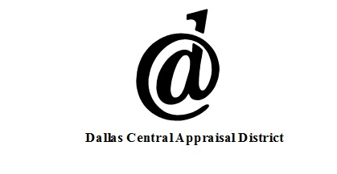

Property Taxes
Property Tax collections of $65.3M through the second quarter are 105.3% of the budget compared to $62.0M or 98.8% of last year’s total collections
  Property Taxes make up of 47.5% of the City’s budgeted revenues
  Reminder that the adopted budget was based on a Certified Tax Estimate, with the final Certified Tax Roll being received after budget adoption
    Certified Estimate: -1.81% decrease
    Certified Tax Roll: 4.81% increase

Slide 6
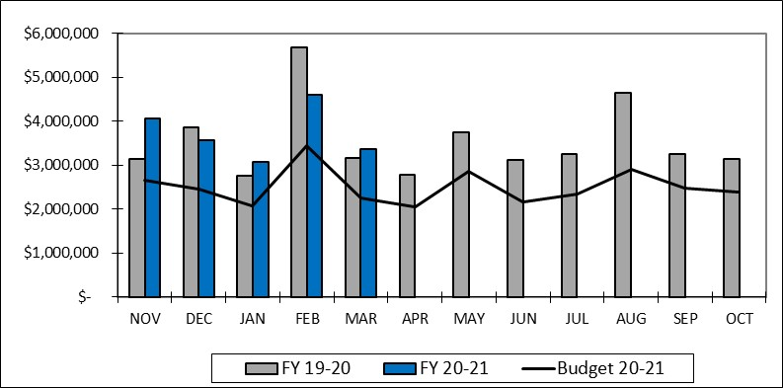
Sales Taxes
Sales and Other Business Tax collections of $19.0M represent 62.1% of the budget and even with last year
  The Second Quarter ends with Sales Tax $48K over last years actual, $5.8M over the budget target, and ($409K) below last years “base-to-base” collections

Slide 7
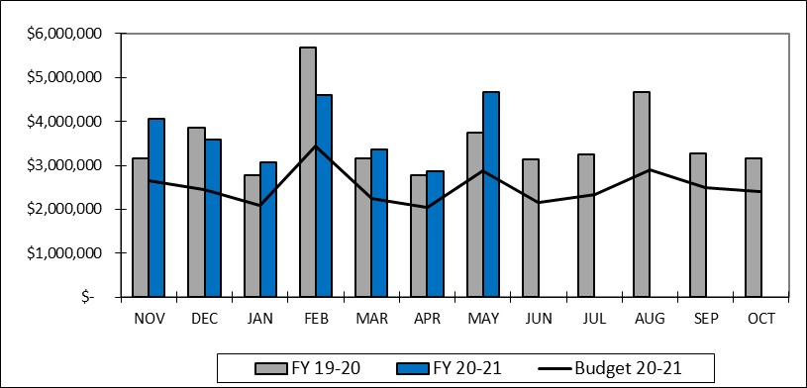
Sales Taxes
Not part of this report, both the April and May 2021 remittance have been received
  After 7 months of collections, Fiscal Year 2020-2021 is $1.1M over last year’s actual, $8.4M above the original budget, and $673K above “base-to-base” collections

Slide 8
Franchise Fees
YTD Franchise Fees of $6.1M represent 36.2% of the original budget, down from last year’s collections of $6.9M or 39.4% last year
  The electric franchise fees of $1.8M is down from $2.0M through this point last year
  Telecommunications franchise fees continue to decline as residential accounts eliminate their landline. Down below last year and slightly behind what was anticipated this year
  Cable Franchise Fees continue to decline as we begin to see the impact of SB 1152 from the 2019 session. This subcategory has declined from $551K last year to $302K this year, or a reduction of $249K

Slide 9
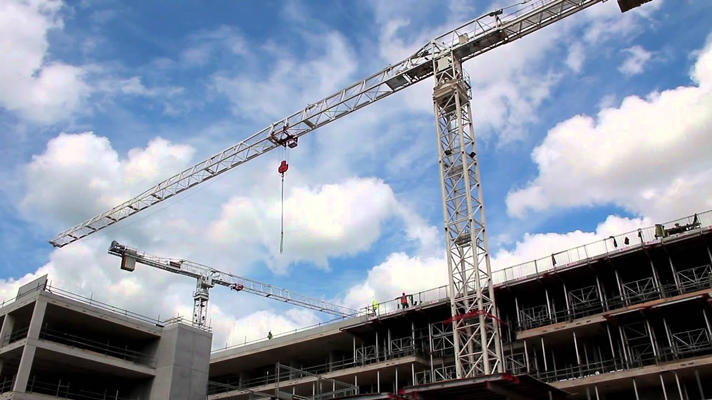

License and Permits
License and Permits of $1.7M represent 85.0% of the budgeted $2.1M compared to the $1.5M or 54.0% of last years actual of $2.7M
  First quarter included permits for Texas Instruments, Richardson Industrial Park and West Coast University
  Second quarter includes permits for Digital Realty’s new data center, the Amazon Warehouse development and for the Shiloh Commercial Center

Slide 10
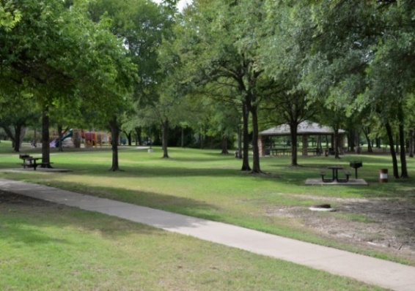
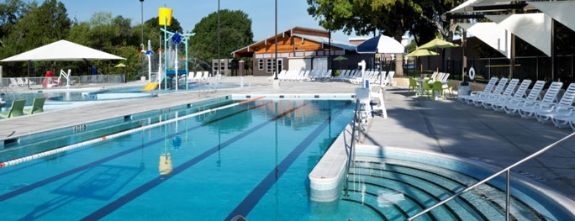
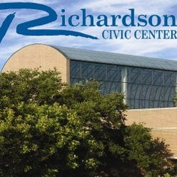
Parks and Leisure and Civic Center Revenues
Parks and Leisure revenues of $597K represent 25.1% of the original budget of $2.4M, which is down from $1.3M through the second quarter last year
  The budget for parks revenues is based on limited facility and program offerings through the first half of the year with a modest recovery beginning in the second half of the fiscal year
Civic Center revenues reflect a hold on facilities bookings as a result of the current pandemic

Slide 11
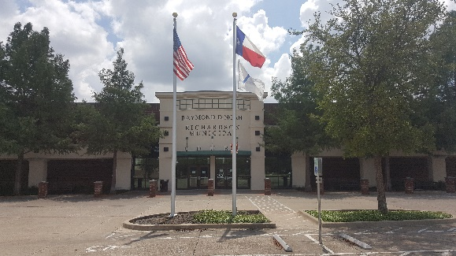

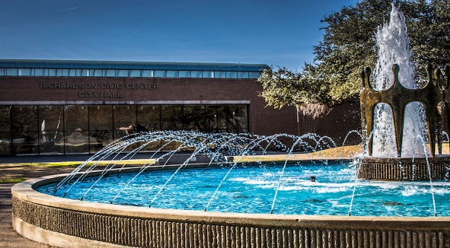
Remaining General Fund Revenues
Library fines are down slightly from last year but even with budgeted expectations
Interest earnings continue to track behind last year and the budgeted expectations due to lower interest rates
The Other Revenue category revenue of $3.5M represents 73.6% of the budgeted $4.7M. Included in the $3.5M is $1.4M of additional CARES funding that was not factored into this year’s budget. The remaining revenues in this category are preforming as anticipated
General and Administrative Charges are even with budget expectations

Slide 12
General Fund Expenditures
YTD Expenditures for Fiscal Year 2020-2021 of $76.4M represent 57.1% of the budgeted expenditures, compared to $75.9M or 53.9% of the year-end actual last year
  The Contracts category expenses of $5.3M includes $1.3M for COVID-19 related expenses that are covered through a reserve of fund balance
    Reserve for COVID-19 related expenses totals $3.8M
  Expenses in the Supplies category increase $1.6M over this time last year as the result of recording $3.3M in expenses related to prior year encumbrances that are also covered by a reserve of fund balance
    Reserve for Prior Year Encumbrances related expenses totals $4.2M
  The remaining expenditure categories are performing as anticipated

Slide 13
Water and Sewer Fund
An enterprise fund and the second largest of the City’s five operating funds.
Provides for administration, operation and maintenance of the City’s water and wastewater system.
Revenue from water and sewer sales make up 98% of the fund’s total revenues.
Expenses for wholesale water and sewer treatment services make up about 65% of the fund’s total expenses.

Slide 14
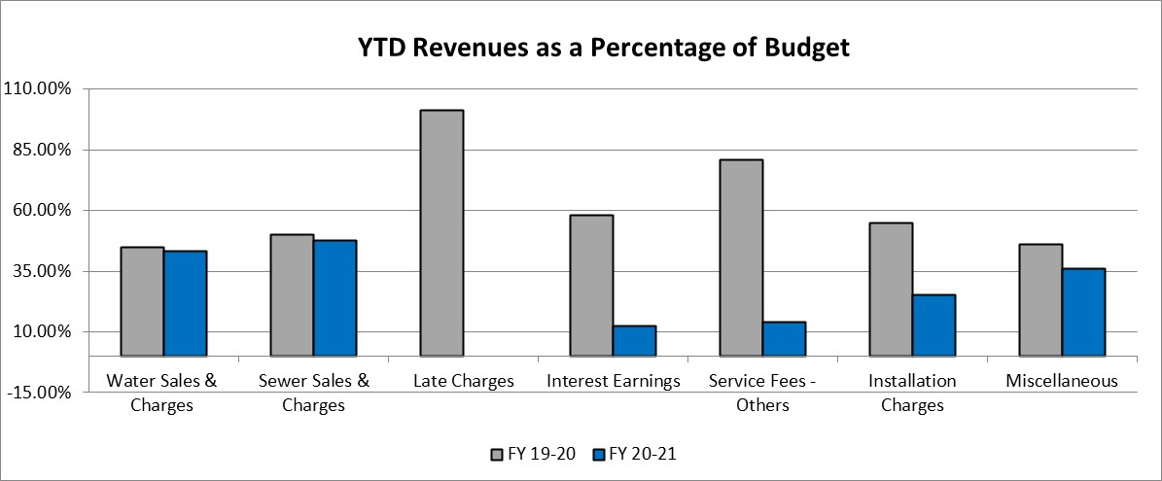
Water and Sewer Fund Revenues
Total Water and Sewer Fund Revenues through the second quarter of FY 2020-2021 are $38.9M, or 44.8% of the budget compared to $41.2M or 47.2% of the year-end actual last year

Slide 15
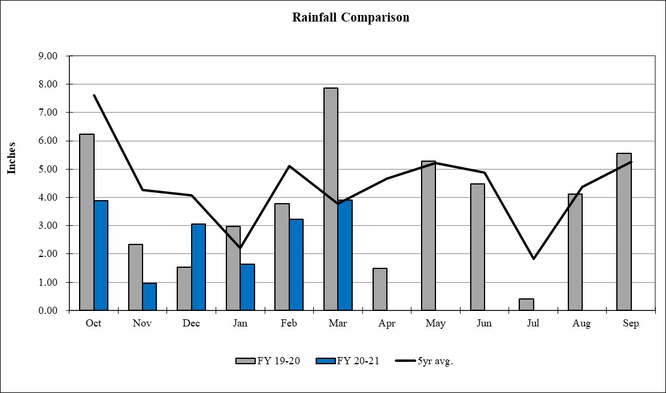
Rainfall
The following graph compares rainfall YTD of 16.7” compared to last years 24.7” and the 5-year average 27.1”

Slide 16
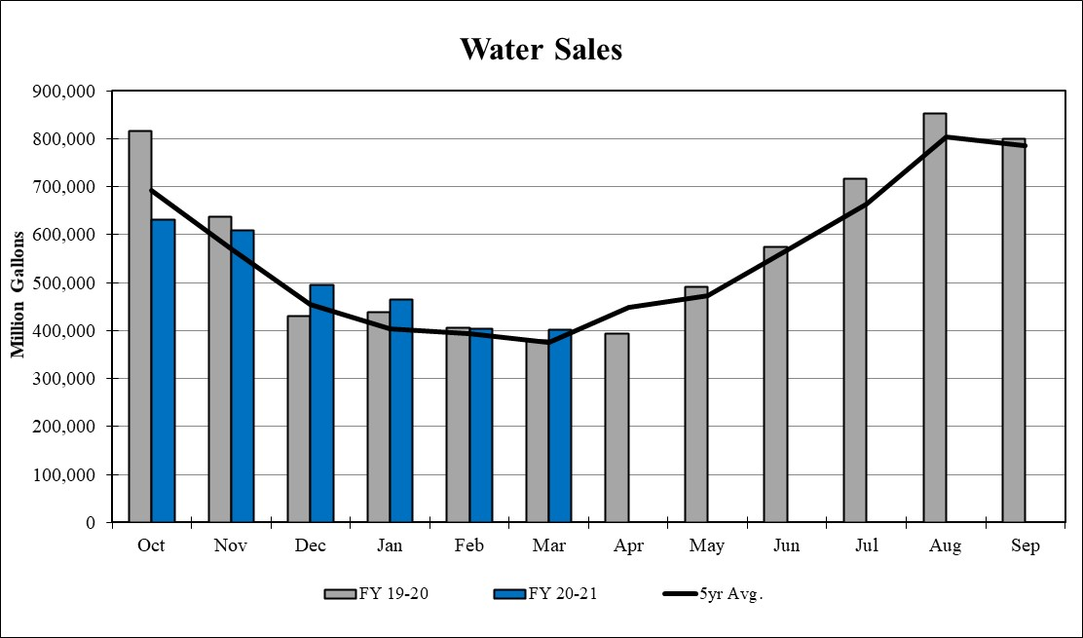
Water Sales
The following graph compares total water sales, in 1,000 gallon increments, by month for both this year and last year

Slide 17
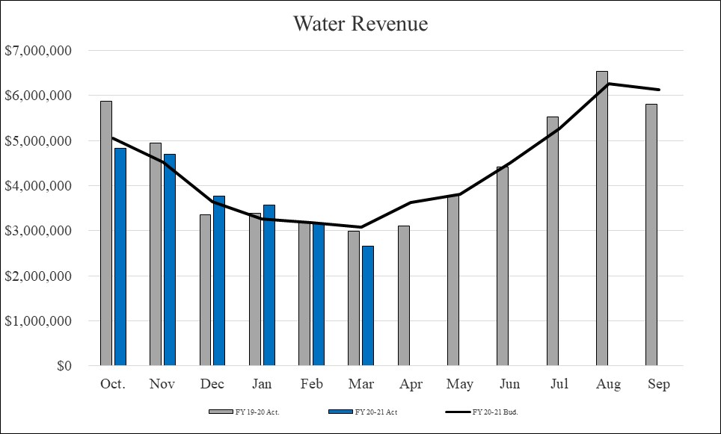
Water Revenue
Water Revenues $22.7M represent 43.3% of the budget compared to $23.8M or 44.9% last year
  March revenue includes drip credits of $15 per account totaling ($451K)

Slide 18
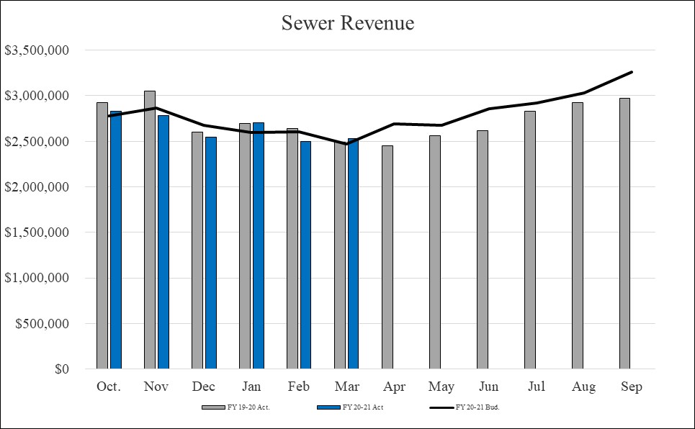
Sewer Revenue
Sewer Revenues $15.9M represent 47.5% of the budget compared to $16.4M or 50.1% last year

Slide 19

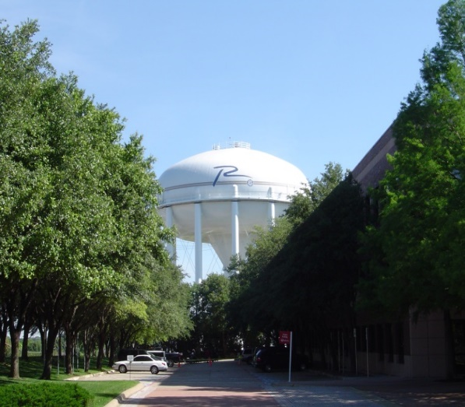
Remaining Water and Sewer Fund Revenues
The remaining revenues in the Water and Sewer fund of $317K through the second quarter are ($692K) below this time last year
  Late Fees are currently being waived, a reduction of ($509K)
  Interest Earnings through the second quarter total $30K compared to $171K at this point last year due to lower interest rates
  Installation Charges of $20K are up from $17K at this point last year but trailing budgeted expectations
  Other miscellaneous charges are ($24K) below last year

Slide 20
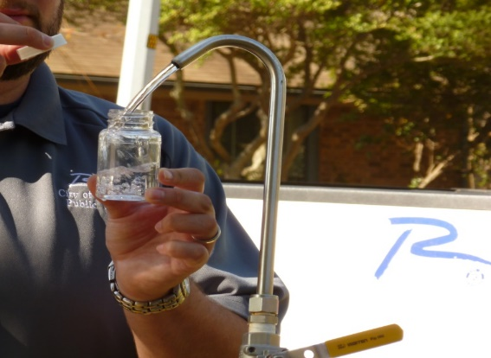
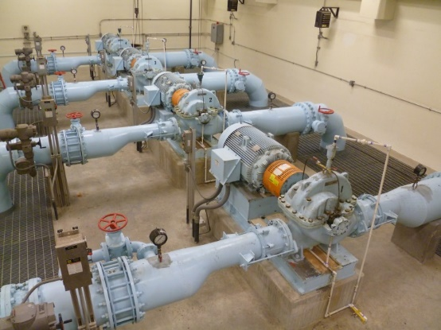
Water and Sewer Fund Expenditures
Total Expenditures and Transfers for the Water and Sewer Fund of $39.7M represent 46.2% of the budgeted $86.1M compared to last years $41.1M or 48.2% of last years actuals
  All expenditure categories are within established parameters for their category

Slide 21

Solid Waste Services Fund
An enterprise fund and the third largest of the City’s five operating funds.
Provides for residential and commercial solid waste collection services, including recycling and bulky item collection.
Revenue from solid waste collections make up 95% of the fund’s total revenues.
Disposal fees make up 25% of the fund’s total expenses.

Slide 22
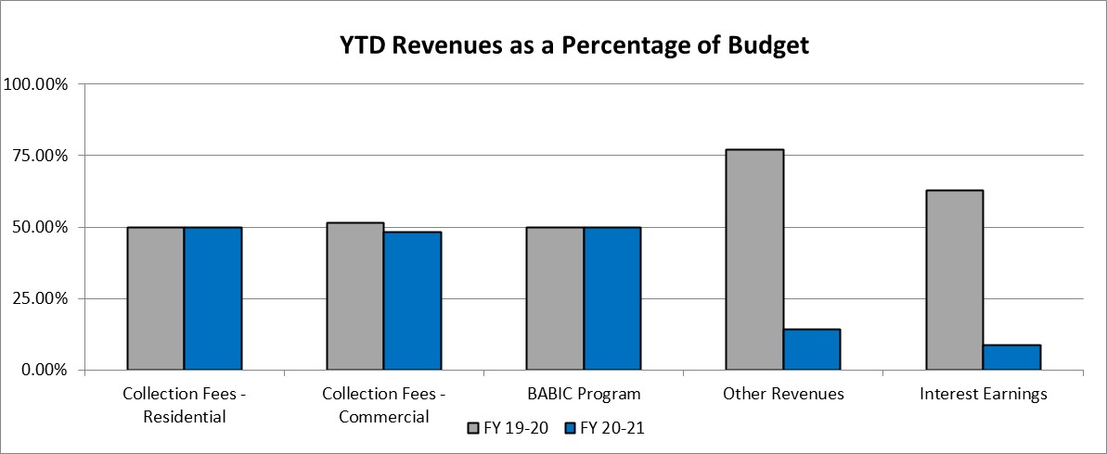
Solid Waste Services Fund Revenues
Total Solid Waste Services Fund Revenues through the second quarter of FY 2020-2021 are $7.5M, or 48.0% of the budgeted $15.5M compared to $7.8M or 51.3% of the year-end actual last year

Slide 23
Solid Waste Services Fund Revenues
Residential collections of $3.0M are even with last year
Commercial collection fees of $4.1M are ($152K) below last year
Other Revenue category is ($202K) below last year. The majority of this decrease, or $178K, is due to auction revenue received in the first half of last year
Interest Earnings through the second quarter total $4K compared to $25K at this point last year due to lower interest rates
The BABIC program support from the Water and Sewer Fund of $233K is even with last year

Slide 24
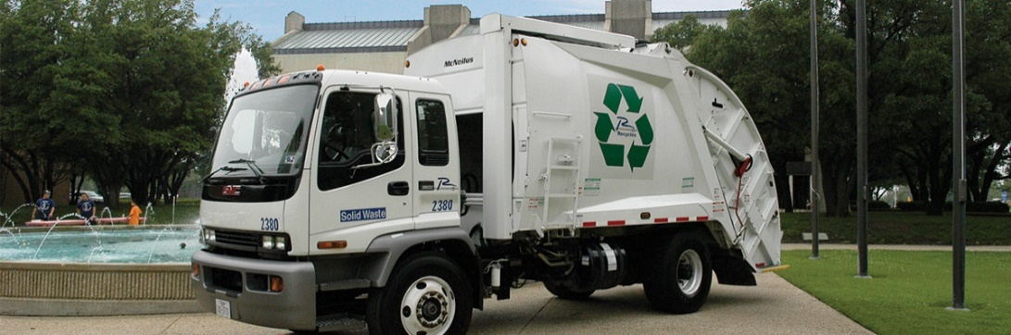
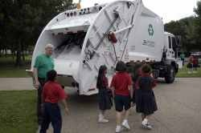
Solid Waste Services Fund Expenditures
YTD expenditures of $7.9M are 50.7% of the budget compared with 51.5% or $7.8M of the year-end actual at this time last year
All expenditure categories are performing within established parameters

Slide 25
Golf Fund
A special revenue fund.
Provides for the administration, operations and maintenance of Sherrill Park Golf Course.
Revenue from green fees make up roughly 65% of the fund’s total revenues.
Personal services expenses make up roughly 50% of the fund’s total expenses.

Slide 26
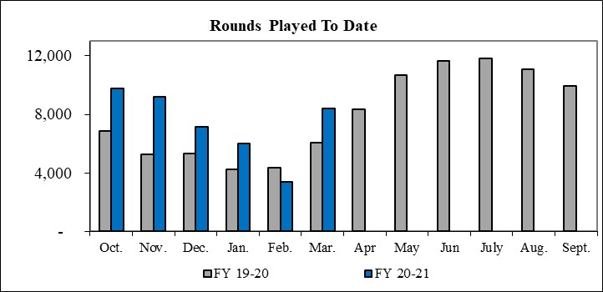
Golf Fund Revenues
Total Golf Fund Revenues through the second quarter of FY 2020-2021 are $1.4M, or 59.3% of the budgeted $2.3M compared to $908K or 30.8% of the year-end actual last year

Slide 27

Golf Fund Revenues
Green Fees of $927K are $315K over last year actuals and $368K over the budgeted target for the year
Cart Fees of $351K are $113K over last year and $103K over expected FY21 target
Remaining revenues of $106K are $48K over last year

Slide 28
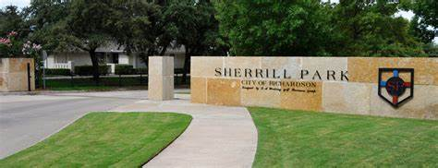
Golf Fund Expenditures
Total Expenditures and Transfers of $1.1M represent 47.6% of the budgeted $2.3M
All expenditure categories are within established second quarter parameters

Slide 29
Hotel/Motel Tax Fund
Provides for the administration, operations and maintenance of the Charles W. Eisemann Center, parking garage, Convention and Visitors Bureau and annual grants to local arts organizations.
Revenue from hotel/motel occupancy taxes and revenue from the operation of the Charles W. Eisemann Center and Parking garage are the main sources of the fund’s total revenues.
Eisemann Center operations historically make up roughly 75% of the fund’s total expenses.

Slide 30
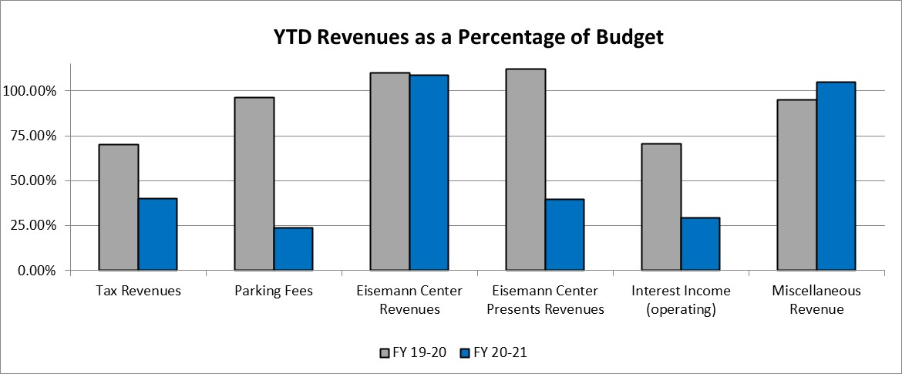
Hotel/Motel Tax Fund Revenues
Total revenues of $754K, or 45.2% of the original budget compared to $2.9M, or 63.7% of FY2019-20 YTD actuals

Slide 31
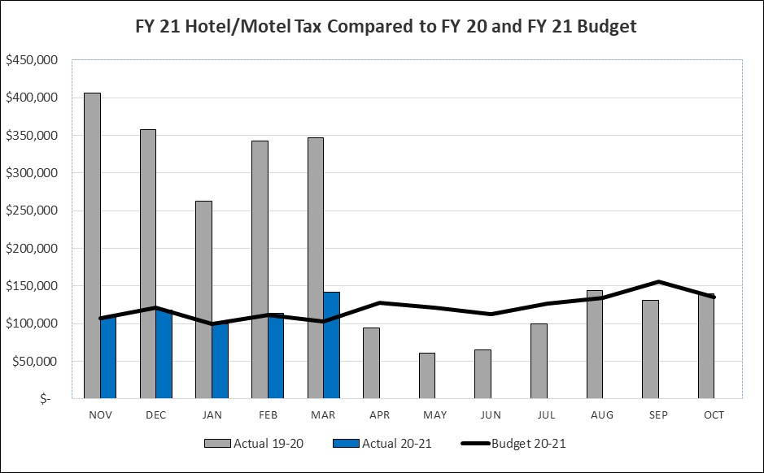
Hotel/Motel Tax Revenues
Hotel occupancy taxes of $583K are ($1.1M) below last year and $40K above the budgeted target through the end of the second quarter

Slide 32
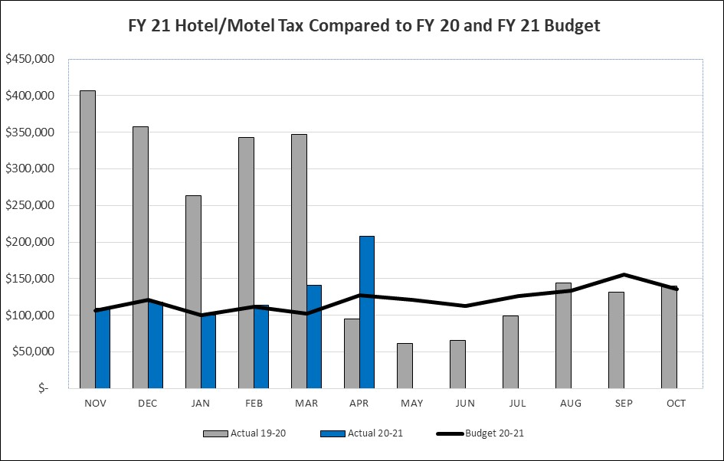
Hotel/Motel Tax Revenue Outlook
Not included in this report, April receipts from March stays saw a bump from winter storm related stays for insurance adjusters and restoration companies, as well as from weekend stays related to weddings, sports groups and spring break traffic

Slide 33
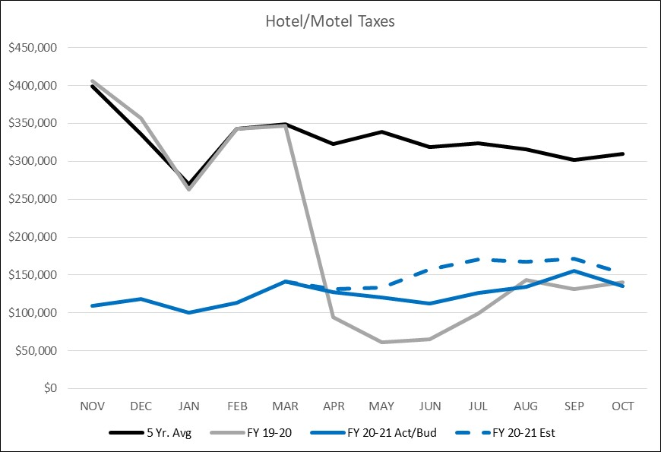
Hotel/Motel Tax Revenue Outlook
Current trends point to a modest boost from leisure travel during the summer months
Multi-year recovery for business travel still expected

Slide 34
Hospitality Forecast
  Promising Signs:
  Spending on business travel fell 70% in 2020. Business travel is projected to increase 21% in 2021 with further acceleration in 2022 due to significant pick-up in group meeting activity and international business travel*
  The hotel industry is projected to recapture 80% demand by the end of 2021, but RevPAR (revenue per available room) will be 34.2% lower than 2019. Occupancy is projected to rise from 42.2% in 2020 to 52.2% in 2021**
  Full recovery in average daily rate is projected by the end of 2023 and recovery in RevPAR is projected for 2024**
  The week of April 10th resulted in the highest U.S. hotel occupancy of 56.6% in the pandemic-era for hotels in the U.S. since March 2019**
* Business Travel Industry Outlook, January 2021 and U.S. Travel Association
** STR and Tourism Economics

Slide 35
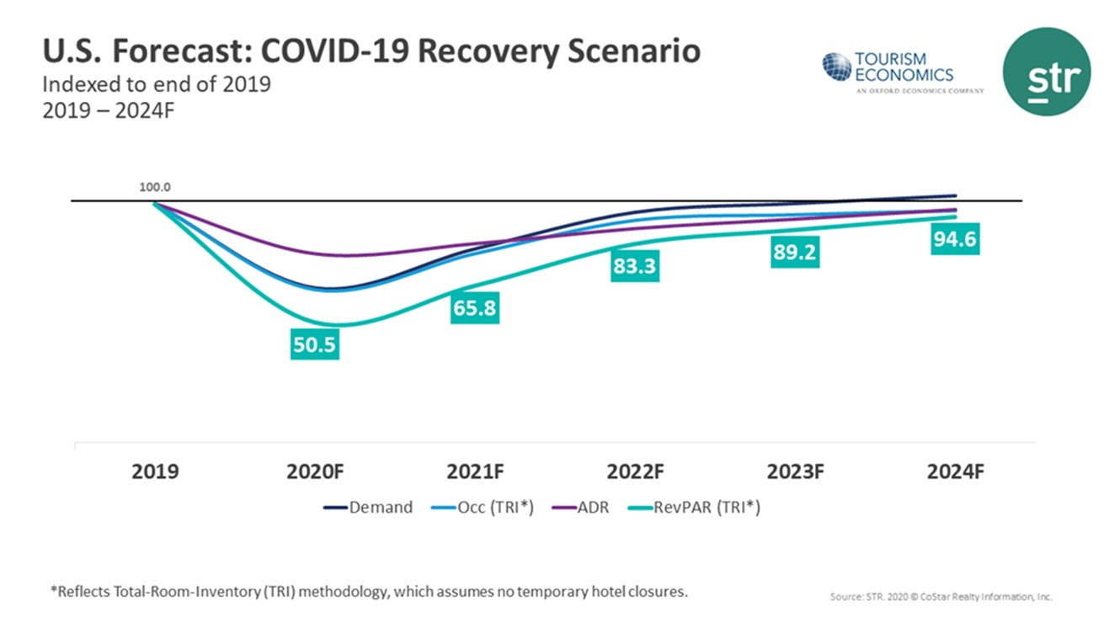
Hospitality Forecast

Slide 36
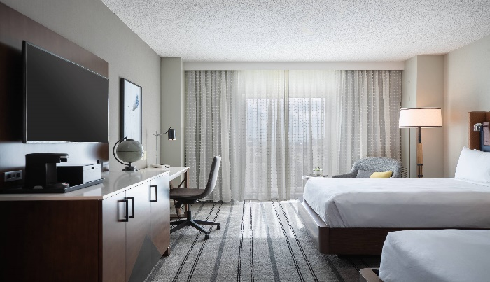

Hotel Inventory – Richardson, Texas

Slide 37

Richardson Hotel Market Segment
Hotel Type | Business | Group | Leisure | Long Term
Full Service | 65% | 33% | 2% | 0%
Select Service | 49% | 18% | 24% | 9%
Extended Stay | 50% | 11% | 18% | 21%
Economy | 27% | 0% | 73% | 0%
City-Wide Makeup | 50% | 19% | 24% | 7%

Slide 38
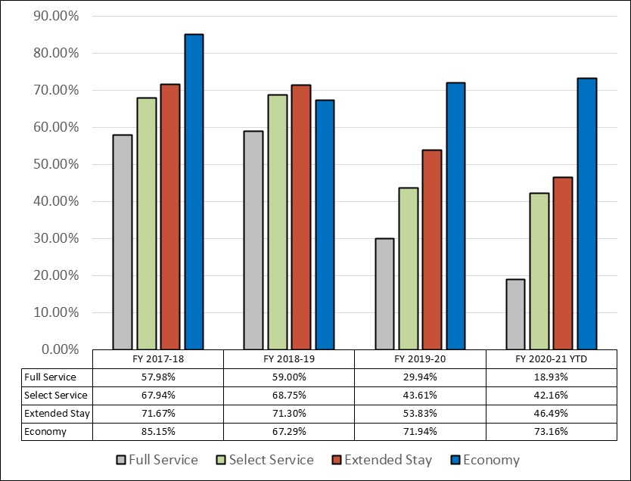
Occupancy Rates by Category (OCC)

Slide 39
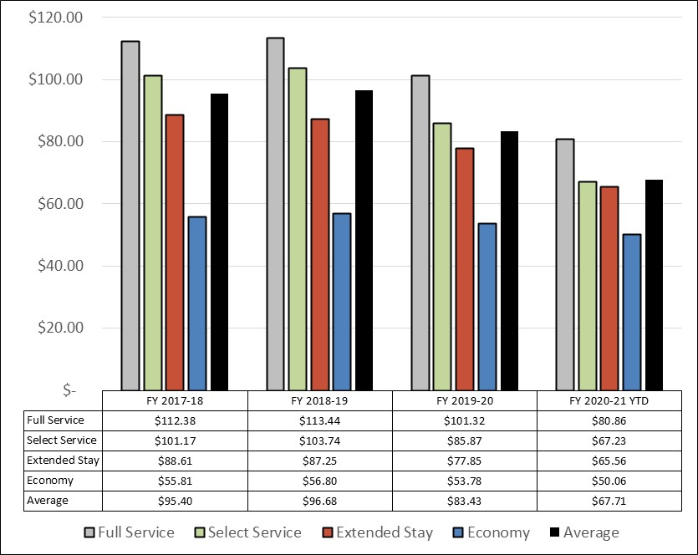
Average Daily Rate by Category (ADR)

Slide 40
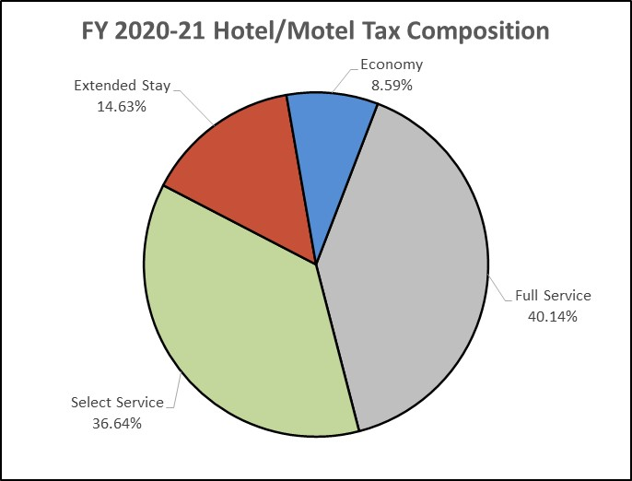
Hotel/Motel Tax Composition

Slide 41
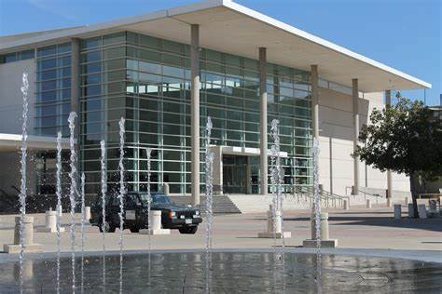
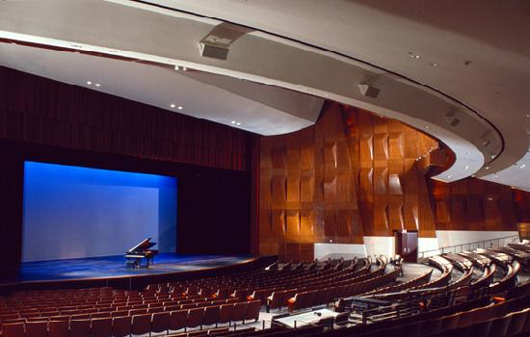
Eisemann Center Revenues
Eisemann Center and Eisemann Center Presents Revenues of $130K represent 84.7% of the original budget
  Eisemann Center revenues of $109K currently exceed the original budget for this category of $100K
    Eisemann Center has seen an increase in activity since COVID restrictions have been eased
    Bookings include from both the Richardson and Plano Symphony Orchestras, various dance recitals and from the Eisemann Center’s streaming offerings
  Eisemann Center Presents revenue of $21K is mainly attributed to sponsorships related to cancelled offerings and Friends memberships
  Interest earnings and parking fees continue to track below last fiscal year

Slide 42

Hotel/Motel Tax Expenditures
Total expenditures of $1.5M, or 50.4% of the original budget compared to $3.3M, or 72.0% of FY2019-2020 YTD actuals
  The Eisemann Center continued to work with arts organizations on options for hosting performing arts offerings in a “modified environment” with additional capacity in venues this spring and summer
  All expenditures are performing as expected

Slide 43
Performing Arts Forecast
Hopeful Signs:
As of February 2021, the estimated financial impact on the arts and culture sector of the U.S. was $30.7 billion with an estimated loss in attendance of 488 million attendees*. Many arts organizations have replaced in-person offerings with virtual arts experiences
Congress created the “Shuttered Venue Operators Grant” as part of the coronavirus relief package and government spending bill. This act created a grant program to aid financially distressed venue operators, etc. The Eisemann Center applied for $976,764.40 in funding in late April 2021 to provide funding for equipment, contractual services and other business expenses
Broadway is reopening at 100% capacity on September 14, 2021. Actors Equity approved the first live theater performance in North Texas on May 7, 2021
Eisemann Center rental events increased from 3 total usage days in April 2020 – September 2020 to 67 total usage days from October 2020 – March 2021
* Americans for the Arts
** Playbill, April 2021

Slide 44
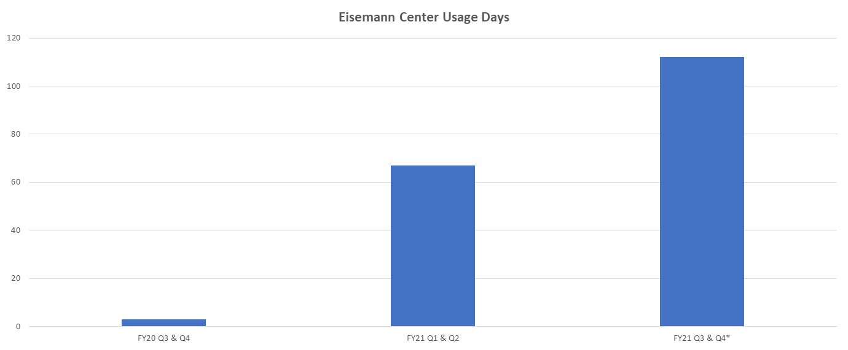
Eisemann Center – Usage Days
* Events on calendar as of April 21, 2021

Slide 45
Hotel/Motel Fund Projection
Based on FY 2021 year-to-date actuals as well as projections for the remainder of FY 2021, the Hotel/Motel Fund is projected to end FY 2021 within budget
A multi-year recovery strategy is still anticipated for the Hotel/Motel Fund, which will most likely result in expenses exceeding revenues in FY 2022 and in future years
Additional analysis regarding the Hotel/Motel Fund will be reviewed during the Budget Workshop scheduled for July 26-27, 2021

Slide 46


