Slide 1


FY 2020-2021
Year End Report
December 6, 2021

Slide 2


Presentation Overview
Year End Financials across all operating funds . . .
  General Fund
  Water and Sewer Fund
  Solid Waste Services Fund
  Golf Fund
  Hotel/Motel Tax Fund
The focus is on the year-end performance of revenues and expenditures against the estimates developed in June 2021.

Slide 3
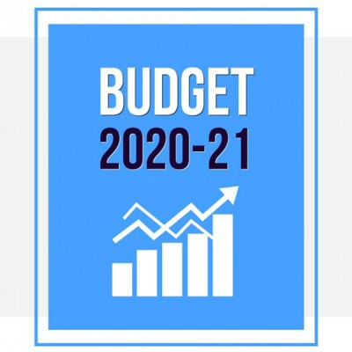

General Fund
The largest of the City’s five operating funds.
Provides for basic services like public safety, parks, health and community services and administration.
Revenue from property taxes, sales taxes and franchise fees typically make up 80-85% of the fund’s total revenues.

Slide 4
General Fund Revenues

Slide 5
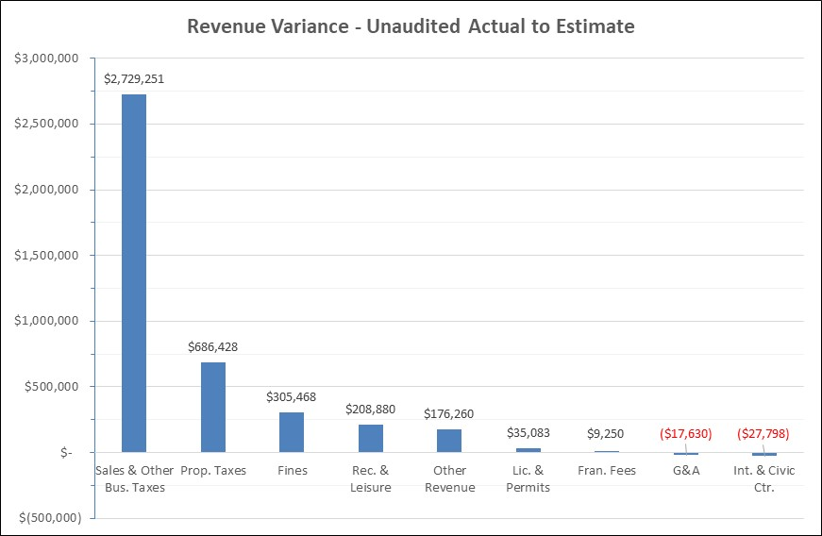
General Fund Revenues

Slide 6
General Property Taxes
General Fund Property Tax came in $686,000 or 1.0% over year end estimates and 6.7% above the original budget.
  Current Year taxes finished the year $745,000 over the estimate and $4.7 M over the original budget.
    Reminder that the original budget for FY 2020-21 was based on a Certified Estimated Tax Roll and not a final Certified Tax Roll, which was received after the budget was adopted.
  Prior Year Taxes and Penalties and Interest ended the year ($58,000) below the estimate.

Slide 7
Sales and Other Business Taxes
Sales and Other Business Taxes finished the year $2.8 million over the year-end estimate of $44.7 million.
  Total collections were $16.8 million over the original budget.
Sales Tax increased $2.6 million from year end estimates, ending the year at $44.3 million. This is an increase of $16.8 million from the original budget.
  Audit adjustments totaled $1.6 million.
The Mixed Beverage and Bingo tax finished the year $133,000 above the combined year end estimate of $474,000 as a result of stronger than anticipated mixed beverage taxes.

Slide 8
Sales Taxes
Note: Actuals do not include sales taxes retained by the City. For FY21, that amount is $136,274.

Slide 9
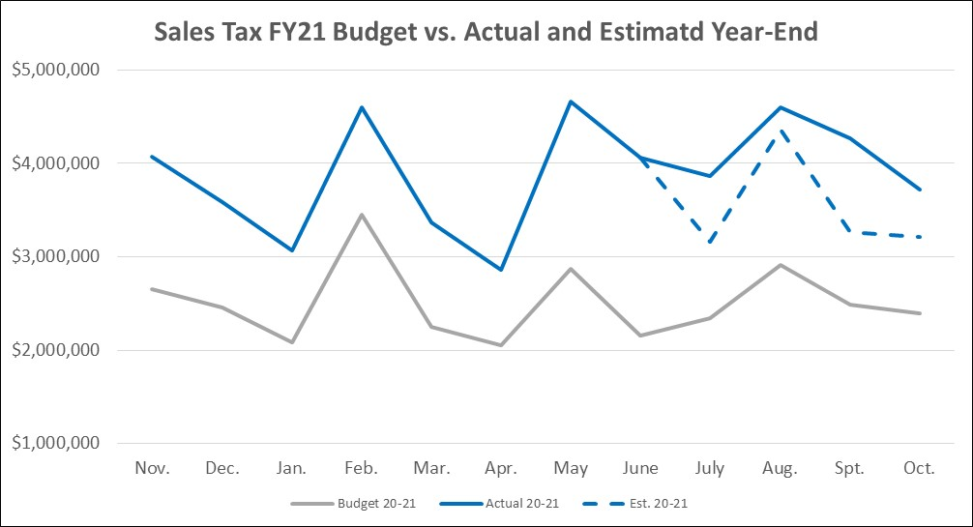
Sale Taxes

Slide 10
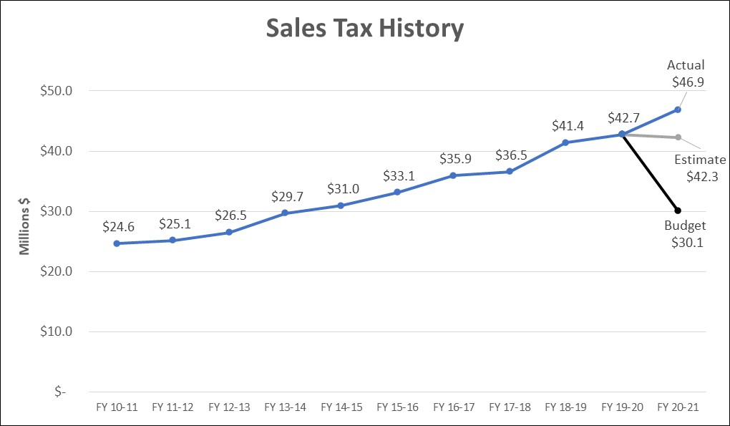
Note: These figures represent Sales Tax receipts alone. They do not include Other Business Taxes.

Slide 11
Franchise Fees
Franchise Fees ended the year $9,000 over year-end estimate.
    Telecommunications franchise fees continue to decline as more and more customers drop their residential landlines. These fees finish the year ($134,000) below the estimate of $1.8 M.
    Electric franchise fees finished the year $81,000 above the year-end estimate as a result of higher usage this past summer.
    Gas franchise fees finished the year $64,000 above the estimate as we recognized the full impact of the winter storm.
    The remaining franchise fees finished the year a combined ($3,000) below their estimated year-end position.

Slide 12
Fines and Forfeitures
The category increased $305,000 or 10.3% over year-end estimate of $3.0 million.
  Municipal Court revenue increased $302,000 over the year-end estimate of $2.9 million.
  Library Fines finished the year at $42,000, an increase of $3,000 above the estimated $38,000.

Slide 13
Recreation and Leisure
The category increased $209,000 or 11.8% from the year-end estimate of $1.8 million.
  Class and Entry fees were up $110,000 from the mid-year projection of $482,000, as participation in the programs continues to recover from the impacts of the pandemic. This is still roughly ($200,000) below the pre-pandemic average for this category.
  Tennis fees finished the year $54,000 above its estimated position of $235,000. Like in golf, we have seen an increase in participation during the pandemic.
  The remaining 9 categories finished the year $45,000 over the estimate of $1.1 million.

Slide 14
Other Revenue Category
The category increased $176,000 over year-end estimate of $6.1 million.
  Ambulance Fees increase $187,000 primarily due to a $125,000 payment from the Texas Department of Health and Human Services; basically a “true-up” of the Medicaid program.
    “Governmental ambulance providers may receive a supplemental payment if the governmental ambulance provider's allowable costs exceed the fee-for-service revenues received during the same period…”
  The Miscellaneous sub-category finished the year $76,000 above its estimate mainly as a result of higher than anticipated insurance and workers compensation reimbursements.

Slide 15
Other Revenue Category (continued)
  Auction and Storage revenue finished the year down ($85,000) from it estimated position of $152,000.
  Reimbursements from the Richardson Independent School District for School Resource Officers and 9-1-1 revenues finished the year as expected.

Slide 16
Remaining Revenue
The three remaining revenue categories of Licenses and Permits, Money and Property (Interest and Civic Center) and General and Administrative Charges, which combine for a total $12.3 million in revenue, fell short of their combined year-end estimate by ($10,000) in total.
  Licenses and Permits increased by $35,000.
  Money and Property (Interest and Civic Center) decreased by ($28,000).
  General and Administrative Charges finished the year ($18,000) below its estimated position as a result of the transfer in in support of the CVB being matched to their year-end expenditures.

Slide 17
General Fund Expenditures

Slide 18
General Fund Expenditures
Total Expenditures, excluding transfers, finished the year ($3.7 million) below the mid-year estimate of $131.1 million and $4.8 million or 3.9% above the original budget.
Personal Services ended the year ($1.8 million), or -1.9% below year end estimate as a result of vacancies across General Fund departments.
  There were an average of 67 vacancies per month out of a total of 821 authorized positions.
  Recruiting challenges were also seen with part-time positions.

Slide 19
General Fund Expenditures
Professional Services ended ($31,000), or -0.3% below the estimate of $10.7 million.
  Economic Development costs were $211,000 above the estimated amount.
  The remaining accounts combined for ($242,000) in savings across many departments.
  Of this savings, $67,000 has been encumbered and will be made available in FY 2021-22 as those services are completed.

Slide 20
General Fund Expenditures
The Maintenance category came in ($578,000), or -14.6% below the year end estimate of $4.0 million.
  The City recognized ($249,000) in savings on computer hardware and software license and maintenance agreements.
  ($78,000) of savings was recognized on irrigation repairs.
  Radio Maintenance came in ($51,000) below the estimate.
  Of this overall savings, $240,000 has been encumbered or reserved in fund balance for delivery or completion of the work in FY 2021-22.

Slide 21
General Fund Expenditures
Contracts came in ($702,000) below its estimated position of $8.8 million.
  Telephone and 911 related service charges are down ($110,000)
  Costs associated with the winter storm came ($108,000) below the $275,000 set aside for the City’s response
  Insurance premiums are down ($89,000)
  Economic Development Costs are down ($87,000)
  Election Expenses are down ($66,000)
  Printing costs down ($62,000)
  $40,000 of the savings has been encumbered or reserved in fund balance for delivery or completion of the work in FY 2021-2022

Slide 22
General Fund Expenditures
Supplies finished the year with ($598,000) in savings from an estimated position of $11.8 million.
  ($202,000) is savings was recognized on 3rd party fleet repairs.
  The City recognized ($83,000) in savings for electricity.
  The remaining savings represents minor savings across multiple General Fund departments.
  $217,000 of this savings has either been encumbered or reserved in fund balance for delivery or completion of the items in FY 2021-2022.

Slide 23
General Fund Expenditures
The Capital category finished the year at $447,000, or $17,000 above its estimated position of $430,000.
  The $1.0 million that was originally budgeted in this category for repairs related to the October 2019 tornado have been transferred to a capital fund to better track the multi-year aspect of the repairs.
  $425,000 was made available for upgrades to the City’s outdoor warning system. Of that, $315,000 has been spent with the remainder encumbered for the completion of the project.
  $132,000 was used to purchase equipment for the Police Department’s vehicle and body camera system.

Slide 24
General Fund Expenditures
Transfers
  Street and Alley Rehabilitation, Parks Maintenance, Economic Development, and the Equipment Replacement Fund transfers remain as budgeted.
  This category reflects the previously mentioned transfer $1.0 million of funding related to the tornado recovery being transferred to a capital fund.
  No change is being made to the planned $1.0 million transfer to assist the Hotel/Motel Tax Fund to help ensure the stability of the fund during the slowdown in the hospitality industry as a result of the pandemic.
    No additional support is expected to be needed in future years.

Slide 25
General Fund Expenditures
Special Projects Transfers
  As a result of the previously discussed revenue and expenditure performance, $16.9 million will be set aside to assist with the recently approved bond program and the City’s capital infrastructure programs.
  An additional $1.0 million will be reserved for special projects to be determined at a later date.

Slide 26
General Fund - Fund Balance
$735,000 of fund balance is being reserved to fund FY 2020-21 encumbrances to be paid in FY 2021-22.
Unreserved fund balance will finish the year at $39.2 million, which equates to 90.12 days or 0.12 days over the recently adopted financial policy of 90.00 days.

Slide 27
Water and Sewer Fund
An enterprise fund and the second largest of the City’s five operating funds.
Provides for administration, operation and maintenance of the City’s water and wastewater system.
Revenue from water and sewer sales make up 98% of the fund’s total revenues.
Expenses for wholesale water and sewer treatment services make up about 65% of the fund’s total expenses.

Slide 28
Water and Sewer Fund Revenues

Slide 29
Water and Sewer Fund Revenues
Total revenues of $83.8 million are ($575,000) below the year-end estimates.
  Water Sales are ($1.0 million) below year-end estimate of $51.2 million and ($2.2 million) below the original budget of $52.3 million.
  Sewer Sales finished the year $468,000 above the year end estimate of $32.5 million, but ($431,000) below the original budget.
  Remaining revenue sources of $649,000 finished the year ($8,000) below the estimated $657,000.

Slide 30
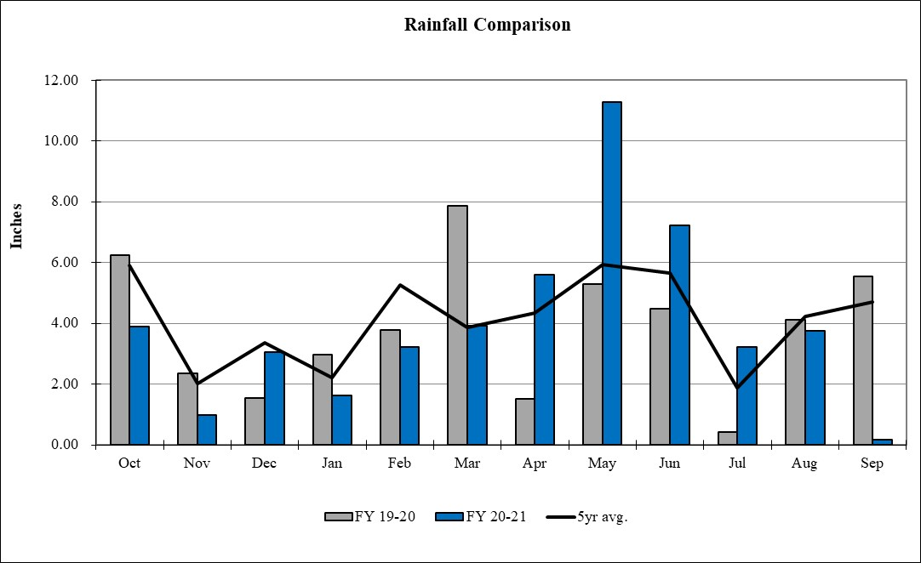
Rainfall
The City received 47.87” of rain in FY 2020-21, compared to the 46.05” in the previous year and the five-year average of 49.31”.

Slide 31
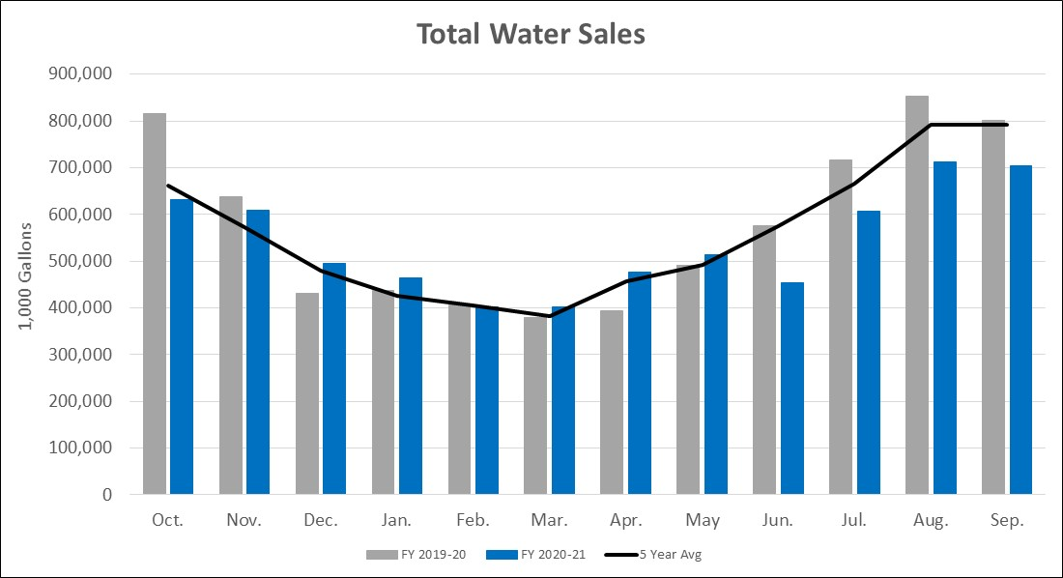
Total Water Sales

Slide 32
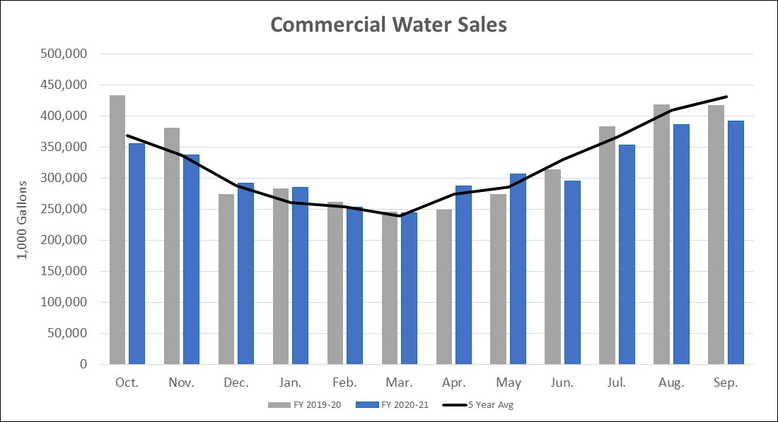
Commercial Water Sales

Slide 33
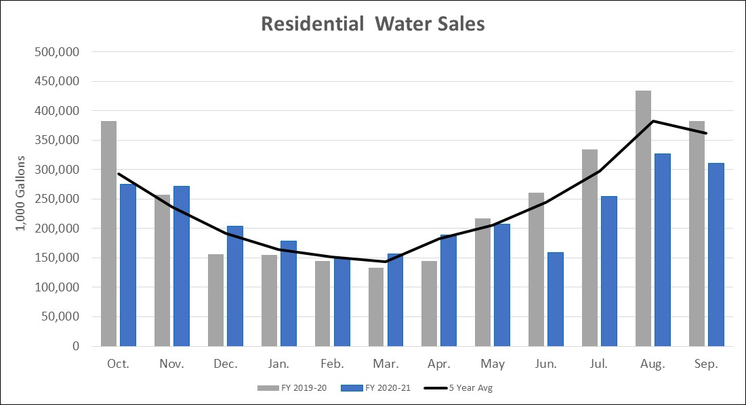
Residential Water Sales

Slide 34
Water and Sewer Fund Expenditures

Slide 35
Water and Sewer Fund Expenditures
Total expenditures, excluding transfers, ended the year ($4.7 million) below year end estimates.
Personal Services ended the year ($684,000), below year end estimate due to personnel savings across many departments.
Professional Services recognized a savings of ($1.2 million) in current year expenditures.
  $124,000 was deferred as a result of staffing shortages.
  $380,000 was deferred as a result of weather-related issues.
  $682,000 of these funds have been encumbered for expense in FY21-22 as those services are completed.

Slide 36
Water and Sewer Fund Expenditures
The Maintenance Category, which includes among other items, the cost of wholesale water and sewer treatment services, came in ($2.7 million) below estimates.
    Wholesale water costs of $32.0 million include a rebate of ($1.3 million) based on $0.49 per 1,000 gallons of unused water.
      Due to the revised rate methodology the District implemented; this rebate was not budgeted as in years past.
    Sewer treatment costs of $20.2 million are ($887,000) lower than year-end estimates.

Slide 37
Water and Sewer Fund Expenditures
The Contracts, Supplies and Capital expense categories combine for a decrease of ($55,000) below the estimated budget of $2.9 million.
Operating Transfers finished the year ($29,000) below the year-end estimate of $9.3 million as franchise fees are adjusted based on final water and sewer sales revenue.
  Franchise fees are 5% of total water and sewer sales revenue.
The transfer to the debt service fund finishes the year up $10,000 from its estimate position in order to support the actual debt service requirement for the fund.
As a result of better-than-expected expenditure performance, $3.1 million will be transferred to a capital fund to support the City’s ongoing capital infrastructure program.

Slide 38
Water and Sewer Fund Summary
The fund finishes the year with 93.06 days of fund balance, 3.06 days over the adopted financial policy of 90.00 days.
  These additional days will be used to support the cost of days of fund balance in FY 2021-22.

Slide 39
Solid Waste Services Fund
An enterprise fund and the third largest of the City’s five operating funds.
Provides for residential and commercial solid waste collection services, including recycling and bulky item collection.
Revenue from solid waste collections make up 95% of the fund’s total revenues.
Disposal fees make up 25% of the fund’s total expenses.

Slide 40
Solid Waste Services Fund Revenues

Slide 41
Solid Waste Services Fund Revenues
Total revenues finished the year $90,000 above the year-end estimate of $15.3 million.
Residential revenues finished the year ($16,000) below the estimate of $6.1 million.
Commercial Collections finished the year $142,000 above the estimate of $8.4 million.
The category Other Revenue finished the year ($33,000) below the year end estimate of $271,000 as a result of lower auction revenue.
Remaining revenues of $469,000 were ($3,000) below estimates.

Slide 42
Solid Waste Services Fund Expenditures

Slide 43
Solid Waste Services Fund Expenditures
Total Expenditures, excluding transfers, ended the year ($452,000) below the estimate of $13.9 million.
The Maintenance category recognized savings of ($15,000) ending the year at $3.9 million.
    Actual disposal costs of $37.46 per ton were ($0.79) lower than the original NTMWD estimate of $38.25. The City’s final expense is based on a total tonnage of 97,361 tons or 14.80% of the total tonnage for the 5 member cities, compared to 95,000 tons and 14.50% used in the year-end estimate. This is an increase of $14,000 from the estimated amount.
    The City’s composting expense increased $26,000 above its estimated position as a result of high BABIC usage.
    These increases were offset by savings for radio system and commercial container maintenance.

Slide 44
Solid Waste Services Fund Expenditures
Personal Services ended the year ($291,000), below year end estimate due to personnel savings across the fund.
  The City continues to face recruiting challenges for both full-time and contractual labor.
With combined expenses of $5.4 million, all other expenditure categories finished the year ($146,000) below year-end estimates.
With better-than-expected revenue and expenditure performance, $530,000 will be set aside for capital equipment replacement.

Slide 45
Solid Waste Services Fund Summary
Solid Waste will end the year with 91.77 days in fund balance, or 1.77 days in excess of the Council approved policy of 90.00 Days.

Slide 46
Golf Fund
A special revenue fund.
Provides for the administration, operations and maintenance of Sherrill Park Golf Course.
Revenue from green fees make up roughly 65% of the fund’s total revenues.
Personal services expenses make up roughly 50% of the fund’s total expenses.

Slide 47
Golf Fund Revenues

Slide 48
Golf Fund Revenues
Total Golf Fund revenues finished the year $88,000 over the year end estimate of $2.9 million and $583,000 over the original budget of $2.8 million.
Revenue from green fees finished the year $165,000 over year-end estimates of $1.8 million.
Cart Fees decreased ($63,000) from the $829,000 year end estimate.
Remaining revenues totaling $187,000 are ($14,000) below estimates.

Slide 49
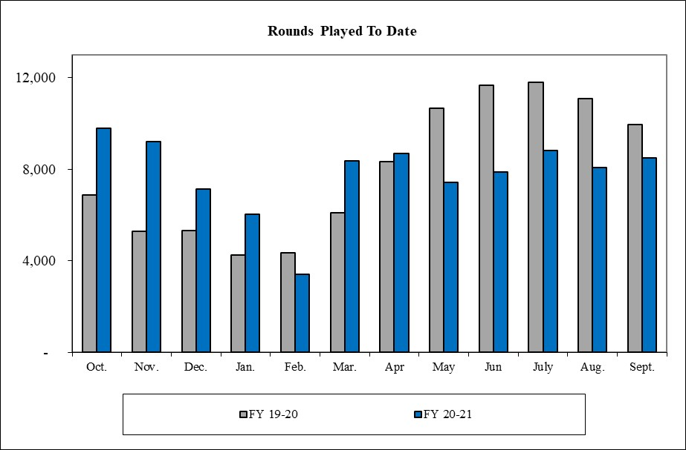
Rounds Played
Rounds played of 93,352 are (2,337) below the 95,689 played in 2019-2020.
  Rounds played continue to trend above pre-pandemic levels.

Slide 50
Golf Fund Expenditures

Slide 51
Golf Fund Expenditures
Total Expenditures, excluding transfers, finished the year ($133,000) below the year-end estimate of $2.5 million.
As a result of the better than anticipated revenue and expenditure performance of the fund, the operations reserve transfer is being increased from $333,000 to $480,000.

Slide 52
Golf Fund Summary
The fund will end the year with 61.09 days in fund balance, in compliance with the adopted financial policy of “30 building to 60 days”.

Slide 53
Hotel/Motel Tax Fund
Provides for the administration, operations and maintenance of the Charles W. Eisemann Center, parking garage, Convention and Visitors Bureau and annual grants to local arts organizations.
Revenue from hotel/motel occupancy taxes and revenue from the operation of the Charles W. Eisemann Center and Parking garage are the main sources of the fund’s total revenues.
Eisemann Center operations make up roughly 75% of the fund’s total expenses.

Slide 54
Hotel/Motel Tax Fund Revenues

Slide 55
Hotel/Motel Tax Fund Revenues
Total revenues finished the year $705,000 over year-end estimates.
Hotel occupancy taxes ended the year at $2.3 million, or $317,000 over the estimate $2.0 million.
  The five-year pre-pandemic average is $4.3 million.
  First seven month averaged 40.4% of average monthly tax receipts.
  Last five months averaged 72.9% of average monthly tax receipt.

Slide 56
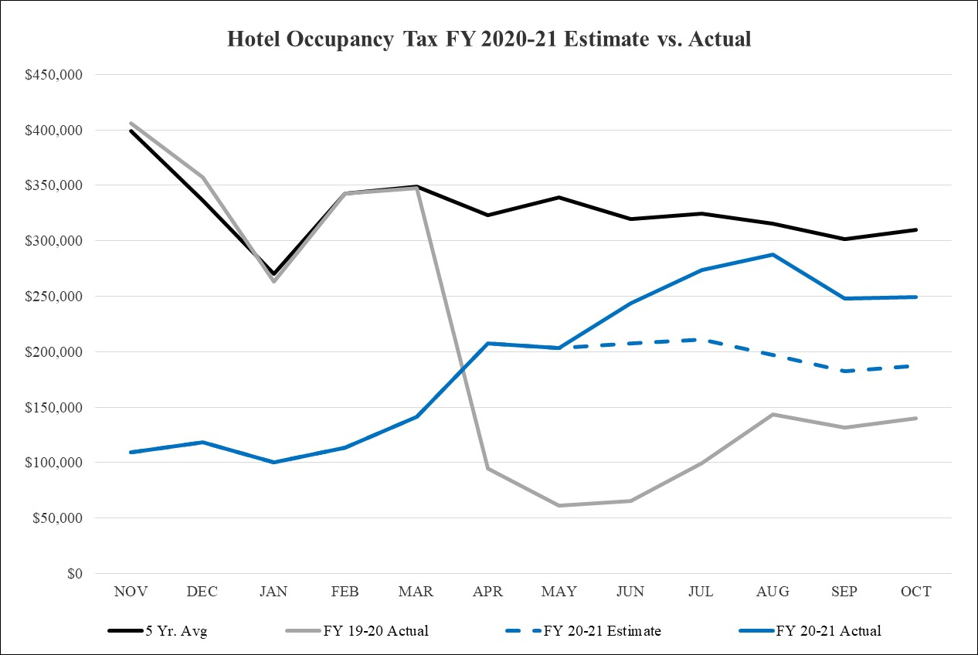
Hotel/Motel Occupancy Taxes

Slide 57
Hotel/Motel Tax Fund Revenues
Eisemann Center revenues finished the year ($47,000) below the mid-year estimate of $484,000.
  Pre-pandemic Eisenmann Center revenues averaged around $2.0 million
  We remain cautiously optimistic about a gradual return to normal usage levels after the significant impact of the COVID-19 pandemic.
Parking Fees finished the year $27,000 over mid-year estimates of $24,000.
Interest earnings finished the year down slightly from the year-end estimate of $5,000.
In an effort to continue to ensure the stability of the fund, no change is being made to the planned $1.0 million transfer from the General Fund.

Slide 58
Hotel/Motel Tax Fund Revenues
Shuttered Venue Operations Grant
  The Shuttered Venue Operators Grant (SVOG) program was established by the Economic Aid to Hard-Hit Small Businesses, Nonprofits, and Venues Act, and amended by the American Rescue Plan Act. The program includes over $16 billion in grants to shuttered venues, to be administered by SBA’s Office of Disaster Assistance.
  The City was awarded $1,226,764
    Initial award - $976,764
    Supplemental award - $250,000
  Grant funds have been recorded in the Federal Grant Fund and will be transferred to the Hotel/Motel Tax Fund as authorized uses are identified and booked
    For FY 2020-21, that amount was $408,917 (equal revenues and expenditures)

Slide 59
Hotel/Motel Tax Fund Expenditures

Slide 60
Hotel/Motel Tax Fund Expenditures
Total Expenditures and Transfers are $150,000 above year-end estimate.
Eisemann Center operating expenditures finished the year ($255,000) below the year-end estimates.
      Eisemann Operations contributing ($240,000) of that savings.
      Eisemann Presents an additional ($15,000) in cost savings.
The Parking Garage finished $15,000 over the year-end estimates.
Capital Renewal expenditures finished even with their year-end estimate of $2,000 for work that began in FY20 but finished in FY21.
Convention and Visitors Bureau support transfer to the General Fund was reduced to match the actual CVB expenditures recorded in that fund.
Qualified Shuttered Venue Operations Grant expenditures of $409,000 were recorded in the Hotel/Motel Fund in FY 2020-21 and offset by grant revenue in the same amount.

Slide 61
Hotel/Motel Tax Fund Summary

Slide 62


