Slide 1


FY 2021-2022
First Quarter Budget Report
February 7, 2022

Slide 2
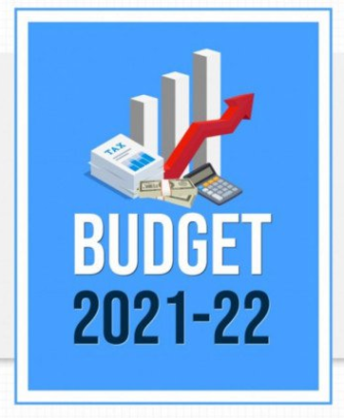

Presentation Overview
Review of the first quarter performance of the City’s five main operating funds
  General Fund
  Water and Sewer Fund
  Solid Waste Services Fund
  Golf Fund
  Hotel/Motel Tax Fund
The focus is on the first quarter performance of revenues and expenditures against the same period last fiscal year

Slide 3
General Fund
The largest of the City’s five operating funds
Provides for basic services like public safety, parks, health and community services and administration
Revenue from property taxes, sales taxes and franchise fees typically make up 80-85% of the fund’s total revenues

Slide 4
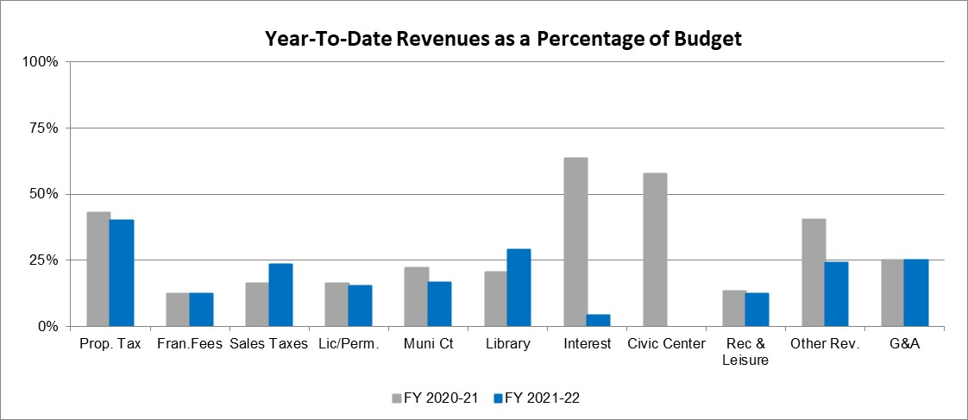
General Fund Revenues
Total revenues of $43.5M, or 29.52% of the original budget compared to $44.7M, or 29.03% of FY 2020-2021 Year-To-Date actual collections

Slide 5
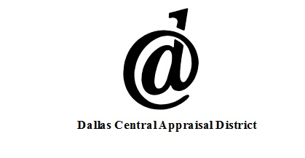

Property Taxes
Property Tax collections of $27.4M through the first quarter are 40.28% of the budget compared to $28.5M or 43.02% of last year’s total collections
  The variance is the result of the timing of receipt of the large tax remittances from the mortgage companies
  Property Taxes are not delinquent until February 1

Slide 6
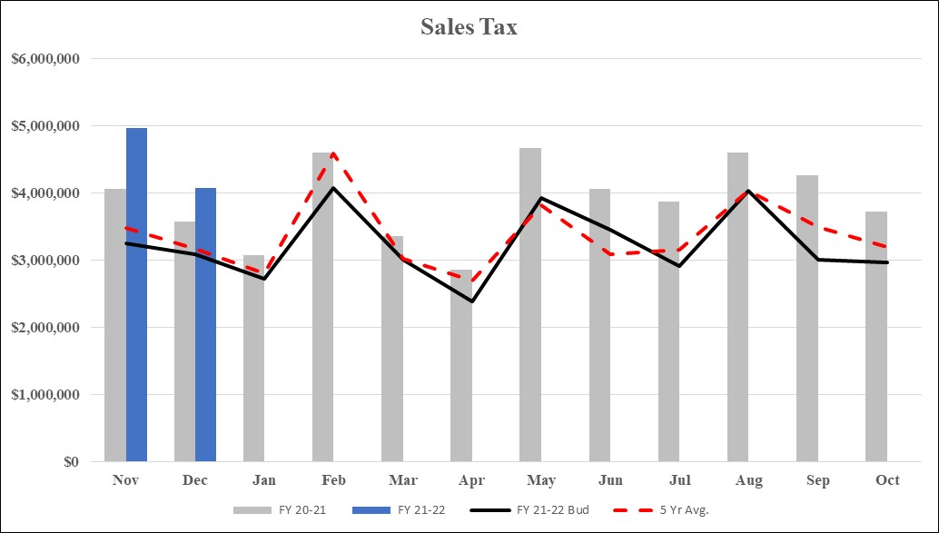
Sales and Other Business Taxes
Sales and Other Business Tax collections of $9.2M represent 23.43% of the budget, or $1.4M over last year
  The First Quarter ends with Sales Tax $1.4M over last years actual, $2.7M over the budget target, and $1.4M over last years “base-to-base” collections

Slide 7
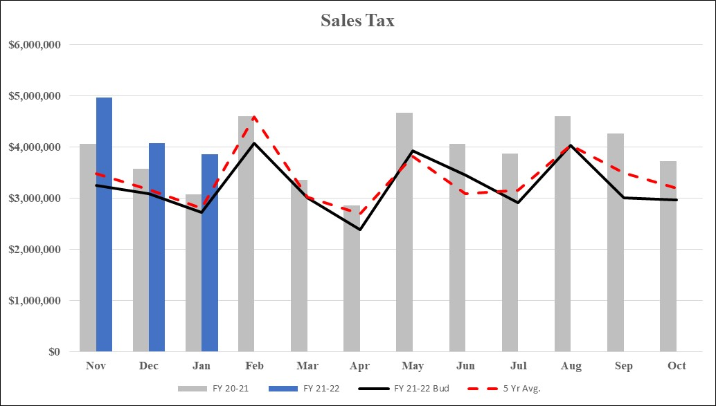
Sales Tax
Not part of this report, the January 2022 remittance has been received
  After 3 months of collections, Fiscal Year 2021-2022 is $2.2M over last year’s actual, $3.8M above the original budget, and $2.3M above “base-to-base”
  We continue to monitor sales tax receipts for the impact of the recently enacted Comptroller’s rule changes

Slide 8
Franchise Fees
Year-To-Date Franchise Fees of $2.0M represent 12.39% of the original budget, down slightly from last year’s collections of $2.1M or 12.58% last year
  The 1st quarter payment of the electric franchise fee is not due for receipt until mid-February
  Telecommunications franchise fees continue to decline as residential accounts eliminate their landline.
    Down below last year and slightly below what was anticipated for this year
  Year-to-date Cable franchise fees of $152K are up slightly from $144K last year.
    Both FY21 and FY22 are reflective of the full year impacted of HB 1152, which reduced cable franchised from roughly $1.1M in FY19 to $585K in FY21

Slide 9
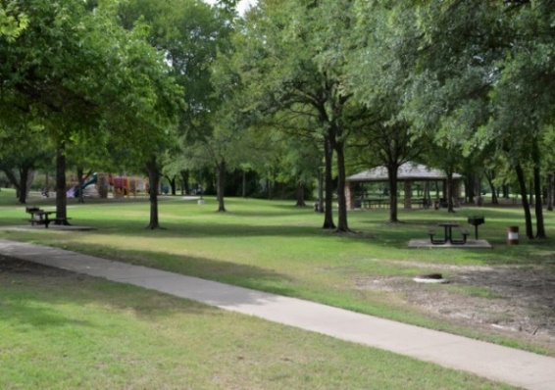
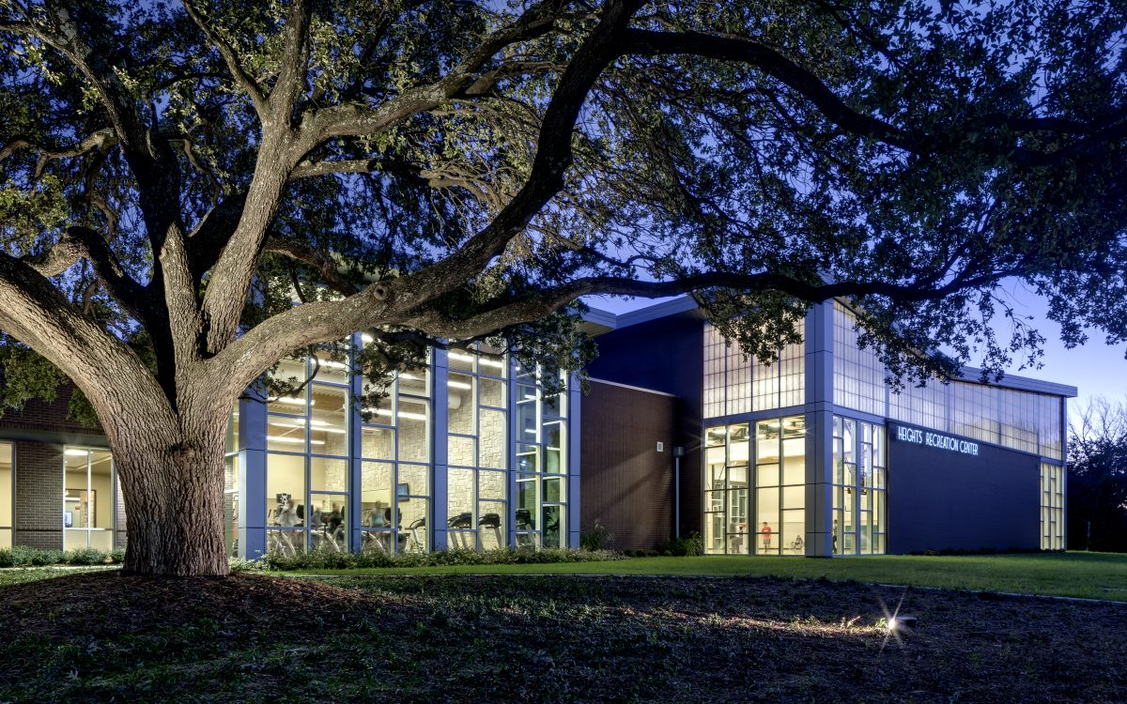
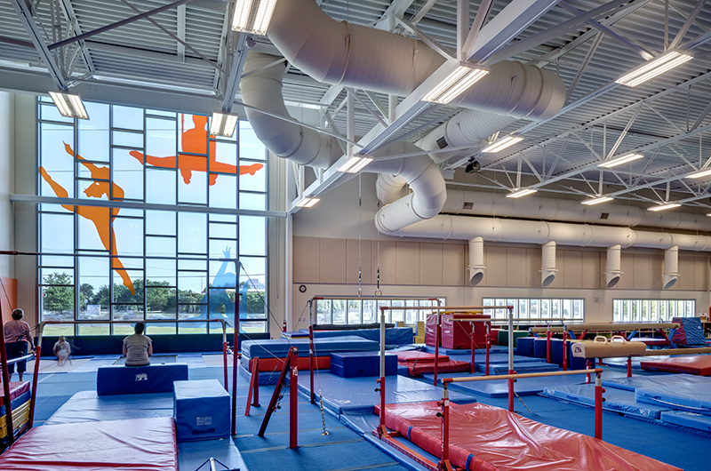
Parks and Leisure Revenues
Parks and Leisure revenues of $409K represent 12.46% of the original budget of $3.3M, which is up from $268K through the first quarter last year
  The FY 2021-22 budget for parks revenues is based on an increase in participation levels, after being impacted by the COVID-19 pandemic the previous two years
  Tennis revenues continue to exceed per-pandemic levels
  Older Adults revenue are $32K above last year, primary due to the facility closure during last year’s remodel
  Recreation Center and Gymnastics revenues are outpacing last year by a combined $76K as a result of high participation levels, which is in line with the budgeted expectations

Slide 10
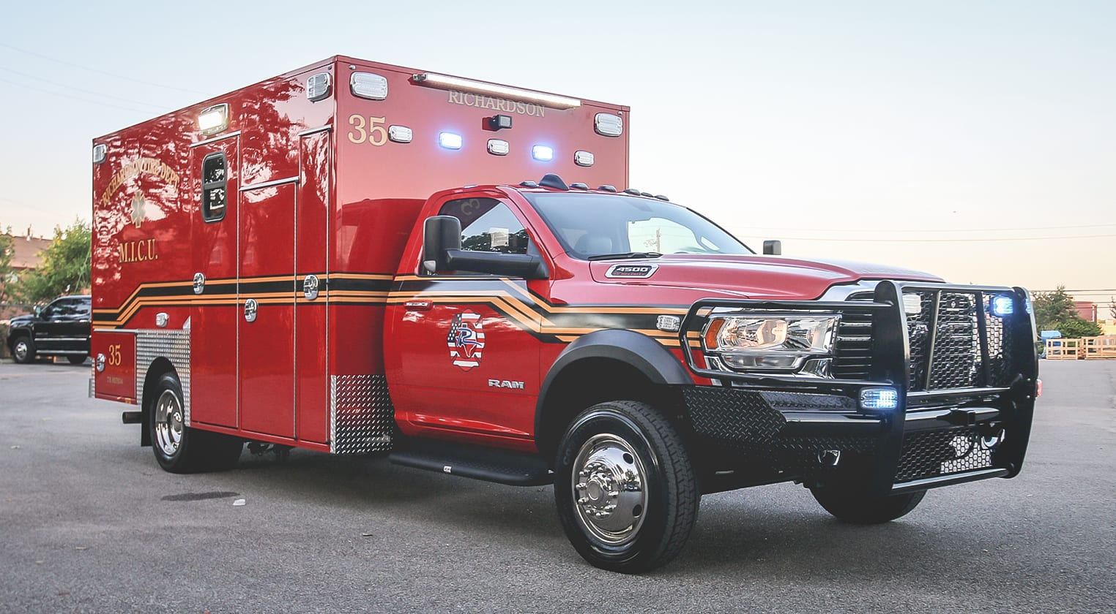

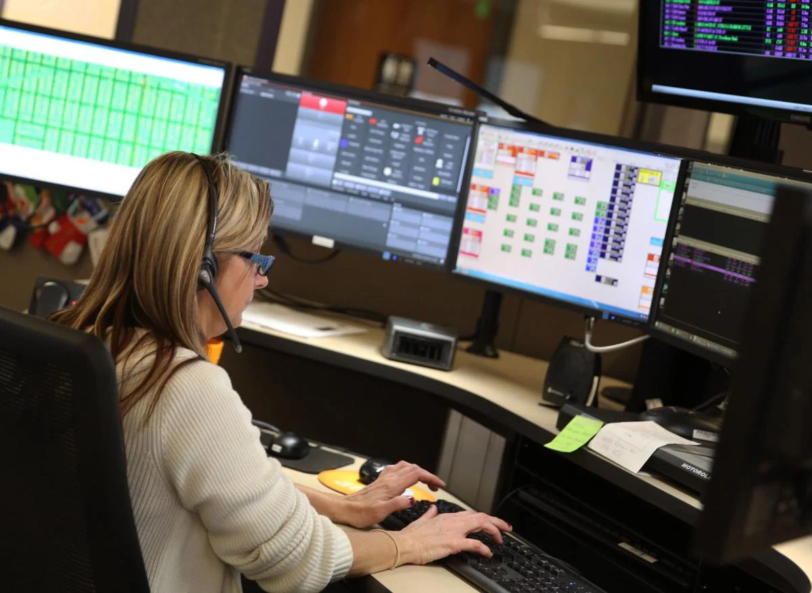
Other/Miscellaneous Revenues
The Other/Miscellaneous category finished the 1st quarter at $1.1M or ($1.4M) below last year.
  The Miscellaneous sub-category revenue of $249K is a reduction of ($1.6M) from FY 2020-2021.
    Included in the first quarter of last year was $1.5M of CARES funding
    This revenue sub-category is down $134K from last year once the CARES funding is removed, mainly due the timing of City auctions and the sale of general fixed assets
  Ambulance revenue is outpacing last year by $122K as transport levels are beginning to return to pre-pandemic levels
  9-1-1 Revenues are $85K above FY 2020-21
    Resulting from catch up payments from voice over IP providers
    We will continue to monitor this situation over the next couple of months

Slide 11
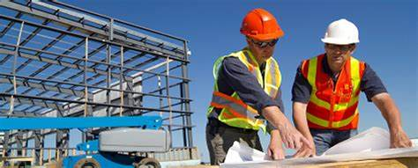
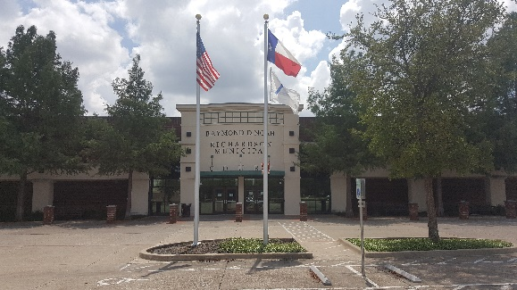
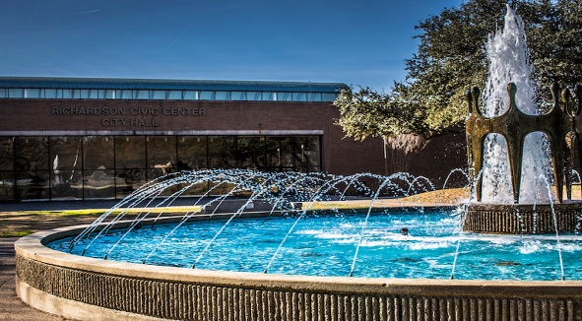
Remaining General Fund Revenues
License and Permit revenues are slightly down for last year but performing in line with budget expectations
Interest earning continue to be down as a result of the current low interest rates
Municipal Court revenue of $504K is down $213K from last year’s $717K
General and Administrative Charges and Transfers In are even with budget expectations

Slide 12
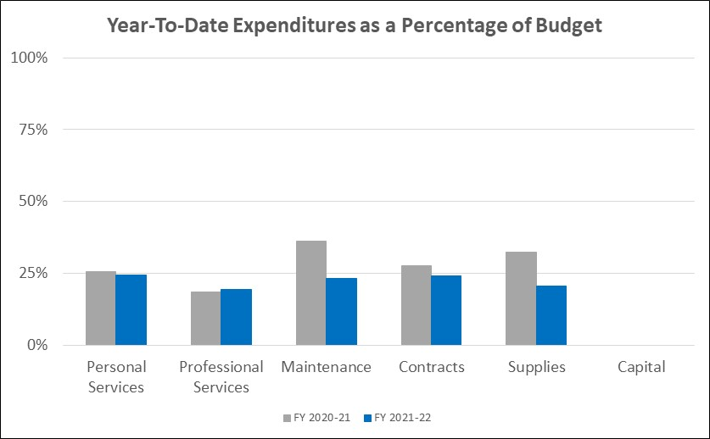
General Fund Expenditures
Year-To-Date Operating Expenditures (excluding transfers out) for Fiscal Year 2021-2022 of $31.9M represent 23.65% of the budgeted expenditures, compared to $33.1M or 25.96% of the year-end actual last year
  All expense categories performing as expected
  The Maintenance category is being impacted by the timing of payments for software licenses
  FY 2020-21 Supplies reflect expenses for prior year encumbrance paid during the first quarter last year

Slide 13
Water and Sewer Fund
An enterprise fund and the second largest of the City’s five operating funds.
Provides for administration, operation and maintenance of the City’s water and wastewater system.
Revenue from water and sewer sales make up 98% of the fund’s total revenues.
Expenses for wholesale water and sewer treatment services make up about 65% of the fund’s total expenses.

Slide 14
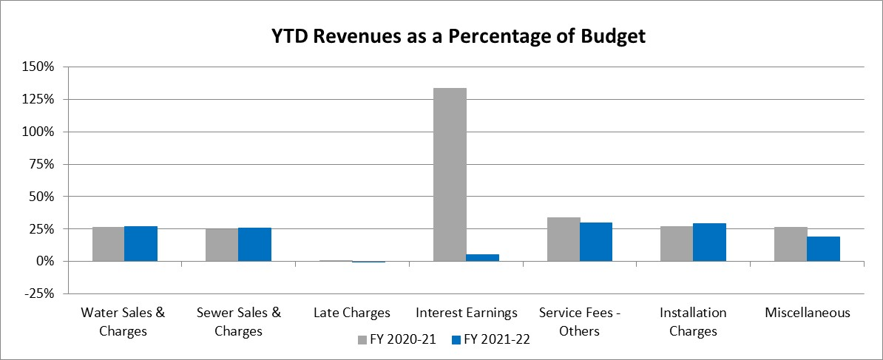
Water and Sewer Fund Revenues
Total Water and Sewer Fund Revenues through the first quarter of FY 2021-2022 are $23.4M, or 26.04% of the budget compared to $21.7M or 25.84% of the year-end actual last year

Slide 15
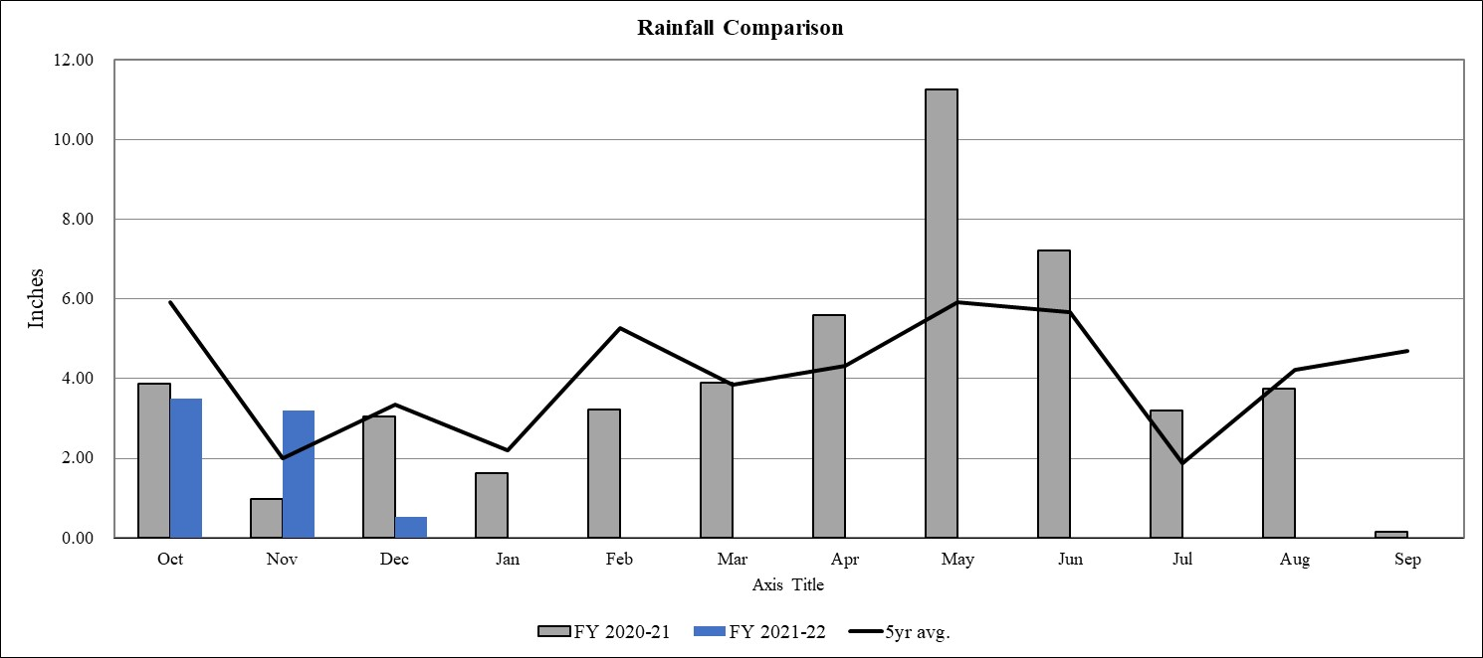
Rainfall
The following graph compares rainfall year-to-date of 7.23” compared to last years 7.90” and the 5-year average 11.28”

Slide 16
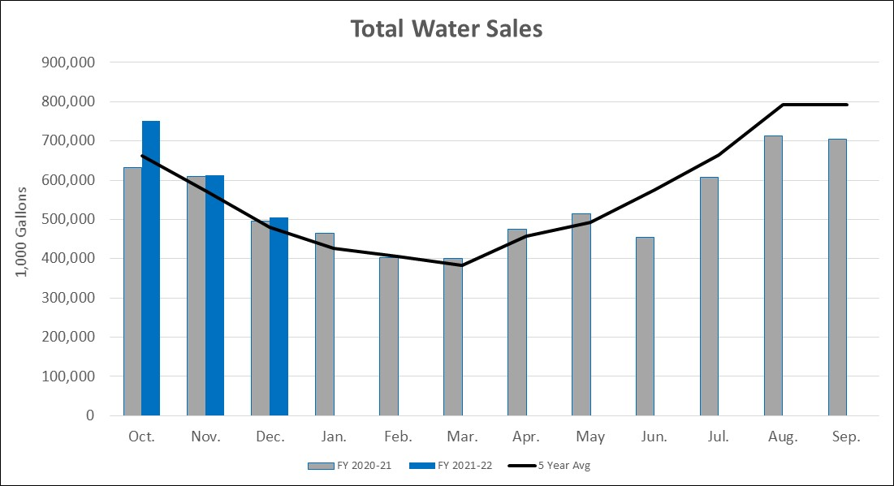
Water Sales
The following graph compares total water sales, in 1,000 gallons increments, by month for both this year and last year
Residential sales are up 7.72%
  Up 25.8% in October but down each of the last two months
Commercial sales are up 9.75%
  Up 13.68% in October
  Up roughly 7.50% in November and December

Slide 17
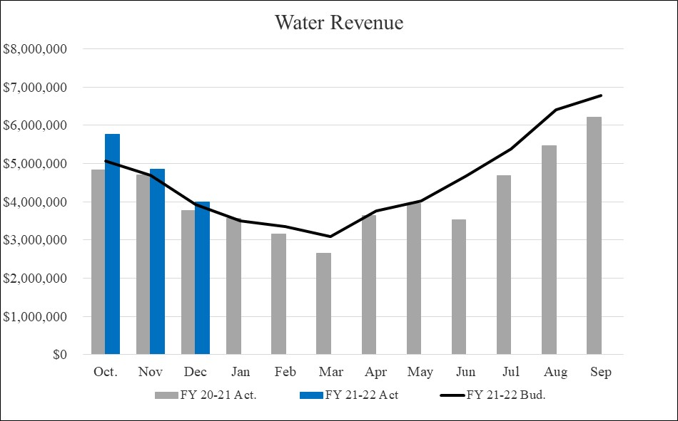
Water Revenue
Water Revenues $14.6M represent 26.71% of the budget compared to $13.3M or 26.52% last year
  The 2.5% rate increase went into effect beginning with November billings

Slide 18
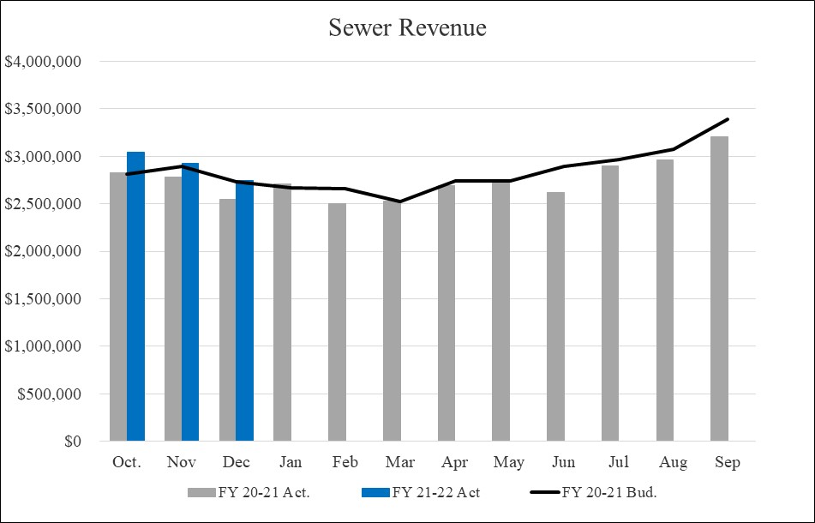
Sewer Revenue
Sewer Revenues $8.7M represent 25.55% of the budget compared to $8.1M or 24.70% last year
  The 2.5% rate increase went into effect beginning with November billings

Slide 19

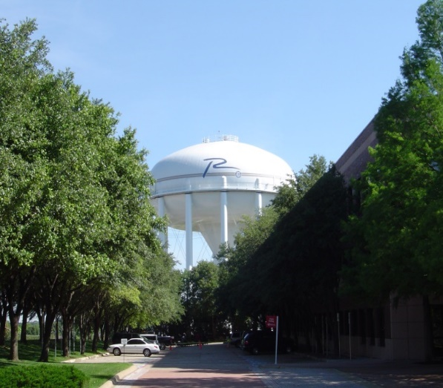
Remaining Water and Sewer Fund Revenues
The remaining revenues in the Water and Sewer fund of $127K through the first quarter are ($73K) below this time last year
  Interest earning continue to be down as a result of the current low interest rates
  Installation Charges of $17K are up $5K from last year
  Other miscellaneous charges are ($57K) below last year as a result of the timing of antenna licenses payments and of City auctions

Slide 20
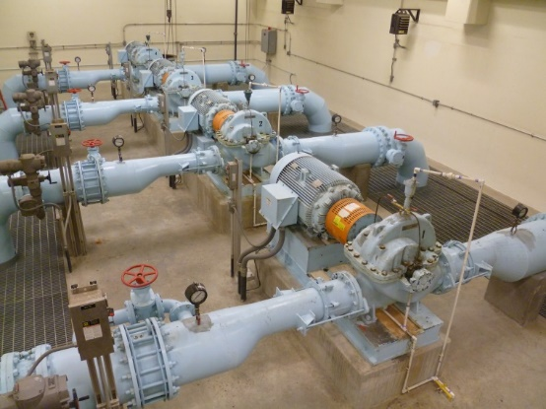
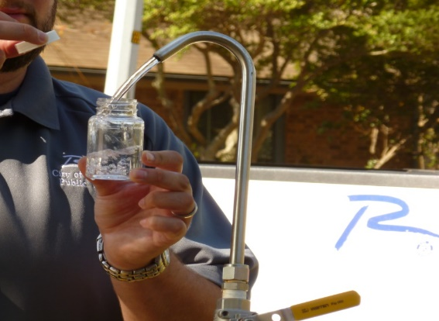
Water and Sewer Fund Expenditures
Total Expenditures and Transfers for the Water and Sewer Fund of $21.9M represent 24.52% of the budgeted $89.1M compared to last years $20.3M or 24.21% of last years actuals
  Year-to-date Maintenance expenditures are $1.4M above last year as a result of increases in the contracts for sewer treatment services, but even with budgeted expectations through the first quarter of the year
  Personal Services is trending below last year and budget as Public Services continues to face staffing challenges
  All other expenditure categories are within established parameters for their category

Slide 21

Solid Waste Services Fund
An enterprise fund and the third largest of the City’s five operating funds.
Provides for residential and commercial solid waste collection services, including recycling and bulky item collection.
Revenue from solid waste collections make up 95% of the fund’s total revenues.
Disposal fees make up 25% of the fund’s total expenses.

Slide 22
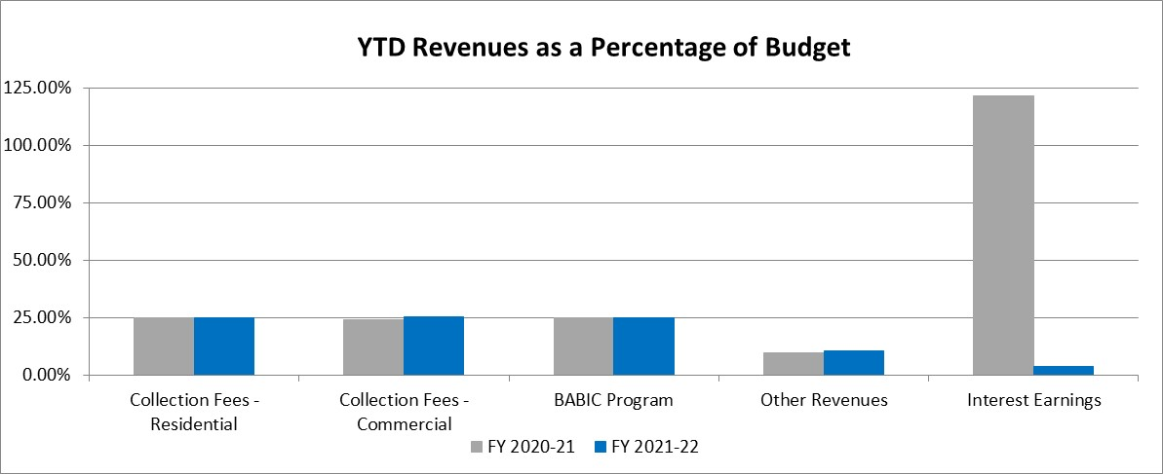
Solid Waste Services Fund Revenues
Total Solid Waste Services Fund Revenues through the first quarter of FY 2021-2022 are $4.0M, or 24.96% of the budgeted $15.9M compared to $3.7M or 24.21% of the year-end actual last year

Slide 23
Solid Waste Services Fund Revenues
Residential collections of $1.5M are even with last year
Commercial collection fees of $2.3M, representing 25.37% of the budget, are $256K above last year
  Includes the market driven rate increases adopted as part of the FY 2021-2022 budget
Other/Miscellaneous revenue of $24K is flat from last year
Interest earning continue to be down as a result of the current low interest rates
The BABIC program support from the Water and Sewer Fund of $167K is even with last year

Slide 24
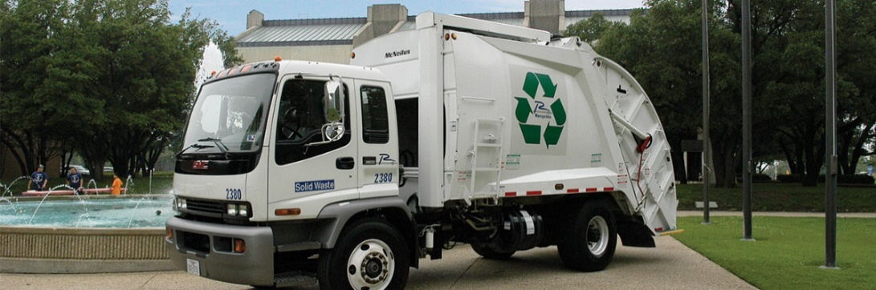
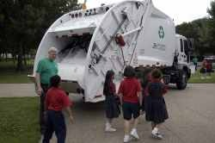
Solid Waste Services Fund Expenditures
Year-To-Date expenditures of $4.3M are 27.22% of the budget compared with 28.27% or $4.3M of the year-end actual at this time last year
Personal Services is tracking slightly below budget through the end of the first quarter
  Solid Waste continues to have recruitment issues and is relying on contract labor to cover shortages
All other expenditure categories are performing within established parameters

Slide 25
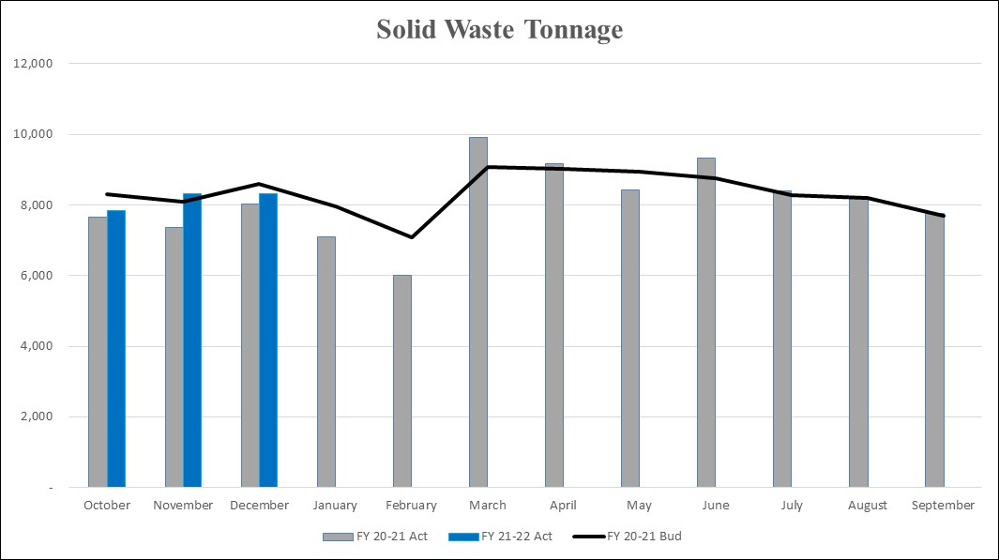
Solid Waste Tonnage
Year-to-date tonnage hauled by Solid Waste Services totals 24,484 tons, an increase of 1,432 tons or 6.21% from last year
  Budgeted NTMWD landfill rate of $38.25 per ton

Slide 26
Golf Fund
A special revenue fund.
Provides for the administration, operations and maintenance of Sherrill Park Golf Course.
Revenue from green fees make up roughly 65% of the fund’s total revenues.
Personal services expenses make up roughly 50% of the fund’s total expenses.

Slide 27
Golf Fund Revenues
Total Golf Fund Revenues through the first quarter of FY 2021-2022 are $737K, or 30.54% of the budgeted $2.4M compared to $808K or 27.69% of the year-end actual last year

Slide 28

Golf Fund Revenues
Green Fees of $495K are ($59K) below last year’s actual, but $158K over the budgeted target
Cart Fees of $195K are ($21K) below last year, but $25K above the expected FY22 target
Lesson revenue of $11K is $6K above this time last year
Remaining revenues of $36K are $2K over last year and exceeding expectations through the 1st quarter

Slide 29
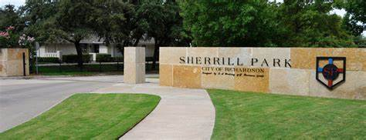
Golf Fund Expenditures
Total Expenditures and Transfers of $686K represent 27.81% of the budgeted $2.5M
All expenditure categories are within established first quarter parameters

Slide 30
Hotel/Motel Tax Fund
Provides for the administration, operations and maintenance of the Charles W. Eisemann Center, parking garage, Convention and Visitors Bureau and annual grants to local arts organizations.
Revenue from hotel/motel occupancy taxes and revenue from the operation of the Charles W. Eisemann Center and Parking garage are the main sources of the fund’s total revenues.
Eisemann Center operations historically make up roughly 75% of the fund’s total expenses.

Slide 31
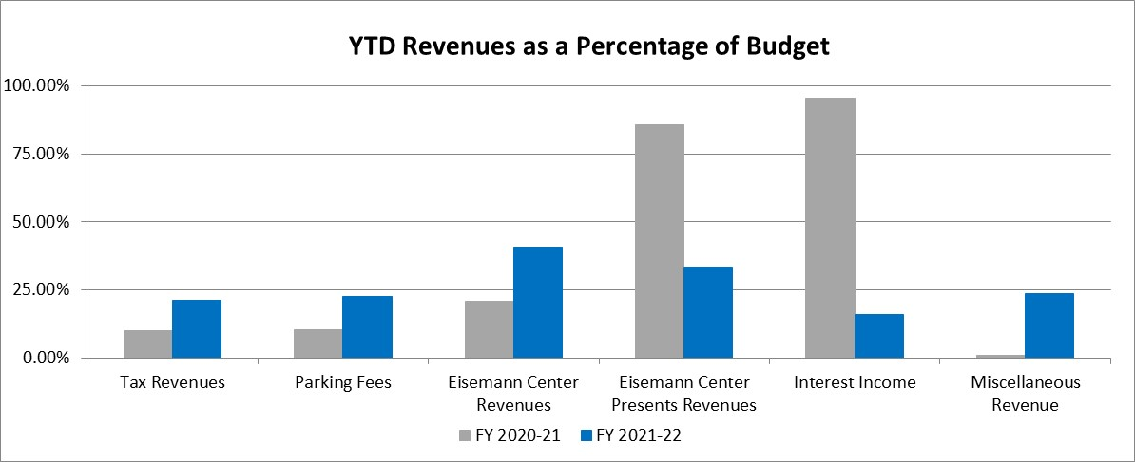
Hotel/Motel Tax Fund Revenues
Total revenues of $1.0M, or 26.04% of the original budget compared to $358K, or 8.53% of FY 2020-21 year-to-date actuals

Slide 32
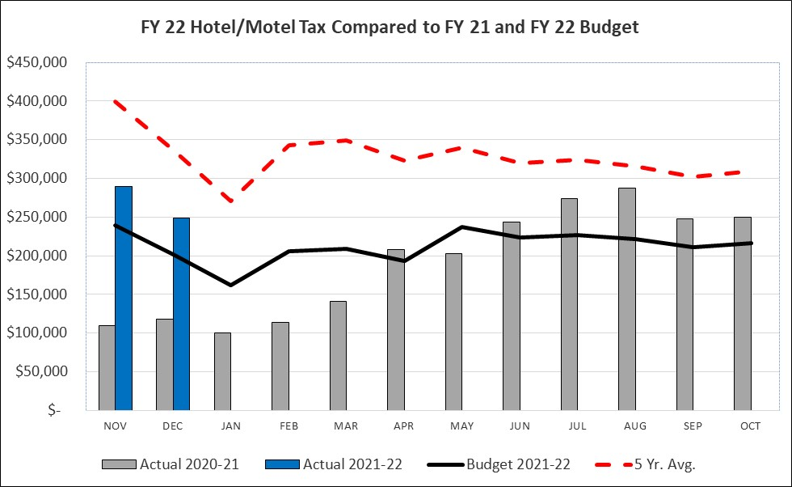
Hotel/Motel Tax Revenues
Hotel occupancy taxes of $538K are $311K above last year and $97K above the budgeted target through the end of the first quarter
  Budget was based on a recovery to 60% of 5-year average through April and to 70% for the rest of the year
  1st Quarter is at 73% of 5-year average

Slide 33
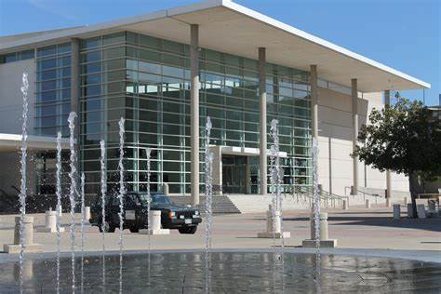
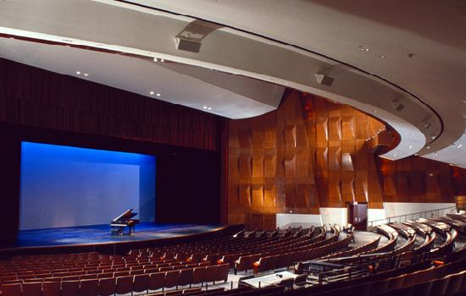
Eisemann Center Revenues
  Eisemann Center and Eisemann Center Presents Revenues of $411K represent 39.15% of the original budget
    The budget is based on conservative booking assumptions
    Eisemann Center revenues of $337K includes bookings for both the Richardson and Plano Symphony Orchestras, numerous Nutcracker performances as well as performances by the Pegasus Theatre and the Vocal Majority
    Eisemann Center Presents revenue of $74K is largely related to the Keyboard Conversations performance
  With the exception of interest earnings, the remaining revenues are performing as expected

Slide 34
Eisemann Center Activity

Slide 35

Hotel/Motel Tax Expenditures
Total expenditures of $1.0M, or 30.76% of the original budget compared to $867K, or 28.40% of FY2020-2021 YTD actuals
  The Eisemann Center continues to work with arts organizations and other rental groups on options for hosting events in compliance with state and local health and safe protocols
  Total expenses include $124K for expenses that qualified for reimbursement from the Shuttered Venue Grant and will be offset by grant revenue by the end of the fiscal year
  All other expenditures are performing as expected

Slide 36


